Slide 1


CWU Conference
May 2026

Slide 2
What is the Royal Mail Collective Pension Plan (the Collective Plan)?

Slide 3



Royal Mail Pension Schemes
Royal Mail Collective Pension Plan (the Collective Plan)
The Collective Plan launched on 7 October 2024. The Collective Plan is for those who have over 12 months continuous service with Royal Mail Group Limited (including Parcelforce).
Royal Mail Pension Plan (RMPP)
The RMPP closed with effect from 7 October 2024, when the Collective Plan launched.
Royal Mail Defined Contribution Plan (RMDCP)
The RMDCP closed for the vast majority of members on 7 October 2024, when the Collective Plan launched.
Royal Mail Statutory Pension Scheme (RMSPS)
The RMSPS closed in 2012, when Royal Mail was privatised.
National Employment Savings Trust (NEST)
NEST is used for some Royal Mail employees, including those with less than 12 months continuous service with Royal Mail Group Limited (including Parcelforce)

Slide 4
How does it work?
The key benefits of the Collective Plan are:
  An automatic income for life, in addition to a one-off cash lump sum, making it easier for people to manage their money in retirement
  When you pay 6% of your pensionable pay into the Collective pot each payday, Royal Mail tops that up with a contribution of 13.3% (+ Royal Mail pays 0.3% of your pensionable pay towards ill health premiums - anything left over from this is paid into the Collective Plan)
  One plan for everyone – every employee with at least a year’s service is eligible to join
Everyone’s contributions to the Collective Plan are pooled and invested collectively to provide the benefits.
4

Slide 5
Overview of RMCPP - contributions
 | CDC Pension Section | DBLS Section
 |  | Lump sum* | DC AVCs
Core Employer Contributions | Fixed 11.2% of pay (of which 0.3% is paid into expense reserves) | Fixed 2.4% of pay PLUS possible deficit reduction contributions | -
Core member contributions | Fixed 4% of pay | Fixed 2% of pay | -
Core total | 15.2% of pay | 4.4% of pay
Lump sum Booster | No option | 1% of pay payable by member, matched by Employer for lump sum booster | Optional
Additional voluntary contributions | No option | £ chosen by member (minimums applicable) | Optional
* includes an amount towards ill-health premiums provided outside the DBLS, and also pays for death lump sums and expenses

Slide 6
Who manages the Collective Plan?

Slide 7
The Collective Plan Trustee Board
RMCPP Trustees Limited (Corporate Trustee Entity)
Commonly used term in communications – The Trustee of the Collective Plan
9 Trustee Directors
Chair – chosen by the Company (in consultation with the Unions)
4 Member Nominated Directors
4 Employer Nominated Directors
Currently the Chair is from an independent trustee company and so are 2 of the employer nominated directors
The Trustee role is not full time - day to day oversight and running of the Collective Plan is supported by an Executive team.

Slide 8
Committee Structure
Trustee Board
Funding & Investment
Governance Audit & Risk
Member Engagement
Covenant

Slide 9
The Collective Plan Trustee Executive
Providing Executive and Finance Function to the Trustee
Full time seconded to the Trustee to run the Collective Plan
Independent from Royal Mail

Slide 10
The Trustee Executive Team Role
Supporting ongoing authorisation
Creation and maintenance of all governing documentation
Risk oversight and management
Member communications
Ballot processes
Delegated powers – IDRP cases, payments etc.
Monitoring pensions developments
Tender exercises
Contractual negotiations
Trustee training
Researching and writing papers for the Trustee
Oversight of adviser work
Annual report and accounts preparation
Managing annual trustee budget
Overseeing the Custodian and Fiduciary Manager
Monitoring contributions

Slide 11
Why is the Collective Plan different?

Slide 12
What are the Compliance Requirements?
Because of the design of the Collective Plan we are often caught by DB, DC and CDC legal and regulatory requirements.
This includes The Pensions Regulator Codes of Practice – both the General and CDC codes.
The CDC code was the code considered by The Pensions Regulator (TPR) when assessing the authorisation application and the Trustee must continue to meet the requirements of this code in order to maintain the Collective Plan’s authorised status.
Notes:
We have two codes:
General code of practice which covers all occupational Pensions Scheme &
Code of practice: Authorisation and supervision of collective defined contribution schemes
Both are to carry out point 3 & 4

Slide 13
CDC Authorisation Requirements
Before a CDC scheme can operate, TPR must be satisfied that it meets all six authorisation criteria. These criteria ensure the scheme is well-governed, financially sustainable, and effectively managed to protect members.
Fitness and Propriety
Systems & Processes
Member Communications
Continuity Strategy
Financial Sustainability
Sound Scheme Design
Meeting all six criteria is mandatory for authorisation.
Each criterion protects members, ensures financial security, and supports good governance.
Trustees should ensure:
They and key individuals are fit and proper
Systems, communications, and contingency plans are robust
Financial resources and scheme design are sustainable and well-documented
Notes:
The Six Authorisation Criteria
A. Fitness and Propriety
Assess the individuals who establish and manage the scheme, including:
Trustees
Those who can appoint/remove trustees
Those who can amend trust deeds or scheme rules
Individuals must demonstrate:
Honesty, integrity, and knowledge appropriate to their role
Competence and proper conduct
B. Systems and Processes
The scheme must have:
Sufficient IT systems for efficient operation
Robust governance processes to manage compliance and risk
C. Member Communications
Trustees must ensure:
Members understand the risks and benefits of the scheme
Clear explanation of how benefits or rates may change over time
D. Continuity Strategy
Contingency planning is critical:
Must have a credible strategy to protect members if a triggering event occurs
Ensures the scheme can continue operating effectively in adverse situations
E. Financial Sustainability
The scheme must demonstrate:
Adequate financial resources at set-up and during ongoing operation
Ability to continue after a triggering event without increasing costs to members
F. Sound Scheme Design
The scheme must have a robust design, demonstrated through:
A viability report
Evidence including:
Advice from qualified professionals
Modelling and testing appropriate to scheme complexity

Slide 14
Supervision of CDC schemes
Once a CDC scheme is authorised, it must continue to demonstrate that it meets all authorisation criteria. TPR’s ongoing assessment of schemes is called supervision.
Supervision is ongoing: Authorisation is not a one-time approval.
Annual reporting and event notifications are mandatory.
Failing to meet criteria can result in regulatory action, including loss of authorisation.
Maintain transparency and proactive management to avoid compliance risks.
Significant events reporting is mandatory and essential for maintaining authorisation.
Develop robust monitoring systems to identify and track potential events.
Encourage a culture of prompt reporting across all parties involved in scheme operations.
Reporting allows TPR to assess ongoing compliance with authorisation criteria and take timely action if required.
Clear documentation and explanation of events support regulatory confidence and scheme resilience.
Notes:
Purpose of Supervision:
Ensures the scheme continues to meet authorisation criteria.
It is risk-based and proactive, allowing TPR to monitor the scheme’s health and compliance.
Supervisory Returns:
Trustees must submit an annual supervisory return with updates against the criteria.
This allows TPR to track performance, risks, and compliance.
Reporting Significant Events:
Trustees must report any significant events immediately.
Significant events are those that could affect the scheme’s ability to meet authorisation criteria.
Regulatory Action:
If TPR determines a scheme no longer meets the criteria, it may:
Take regulatory action
De-authorise the scheme

Slide 15
Collective Plan Valuations & Benefit Adjustments

Slide 16
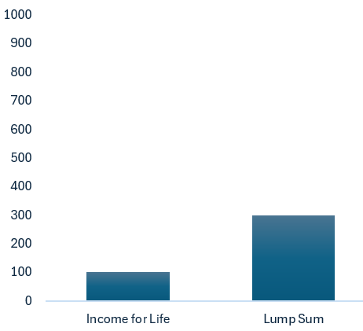
How the adjustments work – year 1
Year 1 – 31 March 2025
Key
Benefits built up to 31 March 2025

Slide 17
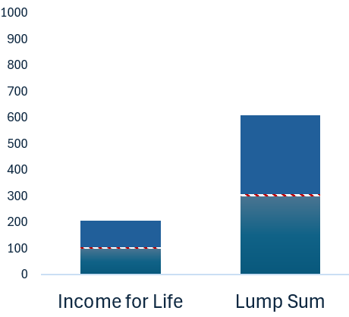
How the adjustments work – year 2
Year 2 – 31 March 2026
Key
Benefits built up to 31 March 2025
31 March 2026 adjustment
Benefits built up between 1 April
2025 to 31 March 2026

Slide 18
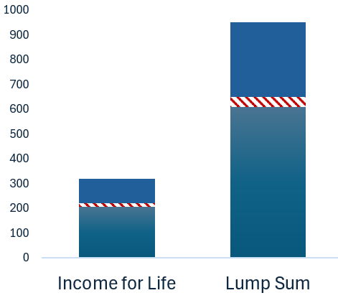
How the adjustments work – year 3
Year 3 – 31 March 2027
Key
Benefits built up to 31 March 2026
31 March 2027 adjustment
Benefits built up between 1 April
2026 to 31 March 2027

Slide 19
First Valuations Outcomes – Headline Results
Section | Benefit adjustment date | Valuation outcome | September 2025 CPI | Total increase
Income for Life | 31 March 2026 | CPI + 2.6% | 3.8% | 6.4%
Lump Sum | 31 March 2026 | CPI + 3.8% | 3.8% | 7.6%

Slide 20
Collective Plan Communications

Slide 21

The Collective Plan is Online
Electronic Communications
Many of the costs of running the Collective Plan are paid for, collectively, by the members. To reduce costs, the Trustee of the Collective Plan will communicate with you electronically by default. This means more money to put towards your income for life
Member Self-Serve Portal
To make sure you get information about your income for life and
lump sum in the Collective Plan, you need to provide us with your email by registering for the Member Self Service Portal. Once registered, you’ll be able to:
Check your personal details and contact information are correct.
Tell us who you’d like your money to go to in the event of your death.
Choose how you’d like us to keep in touch with you.
View what you’ve got so far and what you might get at age 67.

Slide 22
Collective Plan Engagement Plans
🎯Communications strategy review
🎯Pensions roadshows
🎯Feedback surveys
🎯Focus groups & interviews

