Slide 1

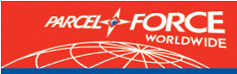



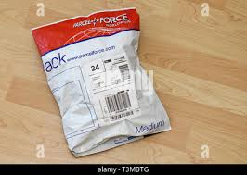


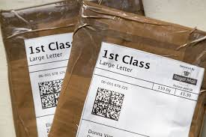
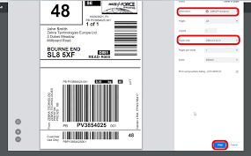
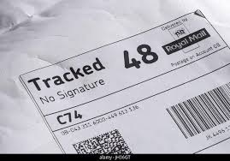
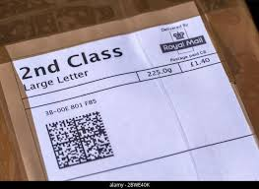
Collector’s – ‘What if?’
UNABLE TO LOAD A PARCEL?
1. Can the Customer provide support lifting the item?
2. Inform your manager – If you are unable to collect the item first time, your manager may be able to arrange a later collection or request support from Parcel Force.
3. If the item has insufficient packaging, or the size/weight exceeds the handling limits described in this document, the collection should be refused.
The handling limits for PFW Large items are:
Length should not exceed 2.5m
Combined length and girth should not exceed 4.0m
Weight 30kg
BULKED OUT?
Inform your manager
Prioritise based on the list below unless advised otherwise by your manager
1 - RM Special Delivery
2 - PFW 24 & RM 1st class (Tracked 24)
3 –RM 1st class (Standard) Letters/LaRGE LETTERS/PARCELS
4 - PFW 48 & RM 2nd Class (TrACKED 48)
5 - RM 2nd class (Standard Letters/LaRGE LETTERS/PARCELS )

Slide 2
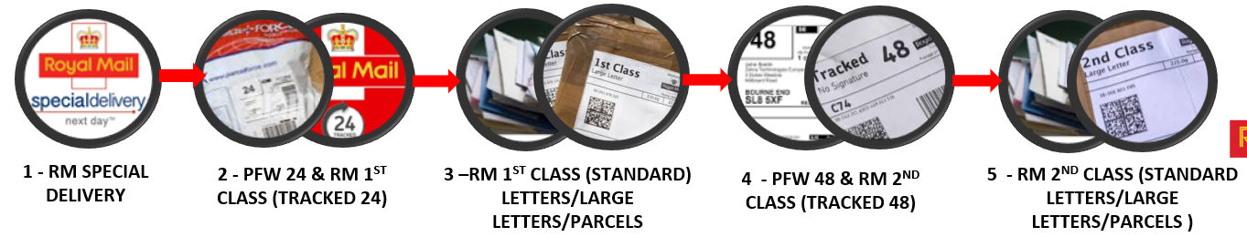
Manager’s ‘What if?’
DRIVER UNABLE TO LOAD A PARCEL
Solutions:
Investigate to see if an extra collection can be made to collect the item. This is likely to require a sack trolley or two people to attend
If this cannot happen, as a last resort, the manager will contact local Parcel Force Depot to arrange a collection.
If the item is a PFW or Tracked 24, it should follow the regular bulk out process and be recovered as soon as possible
If the item is PFW 48 this can be collected the following day and “upgraded” to a 24 by the local PFW Depot. This should be noted to the PFW collection driver at the point of handover
If the item is excessively heavy, Parcel Force can be contacted for further support as a last resort
Note: Regular reviews will take place for duties bulking out and additional collections or direct services from collections hubs will be considered and introduced where required.
Sack Trolley Order Form
BULKED OUT
Solution: Normal bulk out process should be followed, and the items should be prioritised as per the list below:

Slide 3
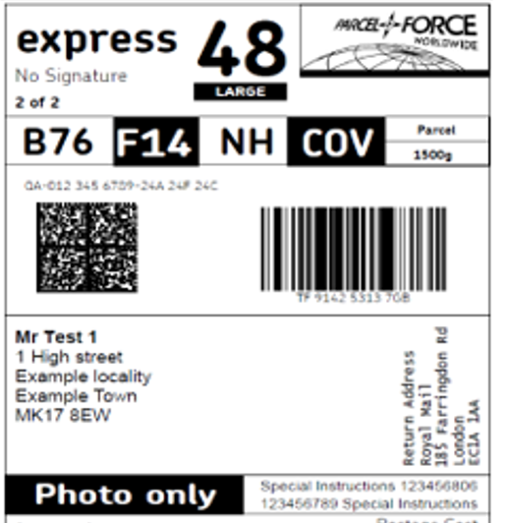
Collector’s – ‘What if?’
Maximum Weight Limit for collecting PFW parcels
For sending within the UK a parcel can’t exceed 30kg.
Weight limits vary for international destinations.
Items should have the weight displayed on the label
Maximum Dimensions for PFW parcels
For standard parcels the size must not exceed 3 metres in length and girth combined and must not exceed 1.5 metres in length.
Larger parcels up to a maximum of 4 metres in length and girth combined and 2.5 metres in length can be sent via express48^{large}
Length & Girth added together
must not exceed 3 Metre
Overall Length must not
exceed 3 Metre

