Slide 1
Raising Concerns
July 2025

Slide 2
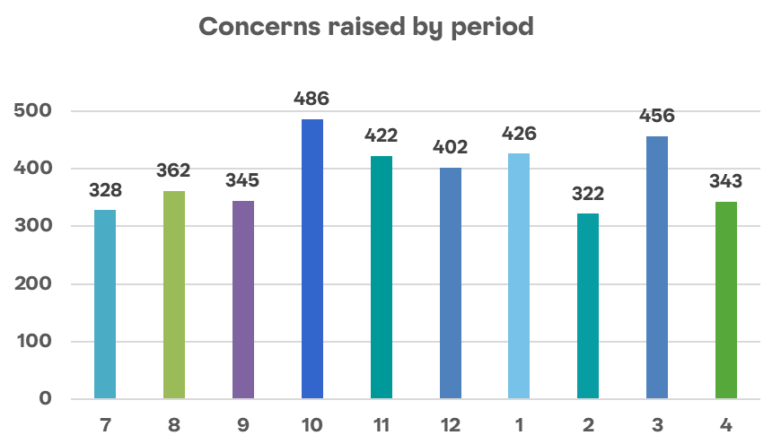
Raising Concerns – Overview of cases
Reason for concern | Number | %
Poor behaviour or treatment | 1008 | 26%
Category not yet confirmed | 422 | 11%
Pay or benefits | 405 | 10%
Working hours or allocation of work | 331 | 9%
Bullying | 218 | 6%
Work conditions | 191 | 5%
Harassment | 182 | 5%
Discrimination | 151 | 4%
Time off work | 137 | 4%
Failure to follow policy or procedure | 122 | 3%
Sexual harassment | 78 | 2%
Transformational change | 29 | 1%
Inappropriate use of data | 26 | 1%
Trade Union activities | 8 | 0%
No category recorded (closed cases) | 584 | 15%
Grand Total | 3892 | 100%
Overview of cases raised:
3892 concerns raised since launch*
  22% cases currently open (853)
  78% cases concluded (3039)
*Data from 22nd July 2025

Slide 3
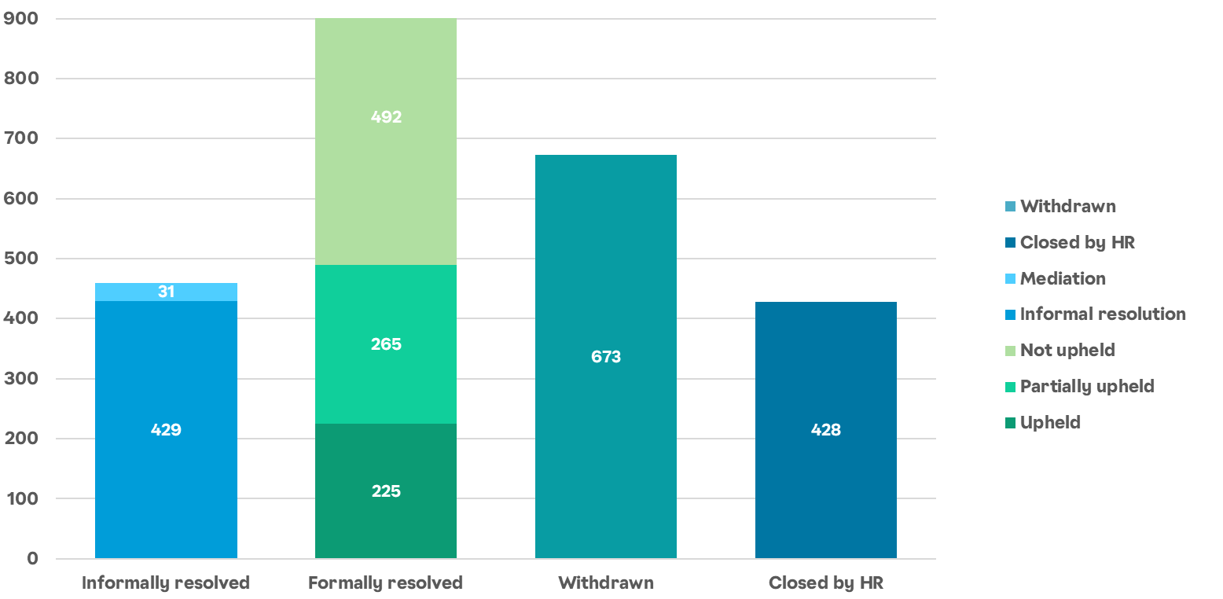
Raising Concerns – Case outcomes
To note: 496 outcomes have not been captured in the MI
*Data from 22nd July 2025

Slide 4
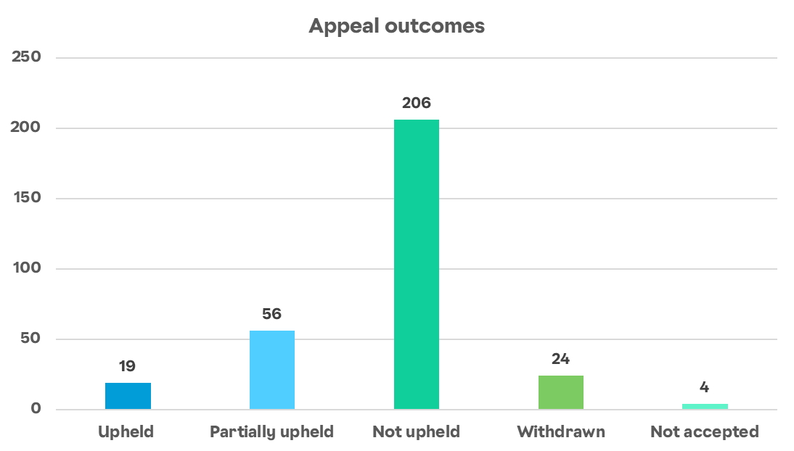
Raising Concerns – Appeals
309 appeals raised since new approach launched
*Data from 22nd July 2025

Slide 5
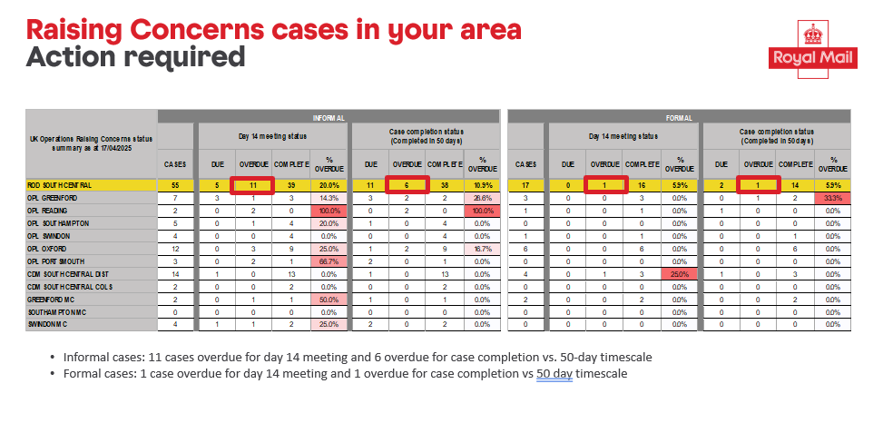
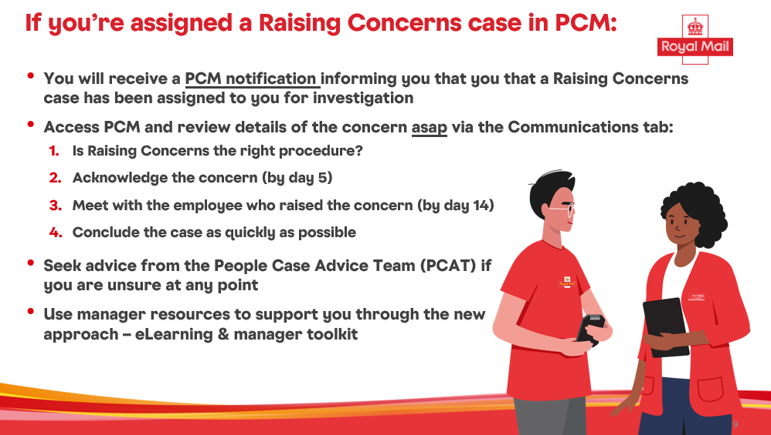
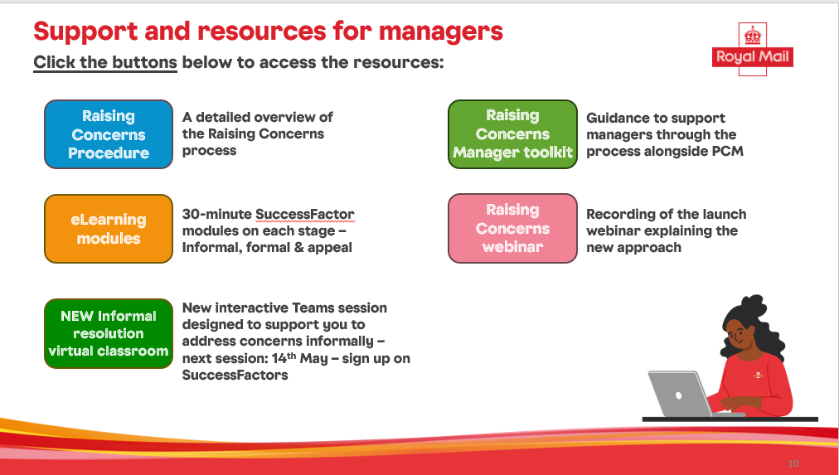
Activity since our last update
Operations data being shared as part of weekly KPI reporting
HRBP briefing packs cascaded:
- a reminder for managers on the new approach including local case progress data and embedded resources
Focus group – to understand manager feedback from those who have used the new approach
Manager survey – to understand experience of those who have concluded a Raising Concerns case

Slide 6
Case progress – What is this telling us?
1640 cases have been concluded at the informal stage
Number of concerns at the formal stage
1640 cases have been concluded at the formal stage
Number of concerns at the informal stage
Initial meeting has taken place for 1661 informal cases
Initial meeting has taken place for 1643 formal cases

Slide 7
Case progress

