Slide 1
Mail Centre Large Parcel Conveyors
MC LPC +9

Slide 2
MC LPC +9 Project Background
The main aim of the project is to deploy LPCs to 9 Mail Centres.
Currently all large parcels at the 9 nominated sites are sorted manually.
The conveyor will sort products with barcodes containing addresses to enable auto-diverting (there will be no OCR capability), but the business case assumes HLC (High Level Control) system will be deployed on to each machine (retrospectively).
  The HLC is being developed in-house with RM Engineering under a separate BC
These machines will provide a DWS scan for each item and contribute to commercial Revenue Protection (RP) targets.
There are two LPC designs being used that fit directly into the nine MCs with minimal disruption or other equipment moves.

Slide 3
Machines and Installation
Throughput 2,950 iph, 4 sort lanes and an overflow
Will handle min 100x100x10 to Max 1000x650x650 and 30kg
Two Different shapes of the same system to fit in different spaces/mail flows
9 MCs, aim is deliver 6 pre-peak
Pre-peak Install-go live Sept-Nov 24. Post Peak Jan-Feb 25.
Expected Delivery – go live 4-5 weeks.
  Jubilee
  Tyneside
  Medway
  Birmingham
  Leeds
  Greenford
  HCN
  Chelmsford
  Bristol
PHS/PRA/Sick will install (used for MSH). RM engineers will maintain

Slide 4
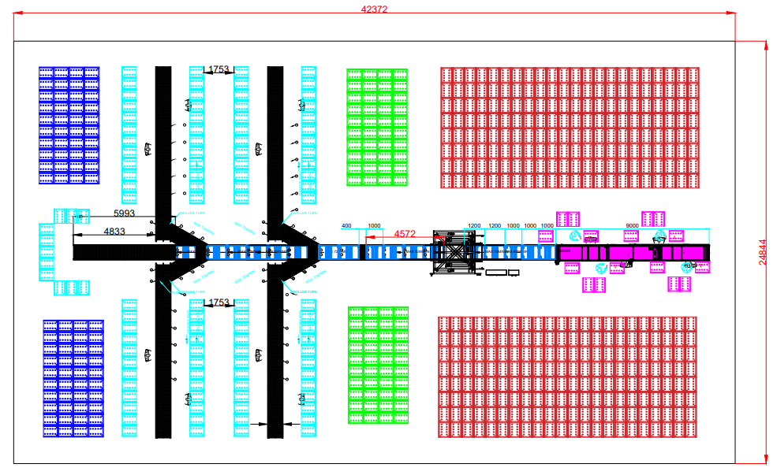
Palm Tree design

Slide 5
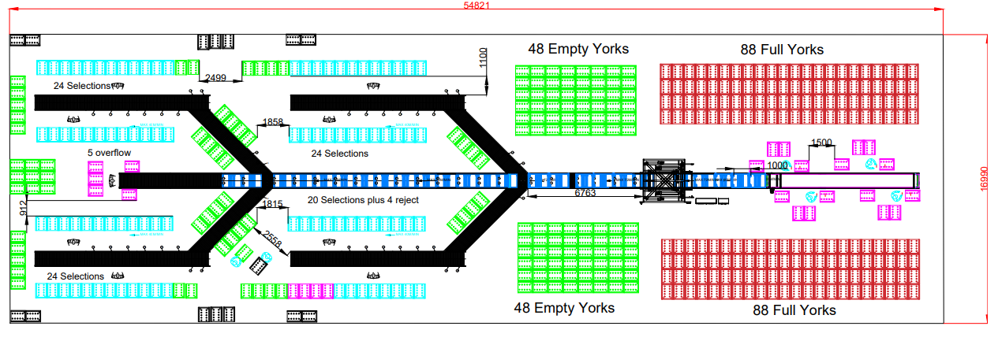
Sword shape design

Slide 6
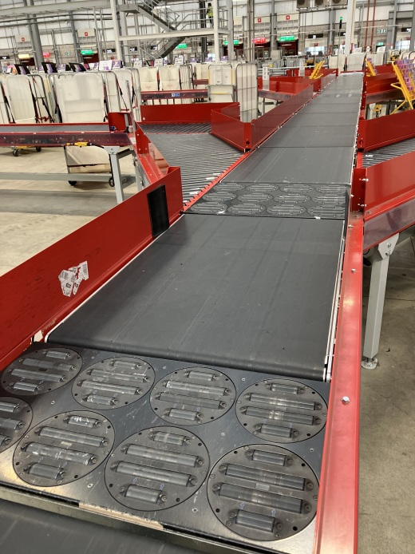

Slide 7
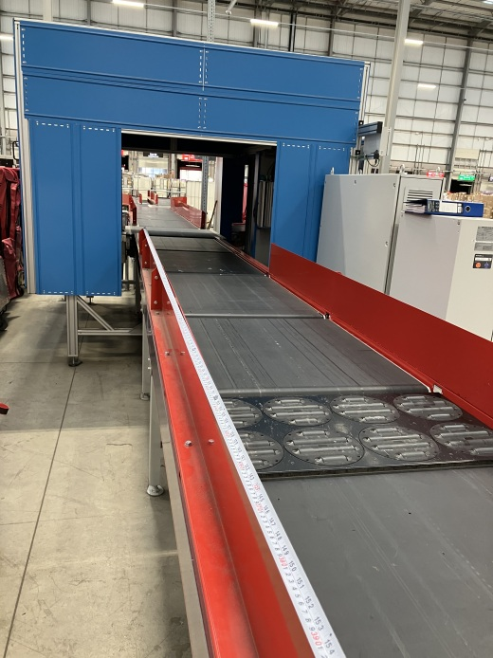

Slide 8

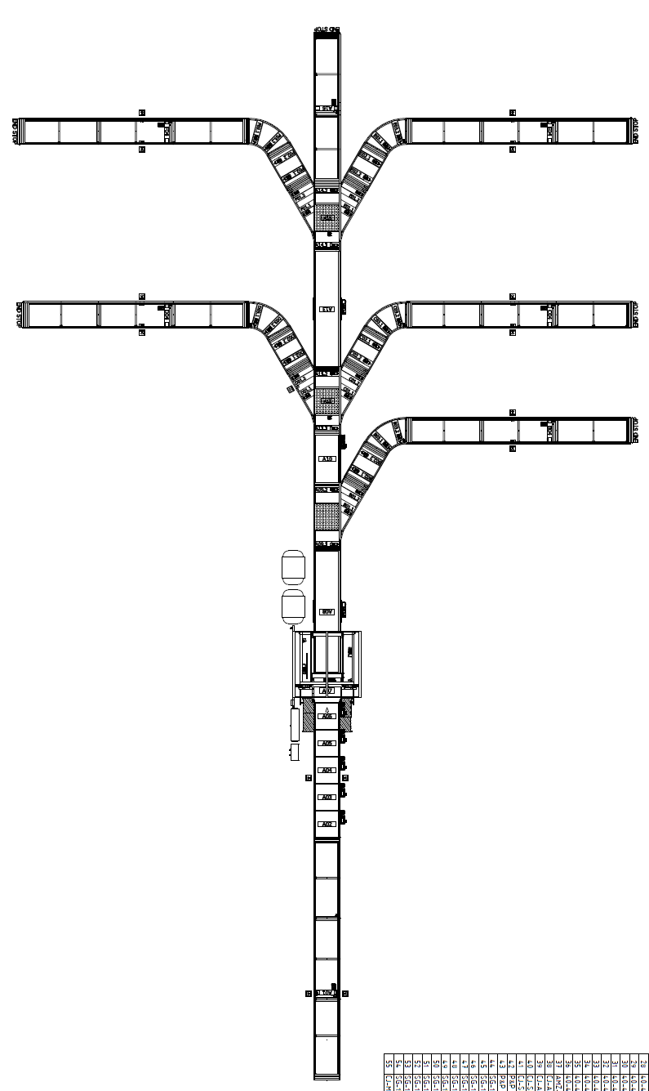
Large Parcel Conveyor – staffing
In-Operation Internal Flows
  Arrival York’s to the front Conveyor Induct lane
  Empty York’s from Induct to go to sort legs
  Any additional empty York’s from York storage area to sort legs
  Full York’s of sorted parcels to despatch store adjacent footprint
  Large Parcel Conveyor Porters work in LPC footprint only
  Separate despatch porters collect full York’s and take to despatch
  Inductors & Sorters supported by dedicated LPC porters
Conveyor Process
  Planned induct is 2950 parcels per hour
  5 way camera, so do not face barcode down on the belt
  96 York selections = 4 lanes @ 2x12 selections per side
  1-4 inductor's @ 12.3 parcels per minute each
  5-10 sort operator’s dependant on traffic and induct operator number
  Lane 1 = Rejects operator, employed on lane 2 if no separate reject lane - rejects/ejects placed on York’s, moved to sort lanes
  Lanes 2 to 5 = 4-8 sorters to 12/24 York’s
  Overflow should be identified and segregated into York’s labelled lane 2 to 5 and moved to equivalent sort lane to scan and sort to correct location – 1 operator
  Conveyor sorters finger scans parcels before placing in location (York) as sorted, (same as manual area).
  At design capacity 2950 iph, 4 full time porters req, 2 each side
  At design capacity 2950 iph 4 inductors & 10 sort operators
  At Max staffing 14 machine staff and 4 porters = 18 in total.
overflow
5
4
3
2
1
REJECTS
Induct
Induct

Slide 9
Weekly Hours saving per plant
From variable/attrition :

Slide 10
Diversions
Bristol – divert to SWDC with staff if deployment date before Xmas if after no diversions required.
Medway – divert to Jubilee &/or Gatwick if not completed by the beginning of Nov 24.
All other plants okay – no diversions required.

