Slide 1
MyPotential PM/PL Workshop
Cablers & Jointers National Rollout
May 2024

Slide 2
Agenda
Introductions & Overview
10:00 – 10:10
10:10 – 11:00
MyPotential Update
11:00 - 11:30
Role of Leaders
11:30 – 11:45
Break
11:45 – 12:45
Training Content: Business Simulation Exercise
Lunch
12:45 – 13:45
13:45 – 14:45
Training Content: Team Rhythm and Effectiveness
Break
14:45 – 15:00
15:00 – 16:00
Overview of Metrics & Scheduler
16:00 – 16:30
Q&A and Next Steps
Notes:
Slide Owner: SEAM

Slide 3
Purpose of the workshop
There are six key objectives of today’s workshop:
Ensure you are clear and comfortable with the culture and strategic direction of travel for FND in this space.
Have the opportunity to discuss and ask questions in a safe environment.
Ensure you understand your role and responsibilities. Recap on the learning from ‘It’s Our Patch’.
Ensure you recognise and comprehend our approach.
Help you feel prepared for leading your team through the roll out.
Provide initial feedback on the proposed approach to support a successful launch.
Notes:
Slide Owner: SEAM

Slide 4
MyPotential Update
Update Speakers: SEAM Regional dev managers?
Notes:
Slide Owner: SEAM

Slide 5
Why does there need to be change across FND?
Our Reach26 strategy:
Deliver the best service on existing products to retain customers
To generate reinvestment into our network, building our full fibre future
Increasing FTTP customers on our network, winning against our competition
We must manage headwinds if we are to deliver on this strategy
Financial Challenges
Cost of living, price rises on raw materials
Customer Expectations
They want affordable broadband and Ethernet, with high speeds and will move to competitors if they can’t get it from us
Competition
Alt Nets are innovating and providing our customers with more choice in the market – we need to stay ahead to maintain our position
Managing these headwinds will require a team effort – we want everyone to feel confident, supported, equipped and motivated to do their best, so that we can fully achieve our Reach26 goals.
Notes:
Slide Owner: SEAM

Slide 6
MyPotential vision
VISION
MyPotential vision is to introduce metrics that will provide you with insight to understand your individual and team contribution, as we build the connections that matter for our business and for our customers.
This is supported by meaningful one-to-one coaching conversations and team huddles to ensure our individuals and teams feel confident, supported, equipped and motivated to do their best.
GOALS
Creating a high trust environment.
Co-designing and building individuals and team level metrics and dashboards.
Ensuring you have the right tools and information you need.
Putting the people experience at the heart of the change.
This is driven by Reach26 objectives, the need for simple and consistent metrics across regions, insight-led coaching conversations to allow managers to recognise strengths and identify opportunities for improvement at an individual, team and regional level.
Notes:
Slide Owner: SEAM
MyPotential is the latest programme looking to provide better tools and insights for our people.
MyPotential will help inform greater coaching conversations and will work hand in hand with our other Transformation initiatives.
Set the scene: Our Journey so far – over 12 months
Why this is important/what it means to our business
We have done numerous test and learns (what have we learned so far)
What do we need from you – if we get this right, it could be amazing, if we get wrong negative impact to engagement/service/cost
Voice of our people – speak with John Mills

Slide 7
MyPotential foundations
These are critical foundations that you need to ensure are in place before we launch metrics in any teams.
The expected frequency of key interactions is embedded.
Patch Managers, Patch Leads and Senior Engineers are doing the job as designed.
Space is created to enable managers to spend 2-3 days a week in the field.
All Managers and Patch Leads have the basic coaching skills. This should have been supported by having completed MyPatch or The Coaching Pathway.
Notes:
Slide Owner: SEAM
Every team member should receive at least 1 coaching session per month
Every team member should have 1 annual check in per year
All coaches (managers and patch leads) should receive coach the coach training at least twice a year
Generally huddles should take place most weeks

Slide 8
MyPotential NRO: The journey so far
As part of National Rollout for Cablers and Jointers we have run two Test and Learns and several key sessions.
February 2024
Director Briefing Session
To update directors on the programme, national roll-out (NRO), training approach and workshop content.
April 2024
National SEAM session
To brief and upskill SEAMs on the programme, training approach, practice content for workshop and understand roles and expectations.
February 2024
Second 6-week T&L
To gain feedback on the headline and supporting metrics at an individual level across 12 patches. Tested MySkills and Qlik dashboard functionality.
Today
PM-PL Session
To brief and upskill PM and Leads on the programme and national roll-out
October 2023
First 4-week T&L
To gain feedback on the Daily Customer Connections (headline metric at a team and individual level across 12 patches.
March 2024
Leadership Session
To introduce SEAMS to the programme, how to win hearts and minds and their role.
Notes:
Slide Owner: SEAM
We introduced Test & Learn in October 2023 using 12 regional teams across the North/South & Central
Initially it was a 4week testing window for single metric
This was followed by 2nd Test & Learn in February 2024 this time 6week testing window looking at additional supporting metric
The Test & Learn group overall have seen a positive increase in teams' performance over the Test & Learn period.
Coaching conversations. Managers were found to be supportive and concerns around negative behaviours did not materialise in coaching conversations or team huddles.
Increased focus on wellbeing. Coaching conversations alongside metrics provided the opportunity to have conversations around wellbeing and provide a fuller picture of an individual’s contribution.
Visibility of leadership. It was reported that there were additional visits and coaching from patch managers and patch leads, which provided more opportunities for in-person coaching conversations and trust building.
Managers are telling us the metrics is supporting their conversations and helping identify development areas within their teams.
We have seen a reduction in engineer concerns however survey feedback is telling us there is still work to do in landing the message.

Slide 9
You said, we did
Summary of feedback and actions taken from the recent test and learn.
Sentiment and Understanding of Metrics Sentiment towards the metrics has been mixed, however recent feedback suggests teams are becoming more comfortable with discussing the metrics with their managers. Questions remain on how the metrics work and how they should be interpreted.
Work Distribution and Allocation Discussions with the team members have surfaced some issues around work distribution and allocation. These issues are now being discussed with patch managers for escalation.
Confidence in Explaining Metrics Managers through discussion on the calls shared that there were aspects of the additional metrics that they were not completely comfortable clear on.
Improved Coaching Sessions We have seen examples where coaching conversations have resulted in skills support and training requests.
Qlik Dashboard Usability We have received feedback that the dashboard could be improved by adding a task count to the time to complete measure. We have also received further suggestions to make it easier to review an individual’s metrics over time.
Dedicated Metrics Sessions Metric sessions are being arranged post manager briefings to support the detail beneath the numbers. These are designed to give clarity around how the metrics support the daily customer connections result.
Work Allocation Patch Managers are working closely with the controls to improve allocation outcomes. Highlighting this issue has ensured better allocation decisions.
Playbook for Managers A Playbook including supporting resources/guidance has been created to ensure our managers are fully prepared to land MyPotential with their teams.
Data Expert Support Feedback sessions have been attended by regional data experts to answer questions related to the metrics enabling managers and engineers to identify coaching opportunities.
Dashboard Updates We are maintaining a backlog of features to be added to the Qlik dashboard, to improve the information available and the ease of access.
You Said
We Did
Notes:
Slide Owner: SEAM

Slide 10
MyPotential programme principles
We are following set culture principles to ensure a positive experience for everyone.
Be Open
Think Impact
Be Part Of It
Own It
Transparent and
Fair Approach
Empowering
you with Data
Consistent
Support
Proactive
Not Reactive
You will have access to your team’s information which will aid you into deciding who deserves recognition and who may need support.
You will be able to suggest relevant training and support based on regular conversations with the individual as well as data and insights - where your team needs extra support, and how they would like to develop.
You will be provided with support and training to ensure you deliver a positive coaching experience. Before receiving dashboard access, all PMs and PLs will go through ‘It’s Our Patch’ training.
Good coaching is done regularly and consistently to ensure we recognise good outcomes, as well as spotting where additional help may be required – most importantly, there are never any surprises.
Notes:
Slide Owner: SEAM

Slide 11
How will coaching conversations feel different?
We need to move our conversations from being data driven to a more informal and exploratory approach, owned by our engineers.
Example of a poor conversation
"I've brought these documents in to help improve your performance. Today, you're
only averaging two completions a week and I need you to be at three. I can see you leave
the house five minutes late every morning. Also, you spend too long in the Exchange."
Historic conversations
Our expected conversations today
“There were only four hours of WAUs on this job but you took six - you need to speed up."
“How are you? How have you been getting on? Is there anything I can do to help? Do you have everything you need?”
“You’re averaging three furthers a week while others are averaging two. Your task time completion is also 20% longer.”
“I can see that your furthers are slightly up. Is there anything I can do to support you with this?”
“Last week, you left the yard/home late every day, why was this?”
“I just wanted to say that you’ve been doing
really well over the last few weeks.”
Notes:
Slide Owner: SEAM

Slide 12
MyPotential Engagement cascade
What support will you receive during each session?
We will be running the following key sessions for national roll-out:
Content to support workshops and briefings.
Guidance from facilitators on how to run workshops and briefings.
Support from your HRBP or Development Manager to assist with delivery of sessions and preparation as required.
Programme team representative or data expert assigned to your region to support with any questions.
Dedicated metrics session will be set up to ensure patch managers, patch leads and engineers get a detailed introduction to the metrics.
Director Briefing
Held on 28 February
National SEAM session
w/c 15 April
Patch Manager and Leads Workshop
w/c 20 May
Engineer Briefing
w/c 03 June
Leadership Session
Held on 22 March
Meeting to brief and upskill Directors on the programme, national roll-out (NRO), training approach and workshop content.
Delivered by: Programme Team
Meeting to introduce our Leaders to the programme, get our leaders thinking about how to win hearts and minds and their role within NRO, as well as the vision of MyPotential.
Delivered by: Programme Team
Workshop to brief and upskill SEAMs on the programme, national roll-out (NRO), training approach and workshop content.
Delivered by: Programme Team & Sponsors
What will you need to do?
Workshops to brief and upskill Patch Managers and Leads on the programme and national roll-out.
To be delivered by: SEAMs
Book time in with your team to brief them on MyPotential and what it means for them. Agree with your SEAM what support is required e.g. from Dev Managers/ROMS.
Once briefings have taken place, ensure team members sign up and attend at least one of the dedicated metrics sessions.
Complete the MyPotential checklist on MySkills for yourself and your engineers post-roll-out.
Team huddles to explain the purpose of MyPotential, how coaching conversations and metrics will work together and how it will feel in their day-to-day.
To be delivered by: Patch Managers and SEAMs
Notes:
Slide Owner: Dev Manager / ROM?
Note that the PM/PL and Engineer briefings will go in post CWU conference from 25/04
The aim is for everything on the checklist to be green. If it’s not we would ask for you to work with the individual until they self-certify.

Slide 13
Role of Leaders
Update Speakers: SEAM?
Notes:
Slide Owner: SEAM

Slide 14
What we need from you as leaders
Through the Test and Learns we identified several challenges; however, your role as leaders is vital in helping us overcome these through your leadership.
1. WINNING HEARTS AND MINDS
1. Winning hearts and minds:
We know team members have real concerns around the use of metrics in FND and it will take a lot of time and effort to allieviate these concerns. We need you to lead from the front, support your managers and role model the right behaviours.
1. WINNING HEARTS AND MINDS
2. UNDERSTANDING THE METRICS
2. Understanding the metrics:
We know the metrics, if understood effectively, can provide managers and team members with useful insight which could lead to improvements, but all managers need to be comfortable and confident in using the metrics you need before they are shared. Be inquisitive and proactive, check in with your team on an ongoing basis. This isn’t about a target, it’s about continuous improvement.
3. CREATING THE CONDITIONS FOR SUCCESS
3. Creating the conditions for success:
We know that to be successful you need to create the right conditions. This means ensuring the foundations are in place and embedded but also means you spend the time making sure your managers have the skills and support to make certain that the tone and culture is brought to life. If there’s something that’s getting in the way of success, then understand the root cause and address it.
Notes:
Slide Owner: Dev Manager / ROM

Slide 15
Role of you as leaders
We've identified key behaviours and actions for you to demonstrate as part of national rollout for MyPotential.
KNOW
DO
I understand the committed tone culture and approach and how I need to lead this with my team.
I understand the metric, how it works and can explain it to my team.
I know whether my business is performing efficiently.
I know where my area could be performing better and can make informed decisions on what action to take to resolve.
I understand the committed tone culture and approach and how I need to lead this with my team.
I understand the metric, how it works and can explain it to my team.
I know whether my business is performing efficiently.
I know where my area could be performing better and can make informed decisions on what action to take to resolve.
Set the right tone and culture with my team.
Ensure the basics are embedded in my team.
Encourage my team to share best practice, but also to raise issues/risks that that they need help to fix.
Support and regularly coach my patch managers.
Recognise and celebrate success.
Identify when my team or I need some support to improve & embrace feedback.
Notes:
Slide Owner: Dev Manager / ROM

Slide 16
Break

Slide 17
Training Content:
Business Simulation Exercise
Update Speaker
Notes:
Slide Owner: SEAM

Slide 18
Session overview
The purpose of this exercise is to discuss in a safe environment how you would use metrics to coach and support your team. Think about your learning from ‘It’s Our Patch’.
The information in this exercise is fictional and is only to be used for training purposes.
The information in this exercise could relate to any business or team.
Notes:
Slide Owner: SEAM
The next couple of hours are focused on making sure we have the right conditions for this programme to be successful, they are designed to get the managers thinking! These are the breakout sessions that SEAMS will need to facilitate with their patch managers, so we want these to be interactive.
Introduce the session purpose:
We want to get the leaders thinking about how they would use metrics. This is a fictional exercise designed to get them thinking about the use of metrics in their team, we don’t want to get too caught up on the metrics themselves which is why we haven’t used the actual ones
Get them thinking about what their role will be to land this successfully
Draw on their learning from It’s Our Patch and think about how they can bring this to life
Remind them this is a safe environment so be inquisitive

Slide 19
Activity 1: What does the data show?
How could you use the detail provided to better understand team and individual performance?
Team KPIs
Profit
Customer Service
Delivery of Service
Health and Safety
People Engagement
Notes:
Slide Owner: SEAM
- As part of Activity 1 – we are showing you data which you will be using across 5 KPI’s - Profit, Customer Service, Delivery of Service, Health and Safety, and Engagement.
- As a manager there are other team KPIS that you may look at such as profit and people engagement but it’s helpful to understand what is happening below the surface at an individual level.

Slide 20
Activity 1: Individual KPIs
How could you use the detail provided to interpret your team and individual performance?
Tristian
Customer Service
Delivery of Service
Health and Safety
Training
Repeat Work
Sam
Customer Service
Delivery of Service
Health and Safety
Training
Repeat Work
Mo
Customer Service
Delivery of Service
Health and Safety
Training
Repeat Work
Jamie
Customer Service
Delivery of Service
Health and Safety
Training
Repeat Work
Hilary
Customer Service
Delivery of Service
Health and Safety
Training
Repeat Work
Simon
Customer Service
Delivery of Service
Health and Safety
Training
Repeat Work
Notes:
Slide Owner: SEAM
- These have all been assigned a RAG status.
- These ones show that all the KPI’s are currently amber.
- You will not be provided any more detail than this and can make assumptions
- We will now split you into breakout groups with each group being assigned a team member to focus on who have their own individual RAG status against these KPIs

Slide 21
Activity 1
How could you use the detail provided to interpret your team and individual performance?
In your groups, you will have been assigned two individuals from the previous slide. Please discuss the following as a team before playback to the group (15 mins)
Taking a glass half empty perspective consider what could be the reasons behind the results?
Now taking a glass half full perspective consider what could be the reasons for the results?
In your groups, please discuss the potential pitfalls of using the data you have been provided in isolation (5 mins)
Notes:
Slide Owner: SEAM
Question 1
Split group into breakout groups to focus on question 1
Each group will be assigned the colleagues to focus on
Ask each group to nominate someone to playback in the discussion
Ask nominees to playback discussion and provide positive and negative view for each character
Question 2
In the same breakout groups, attendees should discuss question 2
Ask nominees to playback discussion and provide further pitfalls
Key points to land at the end of the session:
Data is only the starting point of the conversation
The focus should be on helping people reach their potential/ be their best
There may be things going on for colleagues and/ or the wider business which are important to consider
Coaching is for everyone (not just about underperformance) and can cover a broad range of spectrums (i.e. development, performance)

Slide 22
Activity 1: Summary
What are the key learnings from this activity?
Data is only the starting point of the conversation.
There may be things going on for colleagues and/or the wider business that are important to consider.
The focus should be on helping people reach their potential and be their best.
Coaching is for everyone and can cover a broad range of topics.
Notes:
Slide Owner: SEAM

Slide 23
Activity 2: Business Headlines
Customer X behind schedule need all hands-on deck ​
Concerns raised by the team on the new process introduced last month​
Costs on upwards trend – risk we will come in above budget​
New safety procedure introduced
Absence info...
Sam
Heart bypass op on Tues
Mo
Late again on Tues –Fourth time this month
Hilary
Focussing on delivering the complex jobs this week
Tristian
Didn’t meet the standard for a manager interview
Simon
Seemed unhappy at a meeting last week and had a customer formally complain about him… this is completely out of character for him
Jamie
Quality is still poor despite the refreshed training
Notes:
Slide Owner: SEAM

Slide 24
Activity 2
Based on the business headlines and individual context, how would you approach coaching this team?
In groups discuss…
If you were observing someone else coaching this team (10 mins)
What would you expect to see and hear?
What advice would you give?
Discuss the same points above but now focusing on the colleagues you were assigned during the previous exercise (5 mins)
Notes:
Slide Owner: SEAM
How would you coach this team, based off the headlines and based off the data provided in the previous slide
More about the conversations and not managing behind a spreadsheet – not about the right of wrong answer
In the same breakout groups, attendees should discuss question 1 and 2 as described on the slide

Slide 25
Activity 2: Summary
What are the key learnings from this activity?
It is important to ask questions to find out what is going well or not going well to inform clear actions to take forward.
There is always individual context behind numbers which can help build a fuller picture and bring to light areas for support and/or development.
Everyone will need a different response and action plan for support based on individual challenges and needs.
Importance of regular coaching conversations to uncover challenges that individuals may be experiencing. These may not be uncovered in team interactions or settings.
Notes:
Slide Owner: SEAM

Slide 26
Activity 3
Reflecting on your role as a leader, how can you support your team through this change?
In your groups...
Thinking about your role as a leader in Openreach (10 mins)
What do you think your team will be concerned about when we launch metrics in FND?
What role do you have to play in supporting them to alleviate these concerns?
What support do you a leader need to do this?
Notes:
Slide Owner: SEAM
In the same breakout groups, attendees should discuss the questions as described on the slide.
Allow 5

Slide 27
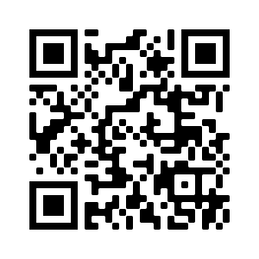
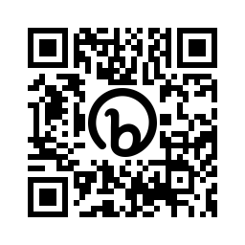
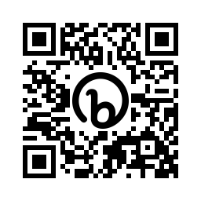
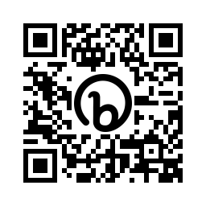
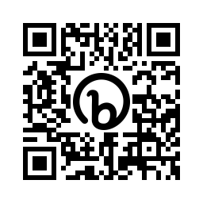
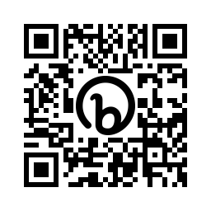
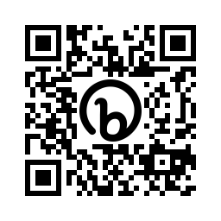
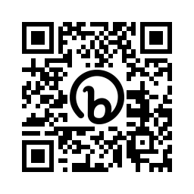
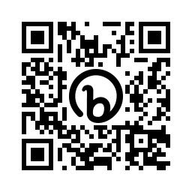
Understanding our support services managers and team members if they are…
Wanting to self investigate
Wanting to self help
Stressed or anxious
Needing a friendly ear or lived experience
In severe emotional distress
Your Wellbeing
Our online Wellbeing portal covering advice on a wealth of subjects from Life to Money, and Health to Relationships. Visit http://www.yourwellbeing.bt.com
Silver Cloud
Self-guided modules to help improve wellbeing. Space from stress, support for resilience, and sleep wellbeing tips. Visit
https://vhg.silvercloudhealth.com/signup/ and enter the code VitaBT
Mental Health Service
Cognitive behavioural therapy (CBT) – stress; depression; anxiety; PTSD; self-esteem; eating disorders; sleep
This service is obtained with manager referral.
https://bit.ly/OR_MHS
Peer to Peer Support Network
A telephone listening support service provided by trained volunteers who can help colleagues across a broad spectrum of experiences
Text p2psn to 81192 https://bit.ly/OR_P2P
Employee Assistance Management (for managers)
If you have any concerns that someone may be at immediate risk to themselves, call immediately - 0800 780 784. https://bit.ly/OR_EAM
Complaining of back pain/ pulled muscle etc
Going in for a planned operation
Needing legal or financial advice or counselling
Wanting to return to work but have MSD problems
Looking for toolkits
Physio
Online support and hands on physiotherapy treatment sessions. Employee contacts 0333 222 0712
https://bit.ly/OR_Physio
Pre-habilitation service
Pre operation – enhancing people’s knowledge, mental and physical resilience and helping them return to work. Employee contact 0333 222 0712 https://bit.ly/OR_Prehab
Employee Assistance Programme (EAP)
A confidential, free service for all employees. Counselling and emotional support. Advice lines and information – debt, legal and financial. Call 0800 917 6767
https://bit.ly/OR_EAP
Functional restoration programme
For people suffering from musculoskeletal disorders, affecting their ability to return or stay on full duties. Contact 0333 222 0712 https://bit.ly/OR_Restore
Line manager support
Support for common issues that your team may experience. Includes homelessness, money worries, domestic abuse and menopause
https://bit.ly/OR_LM_Support
Notes:
Slide Owner: Dev Manager / ROM

Slide 28
Your wellbeing
Support services and guidance to help colleagues when they need it
Three ways to access Your Wellbeing
Visit http://www.yourwellbeing.bt.com
Text wellbeing to 81192
Scan this QR code
Line manager support
Support for common issues that your team may experience. Includes homelessness, money worries, domestic abuse and menopause
https://bit.ly/OR_LM_Support
Triage tool
Family: supporting and caring for the most important people in your life.
Features:
Childcare and parenting
Legal matters
Older relatives
Death and loss
Family and work
Health: keep fit, stay healthy and get help with your physical and mental health.
Features:
Addictions
Healthy habits
Mental health
Physical health
Life: when life challenges you, we’re here to help.
Features:
Work
Personal matters
Legal issues
Practicalities of life
Crisis help and support
Money: got a financial issue? We’re here to help.
Features:
Managing money
Debt
Financial planning and emergencies
Rewards and perks
Savings and pensions
Life Skills: tailored bite size resources.
Features:
There’s uncertainty ahead
I’m feeling stressed
Building stronger relationships
Growing and evolving
Notes:
Slide Owner: Dev Manager / ROM

Slide 29
Lunch

Slide 30
Training Content:
Team Rhythm and Effectiveness
Update Speaker
Notes:
Slide Owner: SEAM

Slide 31
Activity 4
How do you make sure you have the right team rhythm in place? (60 mins)
Part 1: Spend time in your regional groups, developing your own team rhythm
Ensure that minimum interactions can become routine and achievable in normal day to day operations. Your patch managers and patch leads will also be completing one so consider how yours’s could impact upon theirs
You must meet the minimum expectations
Don’t forget to set time aside for your preparation
You can use the following slide to help structure
Part 2: In your group discuss and agree how you will make the Team Rhythm you have designed work
What do you need to stop, start & continue?
What do you need others to stop, start and continue?
Agree what your next steps will be to make this a reality?
How I need to prepare for the activity
What I need to do/cover during the activity
How I will do the activity
What I will do after the activity
Notes:
Slide Owner: SEAM
How do you make sure you have the right team rhythm in place?
Teams to be sat together
Make the groups beforehand based off attendees
Teams to be mixed for 1st set of activities and then back into regional activities

Slide 32
Reminder: Recommended field interactions and routines
The below table provides you with a reminder on the frequency of recommended interactions for both Patch Leads and Patch Managers
 | Daily | Weekly | Monthly | Quarterly | Bi-annually | Annually
Patch Managers | Field interactions with PLs & frontline teams - (Min 2 Days week) | Attend planned (across month) PL huddles Run - Start /End of Week team call with PLs | DRs Team meeting with PLs Run F2F Team Meeting with PLs and frontline team 121 - Operational PLs Attend RD All People Manager Call | Attend 3in1 (SAM, PMs & PLs) session | All Hands - Roadshows | Annual Check-in
Patch Leads | Field Coaching (scheduled and ad hoc) | Huddle session | Attend PM Team Meeting Attend PM Team Meeting with frontline team Attend RD All People Manager Call Engineer check-in | Attend 3in1 (SAM, PMs & PLs) session
Notes:
Slide Owner: SEAM

Slide 33
Team rhythm template
Role | Monday | Tuesday | Wednesday | Thursday | Friday
Patch Manager
Patch Lead
Notes:
Slide Owner: SEAM

Slide 34
Break
Notes:
14:45 – 15:00 (15 mins)

Slide 35
Overview of the Metrics
Update Speaker
Notes:
Slide Owner: SEAM

Slide 36
Cablers & Jointers metrics
Key
Headline Metric
Supporting Metrics
There are five metrics which have been proposed for the Cabler and Jointer community with the headline being Daily Customer Connections metric and four supporting metrics which provide more context and support managers to gain more insight and hold more informed coaching conversations.
Daily Customer
Connections
On The
Tools Time
Time to
Complete
Customer Conversion Percentage
Time
Booking
“Number of weighted completions per day worked”
“What percentage out of the total time booked by an engineer was productive?”
“Number of productive hours booked by the engineer per completion in the time period”
“What percentage of the tasks allocated to an engineer have been completed?”
“What is the percentage of full match time in total time booked by the engineer?”
Dedicated metric sessions will be set up to ensure patch managers, patch leads and engineers get a detailed introduction to the metrics from our data experts Malcolm Gooderham, Steve Bannatyne, Stuart Stevens, with support from the Programme Team.
Notes:
Slide Owner: SEAM

Slide 37
How we would like to use the metrics
Ensuring individuals and teams are supported will always remain our priority.
Team Engagement
Ongoing Individual Support
People-First Approach
Managers will hold weekly sessions with their colleagues focusing on:
Openly sharing how the team is doing and reviewing the trajectory of the metrics.
Ensure key messages are covered and clarity provided on priorities for the week ahead. There will also be briefings on any key business or team updates, so everyone knows what to expect.
Leaders and managers will ensure team huddle experiences are consistent and positive wherever they take place
Before the launch, we would like all managers and patch leaders to go through ‘It’s Our Patch’ or equivalent coaching training.
Individuals will have access to their information on MySkills Passport with live data available which could be discussed with their managers.
They will be able to request relevant training and support based on regular conversations and insights with their manager / patch lead.
Coaching will be done regularly and consistently. Together both parties can proactively identify where additional help and support might be required and recognise good work throughout.
Managers will ensure any coaching experience is consistent and positive wherever an individual works.
If an individual has a low customer connection metric or is on a decreasing trend, their manager (with the relevant support) will:
Assess if this is as expected due to the nature of the work.
Work with the individual to understand why this is the case and provide support if required.
If it is still not clear the manager would then seek to obtain further insight through additional insight metrics as well as engage in an open discussion with individuals and their Patch Lead if appropriate.
Ongoing coaching for everyone
Notes:
Slide Owner: SEAM

Slide 38
Customer Connections
‘Customer Connections’ has been created as a relative indicator of performance which can be displayed at an individual and team level.
How much work did you do and
how complex was it?
How long were you working?
Number of Jobs Completed on FMT
Expected complexity based on historic time to complete
How much time did you book?
Average Customer Connections
How has “complexity” been defined?
Based on hours per completion by skill and task type from the previous 12 months
The most common skill & task combo, Plots has been used as the baseline for hours per completion and allocated a complexity of 1. i.e 1 plot completion = 1 completion point.
Other combinations of work type based around this i.e if another task took twice as long, they would receive a complexity of 2 (2 worth of plots).
This has been done to account for the complexity of task (normally taking twice as long as a plot) so therefore the Engineer would be rewarded more.
Why is this the right KPI to test?
Customer Connections KPI provides a mix-adjusted view of jobs completed cross-programme
It allows for the time that a person has worked so will not unfairly impact someone working part-time
This will provide an initial indicator that can be used to start the conversation
Test and Learn will need to test impact of the below (amongst others):
Crewing
Assist behaviour
Skewing of low volume tasks (only 2.5% of tasks are below 20 completions a week)
Please note: Whilst steps might be taken to improve the team and individual contribution, the impact will be not be seen for a while as there is a 2-week lag, and it is trended data over a 6- and 13-week period.
Notes:
Slide Owner: Data Expert

Slide 39
On The Tools Time (Previously Effective Time %)
‘On The Tools Time’ has been created to give a high-level sense of time out of total time available.
Productive hours booked
Productive Hours
Non-Productive Hours
On the Tools Time
How has on the tools time been defined?
The total amount of all Productive and Non-Productive time (rostered and overtime), and what proportion of it was booked as productive time.
Productive hours booked is the total time an engineer books on their timesheet for any week including all OT and Call Out
Productive hours is any time book against an engineering activity
Non-Productive hours is any time booked against time not working, i.e TWA, VSS, CCTL, etc …..
Why is this the right KPI to test?
As a supporting measure to customer connections this gives the patch manager a simple view of how much productive time per week an engineer produces.
Test and learn will need to assess the impact of the below:
The effect of End of day OT
The effect of Call out
Booking practices (use of shrinkage booking)
Please note: Whilst steps might be taken to improve the team and individual contribution, the impact will be not be seen for a while as there is a 2-week lag, and it is trended data over a 6- and 13-week period.
Notes:
Slide Owner: Data Expert

Slide 40
Time to Complete
‘Time to Complete’ has been created as a primary productivity indicator to provide managers and individuals with a sense of relative pace/efficiency by work type.
Productive Hours
Completions
Time to Complete
How has “Time to complete” been defined?
Time to complete take all time booked by the engineer from each work type (Ethernet, new site spine, new site CBT, new site plots) and divides them by the tasks completed for each type of task.
For example, 36 hours booked to Ethernet divided by 3 comps would show a time to complete of 12 hours per ethernet circuit
Why is this the right KPI to test?
This metric begins to help a PM understand how an engineer delivers on each workstream leading to proactive performance conversations around product level support that could improve performance
Multiskilling engineers leads to needing to help support people in efficiently utilising each skill
Test and learn will need to assess the impact of the below:
Effect of single skilled engineer's vs multi skilled
How this measure effects customer connections
Effect of OT and call out
 | 13 Weeks | 6 Weeks
 | 10/7/2023 | 11/25/2023
ETHERNET | 0.00 | 0.00
OCR | 11.70 | 11.70
SPINE | 0.00 | 0.00
SPLITTER | 3.86 | 3.59
CBT | 3.46 | 3.38
SPLITTER | 3.86 | 3.59
PLOT | 1.68 | 1.58
Please note: Whilst steps might be taken to improve the team and individual contribution, the impact will be not be seen for a while as there is a 2-week lag, and it is trended data over a 6- and 13-week period.
Notes:
Slide Owner: Data Expert

Slide 41
Customer Conversion Percentage
‘Customer Conversion Percentage’ has been created as an initial indicator providing a manager insight into relative ability to complete issued work.
Tasks Completed
Tasks Allocated in the Given Time Period
Customer Conversion Percentage
How has “Customer conversion percentages” been defined?
Of all work tasks issued to an Engineer, what proportion were completed vs furthered
Task completed are all tasks (lead or assist) that an engineer completes (not furthers)
Tasks allocated are all tasks an engineer picks up on the work terminal
Why is this the right KPI to test?
All other metrics being tested are impacted by the success rate of an engineer therefore vital a Patch manager can see the engineer's success rate to fairly judge potential performance improvements
Test and learn will need to assess the impact of the below:
Important to review if this measure during the T&L drives incorrect closure of work to gain a comp credit
Effect of assist only tasks
Effect of repair work
Night Working
Please note: Whilst steps might be taken to improve the team and individual contribution, the impact will be not be seen for a while as there is a 2-week lag, and it is trended data over a 6- and 13-week period.
Notes:
Slide Owner: Data Expert

Slide 42
Time Booking
‘Time Booking’ has been created as an indicator of correct booking practices through Taskforce.
Full Match Time
Total Booked Time
Time Booking
How has “time booking” been defined?
Full matched time is taken from FOS hours recorded for each engineer.
It also looks at individual task level e.g. if an individual has a 1.5hr plot on their terminal, did they book 1.5hrs or did they book 4hrs? And does it match correctly?
Total booked time is taken from the engineer's timesheet
The percentage output will demonstrate if FOS is being accurately recorded to reflect individuals time at work
Why is this the right KPI to test?
Important that all time for each individual is recorded on FOS accurately for safety and Duty of care reasons.
This measure is important to keep our teams safe and to track how efficiently work is being completed.
Test and learn will need to assess the impact of the below:
Does total time exceed full match time indicating people are working and not recording on FOS.
Does an output result of more than 100% cause inefficiency
Please note: Whilst steps might be taken to improve the team and individual contribution, the impact will be not be seen for a while as there is a 2-week lag, and it is trended data over a 6- and 13-week period.
Notes:
Slide Owner: Data Expert

Slide 43
How the metrics can be used in practice to drive more informed coaching conversations?
How can the metrics be used in practice?
Supporting insight metrics assist the daily customer connection metric and provide context behind the score for coaching conversations.
The 4 supporting metrics will show areas of potential improvements to aid an uplift in individual or team contribution, which in turn will deliver uplifts in the customer connections primary metric.
All metrics are to be used as individual potential and not measured against a set criteria, This is about helping everyone to deliver their best.
How much work did you do and
how complex was it?
How long were you working?
Number of Jobs Completed on FMT
Expected complexity based on historic time to complete
How much time did you book?
How should I talk to my team about the metric?
No metric should be reviewed in isolation.
Always refer to the main customer metric and use the 4 new metrics to build a fuller picture of an individual's contribution which will then inform the coaching conversations you’re having and help identify areas of focus or support required.
Time to Complete
Customer Conversion %
Time to Complete
Customer Conversion %
On the Tools Time
Time to Complete
Time Booking
Please note: Whilst steps might be taken to improve the team and individual contribution, the impact will be not be seen for a while as there is a 2-week lag, and it is trended data over a 6- and 13-week period.
Notes:
Slide Owner: Data Expert

Slide 44
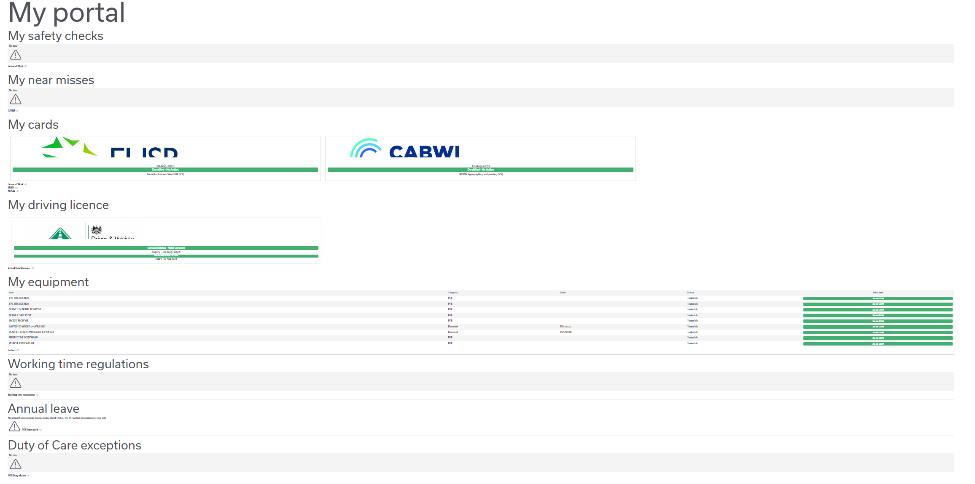
Introducing MyPortal
Overview of My Portal:
As part of MyPotential, we identified a need for additional job essentials data to have a more rounded conversation. It means that this data is more accessible in a ‘one stop shop’ for engineers to review at any time, but of course most likely in preparing for 121’s and annual check-ins.
Data included in My Portal:
Safety checks
Near misses
Cards
Driving license
Equipment
Working time regulations
Annual leave
Duty of care exceptions
Learning (my curricula)
Approach:
This portal is pan-Openreach, so both service delivery and chief engineers have the exact same access and view. We tested this data with a group of engineers and L&D tweaked based on their feedback. We’re now proposing to include this in the next test and learn.
Can be accessed via My Skills Passport – left hand column – ‘My Portal’
Notes:
Slide Owner: Data Expert

Slide 45
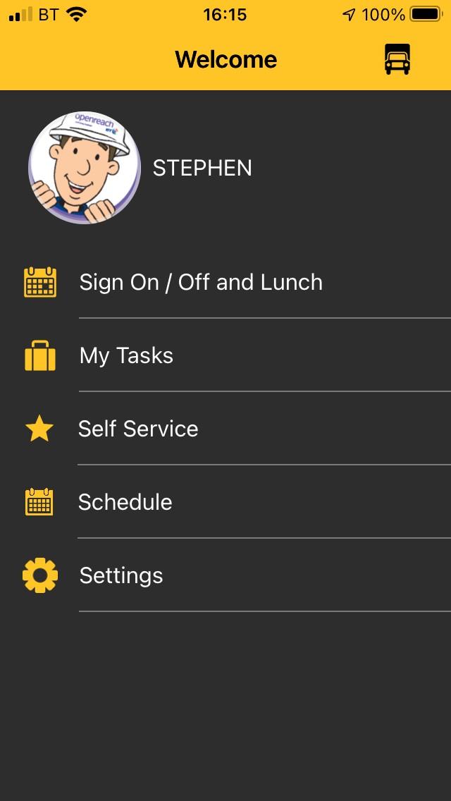
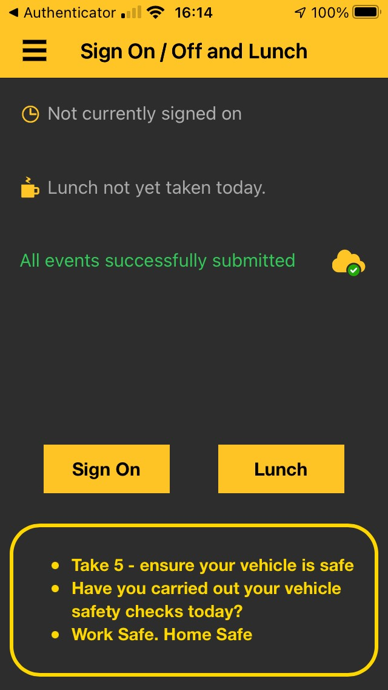
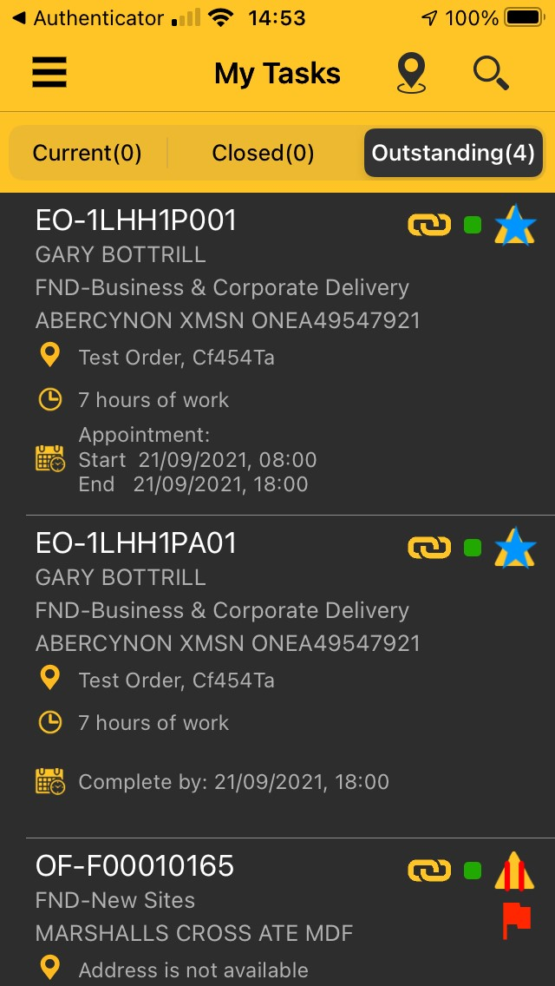
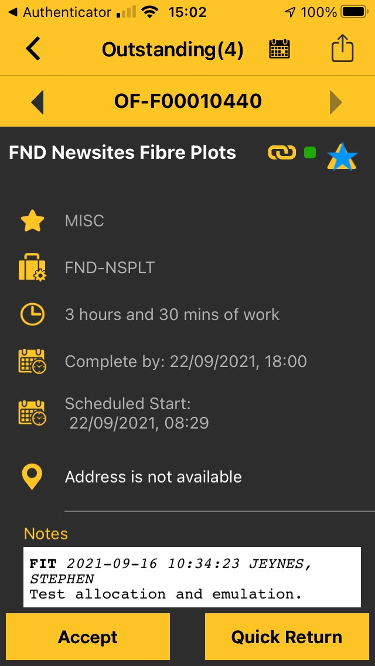
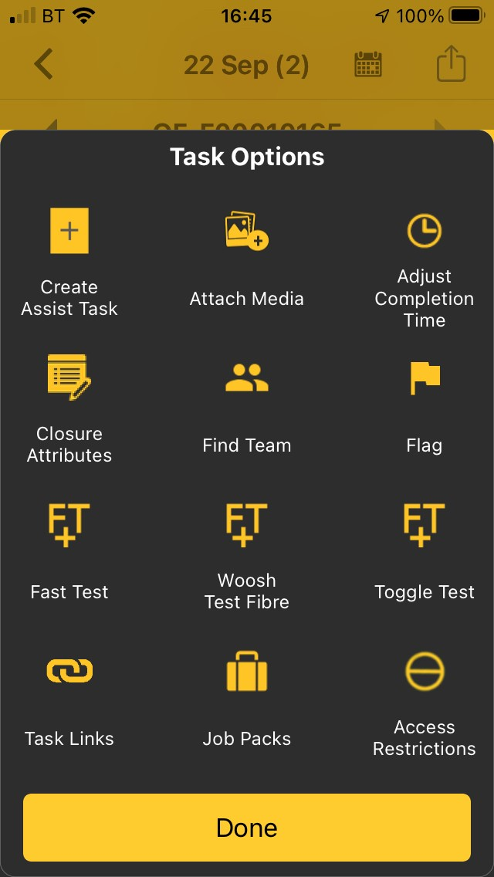
FND Field Master Technician App: Best Practice Handy Guide
Welcome Screen
Sign on/off and Lunch
My Tasks
In Progress Task
Task Options
Sign On and Off on the app – not via FOS!
My Tasks: Pick up work
Self Service: Pick up infill work in future roll out phase
Schedule: See work control have Assigned (planned)/Dispatch (Hard Pinned) as well as any absences.
Update your vehicle reg.
Click Sign On each day to be able to pick up tasks. This will update FOS & Control that you are in work. Ensure you have a green dot.
Remember to Close your task to be able to Sign Off when you have finished work. One click does both so no need to text FOS!
Use the lunch button to record your break.
Green tick in the cloud means data has submitted.
Red indicates a data sync issue. Click the cloud to Retry or Reset.
Tasks show in Current Tab when first dispatched by control,.
They move to Outstanding the following day if not completed or suspended, or if not started.
Tasks starting EO are linked to an estimate and 3rd character from the end of the reference indicates type:
EO-1LHH1P001 is a Lead task as shown by the ‘0’.
EO-1LHH1PA01 is an Assist task as shown by a letter (‘A’ here but can be any letter depending on number for the optimum crew size)
OF-F00010168 is a Manual Assist created by control or field as starts with OF.
Accept all tasks then travel to site.
Start when working the task.
Close when your task is Complete (All work done) or Incomplete (to further).
Scheduled Start is the day the work is programmed by control for work to start.
Complete by is the Required by date for the task as set by planning or updated by controls. Appointment is the day work is booked to be carried out (e.g. Ethernet).
Link icon indicates there is an assist task
Use the arrows to move between jobs
Click for Task Options
Click for Sign On/Off & Lunch
Create Assist Task yourself for additional engineer to help
Attach Media such as photos videos and documents
Adjust Completion Time to update your comeback time
Use Closure Attributes to add Ethernet test results for close Incomplete
Flag information to the control
Use Task Links to see assist info
Lead
Task
New
Task
In Progress
Task
Assist
Task
Suspended
Task
Manual Assist
Flagged
Task

Slide 46
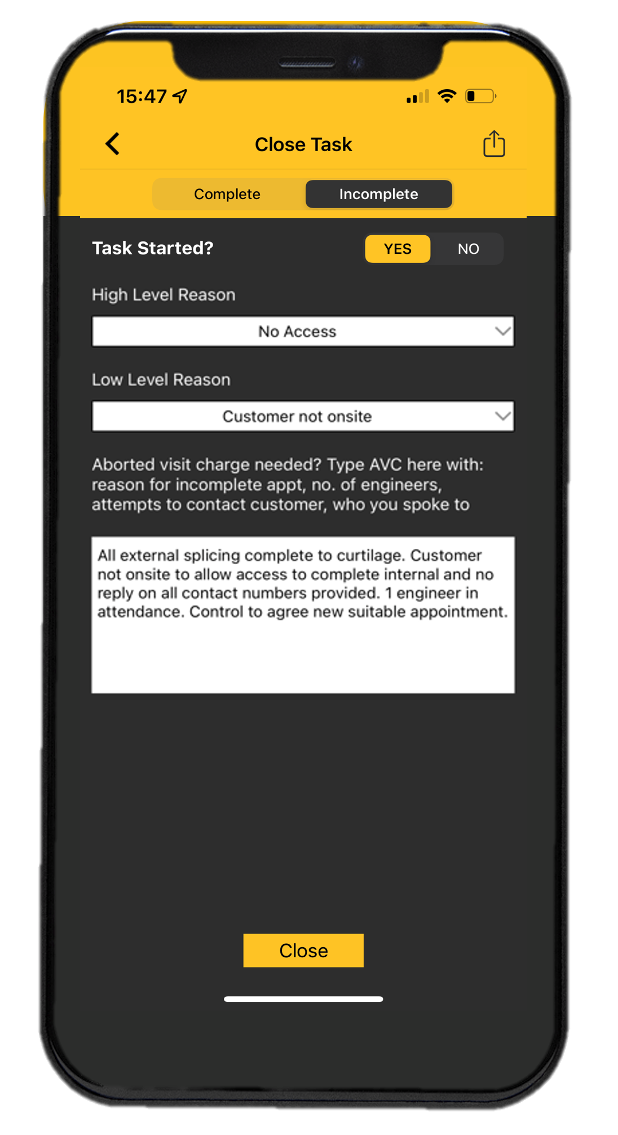
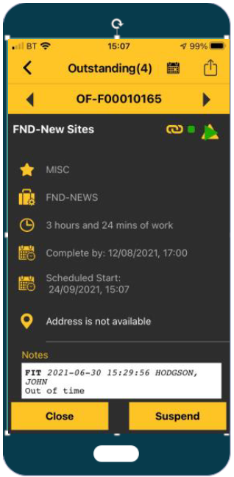
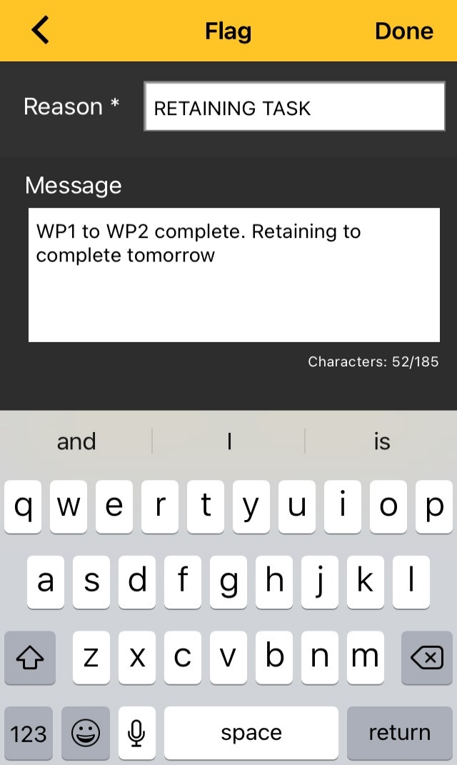
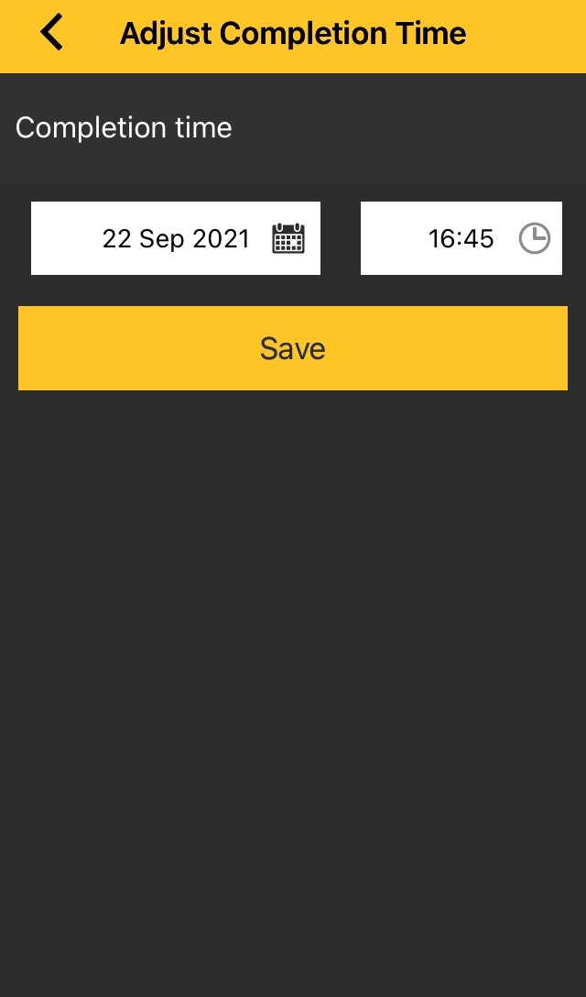
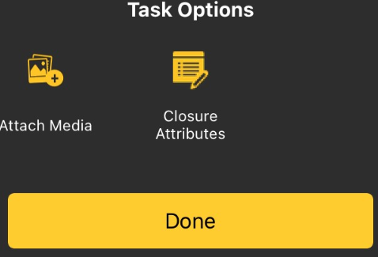
FND Field Master Technician App: Best Practice Handy Guide
Incomplete Task & Notes
Retain to Me
Suspend
Flag to Control
Adjust Completion Time
If you are unable to complete work on a task and cannot continue on your next shift, use Close Incomplete
Complete Time Remaining, High and Low Level Reason.
Selecting the correct reasons is crucial to ensure the job gets the correct triage!
Selecting ‘Traffic Managaement’ makes the job non-fluid and drops into the ‘triage’ pot for the controller to deal with. ‘Out of Time’ keeps the job as fluid and doesn’t highlight to the control – even if you wrote a good note!
Follow the notes prompt and add notes stating:
What work is complete
What work is left to do
More information needed to progress such as known dates and dependencies
Use when you can come back the next day.
Close Incomplete and find the ‘Retain to Me’ option.
Full guide here.
Use when you need to pause the job during the day.
Click Suspend and Raise Flag to control to advise progress and what is left to do
If waiting on civils/TM or other issues that won’t be resolved on the same day Close as Incomplete and select the right reason!
Used to contact control instead of a phone call if support is needed.
Once raised, control is informed in real time via flag in Scheduler
The blue Flagged Task bar will appear on your app if you raise a flag to control or update the task such as changing the comeback time
The bar will disappear when read and closed by control.
If the duration of your task will take longer or shorter than expected, please use Adjust Completion Time to inform control of when you expect to be available before 3pm.
This also gives a good view to inform what will be complete by end of day and inform upcoming allocation.
Scheduler will have a better understanding of how much work is left and therefore how much work can be given in the future.
You can use ‘speak-to-text’ to save time!
Lead
Assist
Enter closure ntoes
Retain Task
Retain Task for first job on next shift
All external splicing complete to curtilage. AVC. Customer not onsite to allow access to complete internal. Will need to do next time. No reply on all contact numbers provided. 1 engineer in attendance. Control to agree new suitable appointment.
2 men required for 1 day to complete this task. Access will be granted on 17.02.
All external splicing complete to curtilage. AVC. Customer not onsite to allow access to complete internal. Will need to do next time. No reply on all contact numbers provided. 1 engineer in attendance.
Coming back tomorrow to finish.
Currently only lead engineer notes show in all systems (EW/NGWFMT)
Assist status follows the lead. But you still need to add notes.

Slide 47
Q&A and
Next Steps
Notes:
Slide Owner: Gemma Holden

Slide 48
Q&A and next steps
Book time in with your team to brief them on MyPotential and what it means for them. Agree with your SEAM what support you need from your HRBP/Dev Manager/ROMs and prep required. The Programme Team will help to provide you with the relevant content to support these sessions and be on hand to answer any questions.
Once briefings have taken place, ensure team members sign up and attend at least one of the dedicated metrics sessions. Complete the MyPotential checklist on MySkills for yourself and your engineers post-roll-out.
You will receive a post-workshop pack which includes the slides covered today as well as the slides for follow-up sessions.
You will have been invited to a dedicated metrics session which will ensure you have all the detail you need.
Notes:
Slide Owner: SEAM

Slide 49
MyPotential programme principles (Team Member)
We are following set culture principles to ensure a positive experience for everyone.
Be Open
Think Impact
Be Part Of It
Own It
Transparent and
Fair Approach
Empowering
you with Data
Consistent
Support
Proactive
Not Reactive
You’ll have access to your own information on My Skills Passport should you choose to do so. You can see how you are getting on day-to-day (whenever you want) Your manager can also discuss this with you at your check-in
You’ll be able to request relevant training and support based on regular conversations and insights with your manager / patch lead - where do you need extra support, where do you want to specialise
Your leaders and managers will ensure your coaching experience is consistent and positive, wherever you work (across the business and nationally). Before the launch, all managers and patch leads will go through ‘It’s Our Patch’ training. All leaders (PM’s and PL’s) will also attend an upskilling workshop when we introduce the test and learns.
Coaching will be done regularly and consistently. Together both parties will proactively identify where additional help and support may be required, and also recognise good work throughout – most importantly, you will know what to expect
Notes:
Slide Owner: SEAM

