Slide 1
MyPotential
Engineer Briefings
Cablers & Jointers National Rollout
June 2024

Slide 2
Agenda
MyPotential Introduction
Overview of MyPotential Metrics
Q&A and Next Steps

Slide 3
MyPotential Introduction

Slide 4
Why does there need to be change across FND?
Our Reach26 strategy:
Deliver the best service on existing products to retain customers
To generate reinvestment into our network, building our full fibre future
Increasing FTTP customers on our network, winning against our competition
We must manage headwinds if we are to deliver on this strategy
Financial Challenges
Cost of living, price rises on raw materials
Customer Expectations
They want affordable broadband and Ethernet, with high speeds and will move to competitors if they can’t get it from us
Competition
Alt Nets are innovating and providing our customers with more choice in the market – we need to stay ahead to maintain our position
Managing these headwinds will require a team effort – we want everyone to feel confident, supported, equipped and motivated to do their best, so that we can fully achieve our Reach26 goals.
Notes:
Important to land the key points on the Reach26 strategy and therefore where MyPotential fits into this
Why does there need to be change in FND?
The cost of living and the cost of raw materials along with our customers continuous rising expectations are all a challenge for us in staying ahead of the competition.
We need to be delivering at cost whilst reducing/removing inefficiencies within the business
Clive commented on his previous calls that following discussions with government there is a commitment to build more homes and following Reach 26 there will be an incentive for us to reach 30million homes by 2030 – we need to ensure we are smart with our work
We can see our competitors are hot on our heels and therefore we need to be ahead of the game and continue to build at pace

Slide 5
MyPotential vision
VISION
MyPotential vision is to provide you with insight to understand your individual and team contribution, as we build the connections that matter for our business and for our customers.
You will be supported with meaningful one-to-one coaching conversations and team huddles to ensure you feel confident, supported, equipped and motivated to do your best.
GOALS
Creating a high trust environment.
Co-designing and building individual and team level metrics and dashboards.
Ensuring you have the right tools and information you need.
Putting the people experience at the heart of the change.
This is driven by Reach26 objectives, the need for simple and consistent metrics across regions, insight-led coaching conversations to allow strengths to be recognised and opportunities for improvement identified at an individual, team and regional level.
Notes:
Set the scene: Our Journey so far – over 12 months
Why this is important/what it means to our business
We have done numerous test and learns (what have we learned so far)
What do we need from you – if we get this right, it could be amazing, if we get wrong negative impact to engagement/service/cost
MyPotential is the latest programme looking to provide better tools and insights for our people.
My Potential vision is to provide our people with the insights to understand their individual and team contribution, as we build the connections that matter for our business and for our customers. This is supported by 1:1 meaningful coaching conversations and team huddles that ensure that individuals and teams feel confident, supported, equipped and motivated to do their best.
MyPotential will help inform greater coaching conversations and will work hand in hand with our other Transformation initiatives.
Why is MyPotential important?
Our Reach26 target is ambitious, by introducing metrics and emphasising the importance of coaching conversations, we can help individuals understand how their work aligns and contributes to the Reach26 objectives.
Our people managers do not currently have simple and consistent metrics across regions which gives a one-stop view of individual and team contribution. Introduction of My Skills and Manager dashboards would provide this view, making it easier for individual and people managers to know where to focus their efforts and develop high-performing teams.
With metrics, coaching conversations can be more specific and tailored to recognise strengths and identify opportunities for improvement at an individual, team and regional level.
How will we achieve this vision?
Creating a high trust environment where people managers and individuals can have open conversations about how to improve and solve problems.
Co-designing and building individuals and team level metrics and dashboards which give us insight on our people and aligns with Reach26 objectives.
Ensuring that people managers have the tools and information they need to lead with insight, develop talent and support those that need help.
Putting the people experience at the heart of the change, ensuring that they are provided with just-in-time training, dedicated support and targeted change interventions.

Slide 6
MyPotential – Our commitments
MYTHS
‘MyPotential gives you a task and a limited time to complete it’ - You will never be asked to compromise quality or safety to achieve quantity
‘MyPotential is a league table’ - You will not be compared to your peers and the dashboards are designed to provide insight on how you could improve
‘MyPotential promotes micromanagement’ - Leaders will have more time to coach and support you and your colleagues
‘It is designed to create a competitive rather than a collaborative culture’ - It will enable teams to support each other & work better together
FACTS
MyPotential will support good quality coaching conversations and enable your manager to give feedback based on YOUR individual contribution
Self-serve MySkills dashboard so you can take ownership of your own performance
Better understanding of your individual contribution and how it supports our Reach26 ambitions
Identify areas for improvement and opportunities for personal growth
WHAT YOU WILL GAIN ​
Access to MySkills dashboard providing insight on your individual performance​. Your manager will have a Qlik dashboard version with individual and overall team insights​
Regular meaningful coaching conversations​ with your manager. This will provide more focused insight-led learning and development support
A sense of purpose as you will see and understand how your hard work contributes to broader Openreach goals​
Notes:
Key point to land on this slide is myth busting
Given there will be concerns around performance management, it is really important to land the facts and what people will gain and dispel the myths
This is all about good quality coaching conversations and is not about micromanaging you or creating competitiveness – it is about helping you

Slide 7
MyPotential NRO: The journey so far
As part of National Rollout for Cablers and Jointers we have run two Test and Learns and several key sessions.
March 2024
Leadership Session
To introduce SEAMS to the programme, how to win hearts and minds and their role.
May 2024
PM-PL Session
To brief and upskill PM and Leads on the programme and national roll-out
February 2024
Second 6-week T&L
To gain feedback on the headline and supporting metrics at an individual level across 12 patches. Tested MySkills and Qlik dashboard functionality.
Today
Engineer Briefings
To brief and explain to you the purpose of MyPotential and how coaching conversations and metrics will work together
October 2023
First 4-week T&L
To gain feedback on the Daily Customer Connections (headline metric at a team and individual level across 12 patches.
February 2024
Director Briefing Session
To update directors on the programme, national roll-out (NRO), training approach and workshop content.
April 2024
National SEAM session
To brief and upskill SEAMs on the programme, training approach, practice content for workshop and understand roles and expectations.
Notes:
We introduced Test & Learn in October 2023 using 12 regional teams across the North/South & Central
Initially it was a 4week testing window for single metric
This was followed by 2nd Test & Learn in February 2024 this time 6week testing window looking at additional supporting metric
The Test & Learn group overall have seen a positive increase in teams' performance over the Test & Learn period.
Coaching conversations. Managers were found to be supportive and concerns around negative behaviours did not materialise in coaching conversations or team huddles.
Increased focus on wellbeing. Coaching conversations alongside metrics provided the opportunity to have conversations around wellbeing and provide a fuller picture of an individual’s contribution.
Visibility of leadership. It was reported that there were additional visits and coaching from patch managers and patch leads, which provided more opportunities for in-person coaching conversations and trust building.
Managers are telling us the metrics is supporting their conversations and helping identify development areas within their teams.
We have seen a reduction in engineer concerns however survey feedback is telling us there is still work to do in landing the message.

Slide 8
MyPotential Programme principles
We are following set culture principles to ensure a positive experience for everyone.
Be Open
Think Impact
Be Part Of It
Own It
Transparent and
Fair Approach
Empowering
you with Data
Consistent
Support
Proactive
Not Reactive
You’ll have access to your own information on MySkills Passport – this is optional. You can see how you are getting on day-to-day (whenever you want). Your manager can also discuss this with you at your check-in.
You’ll be able to request relevant training and support based on regular conversations and insights with your patch manager / patch lead - e.g. where you need extra support or where you want to specialise
Your leaders and managers will ensure your coaching experience is consistent and positive, wherever you work (across the business and nationally). All managers and patch leads have been through or will go through ‘It’s Our Patch’ training. All leaders (PM’s and PL’s) have attended an upskilling workshop focuses on coaching.
Coaching will be done regularly and consistently. Together both parties will proactively identify where additional help and support may be required and recognise good work throughout. Most importantly, you will know what to expect.
Notes:
Important to land the support people will get across MyPotential
Land the positive nature of the programme to use the data to benefit you
And land points around coaching and support provided

Slide 9
Overview of the Metrics

Slide 10
Cablers & Jointers metrics
Key
Headline Metric
Supporting Metrics
There are five metrics which have been developed for the Cabler and Jointer community with the headline being Daily Customer Connections metric and four supporting metrics which provide more context and support more insightful and more informed coaching conversations.
Daily Customer
Connections
On The
Tools Time
Time to
Complete
Customer Conversion Percentage
Time
Booking
“Number of weighted completions per day worked”
“What percentage out of the total time booked by an engineer was productive?”
“Number of productive hours booked by the engineer per completion in the time period”
“What percentage of the tasks allocated to an engineer have been completed?”
“What is the percentage of full match time in total time booked by the engineer?”
Notes:
There is one main metric – the daily customer connection metric
The 4 other metrics are designed to help understand the first metric and gain further insight
Remember this is not a stick to prod and poke people with – it’s about gaining a rounded picture
Remind them that they will be invited to a metrics upskilling session which will help to give them a more informed view on these metrics from one of our metrics experts and that you are not the experts yet on this.

Slide 11
How we would like to use the metrics
Ensuring individuals and teams are supported will always remain our priority.
Team Engagement
Ongoing Individual Support
People-First Approach
Managers will hold weekly sessions with you focusing on:
Openly sharing how the team is doing (as a whole) and reviewing the trajectory of the metrics.
Ensure key messages are covered and clarity provided on priorities for the week ahead. There will also be briefings on any key business or team updates, so everyone knows what to expect.
Leaders and managers will ensure team huddle experiences are consistent and positive wherever they take place
You will have access to your information on MySkills Passport with live data available which you can discuss with your manager.
You will be able to request relevant training and support based on regular conversations and insights with your manager / patch lead.
Coaching will be done regularly and consistently. Together both parties can proactively identify where additional help and support might be required and recognise good work throughout.
Managers will ensure any coaching experience is consistent and positive wherever an individual works.
If you have a low customer connection metric or is on a decreasing trend, your manager (with the relevant support) will:
Assess if this is as expected due to the nature of the work.
Work with you to understand why you think this is the case and provide you with support if required.
If it is still not clear your manager would then seek to obtain further insight through supporting insight metrics as well as engage in an open discussion with you and your Patch Lead if appropriate.
Ongoing coaching for everyone
Notes:
This is about providing continuous support and an open dialogue
We will only ever clarify publicly how the team is doing (as a whole)
We want this to be a positive experience to provide more clarity, insight, training and support – this is all about driving the right behaviours NOT chasing a number
This is about recognising and championing the right behaviours not calling out poor performance

Slide 12
Q&A and
Next Steps

Slide 13
What we need from you
We all have a part to play across MyPotential to help each other
Patch Managers and Patch Leads | Share team metrics as part of team huddles and embed it into the team culture Support engineer’s career journey through regular coaching conversations Support engineer’s understanding of the MyPotential metrics and identify opportunities for the team and individuals Recognise and celebrate success in my team
Engineers | Attend coaching conversations ready to share and discuss day-to-day work and highlight any requests or issues that your manager/lead can support you with Consider ways you could improve your own performance or your team performance Optional – View your MyPotential and MyPortal dashboards on MySkills
Both | Keep each other accountable in ensuring regular coaching conversations are taking place Engage with insights and consider where there are opportunities for improvement or support Communicate as a team, be open and transparent
Notes:
To make this work, we all have a part to play. As a manager or lead, we will:
Share team metrics as part of team huddles and embed it into the team culture
Support engineer’s career journey through regular coaching conversations
Support engineer’s understanding of the MyPotential metrics and identify opportunities for the team and individuals
Recognise and celebrate success in my team
As Engineers, we need you to:
Attend coaching conversations ready to share and discuss day-to-day work and highlight any requests or issues that your manager/lead can support you with
Optional – View your MyPotential and MyPortal dashboards on MySkills
Together we will need to:
Keep each other accountable in ensuring regular coaching conversations are taking place
Engage with insights and consider where there are opportunities for improvement or support
Communicate as a team, be open and transparent
If we collaborate well, we can continue to be a winning team and deliver better for our customers as well as ensure we have access to the right learning and development opportunities for our careers.

Slide 14
Q&A and Next Steps
You will have been or will be invited to a dedicated metrics session with one of our regional data experts. This will help to ensure you have all the detail you need and can ask any questions to better understand the metrics. This will take place w/c 17th June. Please do your best to attend this session.
You will receive a post-workshop pack which includes all the slides covered today.
You will receive instructions on how to use the dashboards on MySkills Passport, which is the platform you will be using to access and view your data. The dashboards should be live on your MySkills Passport now, please let me know if this is not visible.
You will be invited to drop-in calls with the MyPotential Programme Team where you can share feedback on how MyPotential has landed and ask any questions you may have. This will take place from w/c 17th June.

Slide 15
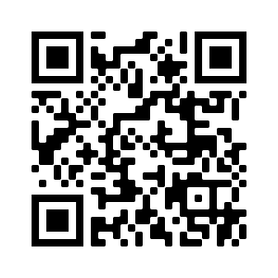
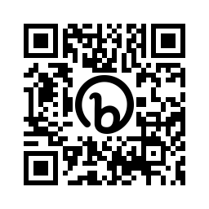
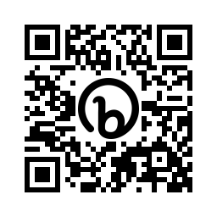
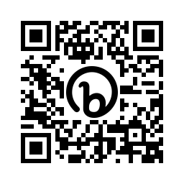
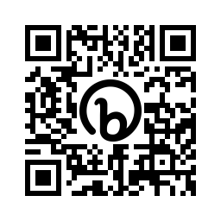
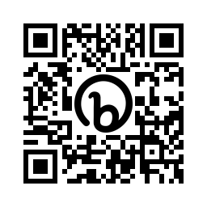
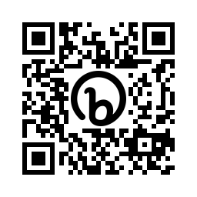
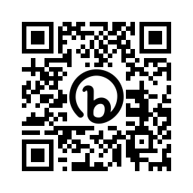
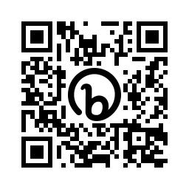
Understanding our support services managers and team members if they are…
Wanting to self investigate
Wanting to self help
Stressed or anxious
Needing a friendly ear or lived experience
In severe emotional distress
Your Wellbeing
Our online Wellbeing portal covering advice on a wealth of subjects from Life to Money, and Health to Relationships. Visit http://www.yourwellbeing.bt.com
Silver Cloud
Self-guided modules to help improve wellbeing. Space from stress, support for resilience, and sleep wellbeing tips. Visit
https://vhg.silvercloudhealth.com/signup/ and enter the code VitaBT
Mental Health Service
Cognitive behavioural therapy (CBT) – stress; depression; anxiety; PTSD; self-esteem; eating disorders; sleep
This service is obtained with manager referral.
https://bit.ly/OR_MHS
Peer to Peer Support Network
A telephone listening support service provided by trained volunteers who can help colleagues across a broad spectrum of experiences
Text p2psn to 81192 https://bit.ly/OR_P2P
Employee Assistance Management (for managers)
If you have any concerns that someone may be at immediate risk to themselves, call immediately - 0800 780 784. https://bit.ly/OR_EAM
Complaining of back pain/ pulled muscle etc
Going in for a planned operation
Needing legal or financial advice or counselling
Wanting to return to work but have MSD problems
Looking for toolkits
Physio
Online support and hands on physiotherapy treatment sessions. Employee contacts 0333 222 0712
https://bit.ly/OR_Physio
Pre-habilitation service
Pre operation – enhancing people’s knowledge, mental and physical resilience and helping them return to work. Employee contact 0333 222 0712 https://bit.ly/OR_Prehab
Employee Assistance Programme (EAP)
A confidential, free service for all employees. Counselling and emotional support. Advice lines and information – debt, legal and financial. Call 0800 917 6767
https://bit.ly/OR_EAP
Functional restoration programme
For people suffering from musculoskeletal disorders, affecting their ability to return or stay on full duties. Contact 0333 222 0712 https://bit.ly/OR_Restore
Line manager support
Support for common issues that your team may experience. Includes homelessness, money worries, domestic abuse and menopause
https://bit.ly/OR_LM_Support
Notes:
We thought it was relevant to include wellbeing content as part of this pack. It’s a really important reminder of the support services that are available.
Two key points to land:
We should always be considering our people’s wellbeing as part of leadership and coaching; this includes- checking in with them and asking them ‘how they are’, spotting signs e.g. if someone isn’t quite themselves, making sure we are supporting their needs.
We also know change can be difficult (reference the change curve) and some people may need some extra support as we introduce reach your potential. It’s important to be sensitive to this and use their leadership style to adapt. Listen to people’s concerns.

Slide 16
Your wellbeing
Support services and guidance to help colleagues when they need it
Three ways to access Your Wellbeing
Visit http://www.yourwellbeing.bt.com
Text wellbeing to 81192
Scan this QR code
Line manager support
Support for common issues that your team may experience. Includes homelessness, money worries, domestic abuse and menopause
https://bit.ly/OR_LM_Support
Triage tool
Family: supporting and caring for the most important people in your life.
Features:
Childcare and parenting
Legal matters
Older relatives
Death and loss
Family and work
Health: keep fit, stay healthy and get help with your physical and mental health.
Features:
Addictions
Healthy habits
Mental health
Physical health
Life: when life challenges you, we’re here to help.
Features:
Work
Personal matters
Legal issues
Practicalities of life
Crisis help and support
Money: got a financial issue? We’re here to help.
Features:
Managing money
Debt
Financial planning and emergencies
Rewards and perks
Savings and pensions
Life Skills: tailored bite size resources.
Features:
There’s uncertainty ahead
I’m feeling stressed
Building stronger relationships
Growing and evolving
Notes:
We thought it was relevant to include wellbeing content as part of this pack. It’s a really important reminder of the support services that are available.
Two key points to land:
We should always be considering our people’s wellbeing as part of leadership and coaching; this includes- checking in with them and asking them ‘how they are’, spotting signs e.g. if someone isn’t quite themselves, making sure we are supporting their needs.
We also know change can be difficult (reference the change curve) and some people may need some extra support as we introduce reach your potential. It’s important to be sensitive to this and use their leadership style to adapt. Listen to people’s concerns.

