Slide 1
PSAP in Operations
GB Domestic Driver Hours

Slide 2
What is the process?
The aim of this initiative is to pilot the enhancement & simplification of the driver hours capture process within delivery offices
This relates to the GB Domestic legislation: The legislation comes in to effect for any driver who drives more than 4 hours in given day on the week and must be monitored for the rest of the week
Daily driving limit: You must not drive for more than 10 hours in a day
Duty time: If you work as a driver for a company, duty time is any working time.
Daily duty limit: You must not be on duty for more than 11 hours in any working day. This limit doesn’t apply on any working day when you do not drive.
Exemption certificates previously given out to some offices are not valid as policy requires hours to be monitored every week to capture accurate actuals including overtime changes each week.
You must record your hours on a weekly record sheet
Plan the duties to ensure -
Anyone driving more than 4 hours must not complete duties with more than 11 hours in.
Anyone expecting to work more than 11 hours on any day must not complete duties with more than 4 hours driving

Slide 3
Why? What are the benefits?
The business is under increasing pressure with the current surge in demand & challenges posed by COVID-19:
This is initiative aims to release capacity back into the delivery office by:
Legislative Compliance
Ensuring only those drivers who legally need to be monitored are recorded
Time Saving
Simpler & more efficient process will release time back to the delivery office

Slide 4
Visio Flow
Notes:
Key messages:
Check if any routes over 4 hours – should only be a few – these need monitoring for any driver completing them every week
Review overtime for 4 hours driving combined over duties
Review overtime for more than 11 hours net duty (should not have driven more than 4 hours)
If people breach then ensure changes made to prevent following weeks

Slide 5
Baseline
To be able to complete the weekly recording of the drivers hours in the monitoring spreadsheet each Delivery Office needs to understand its baseline data on all duties service time and driving content.
If available use Trimble data or Shrewsbury system data on driving content
If this is not available then complete the Average Call Rate Driving Time Master Excel file
Input baseline data in to the input tab on the Drivers Hours Monitor spreadsheet

Slide 6


Scenario 1
John completes his standard shift & drives for 2 hours.
His net duty time is 9 hours
John does not need to be monitored
Why?
He is driving less than 4 hours
He is working less than 11 hours net duty time

Slide 7


Scenario 2
Ross completes his standard shift & drives for 4.5 hours.
His net duty time is 9 hours
Ross does need to be monitored
Why?
He is driving more than 4 hours
We need to ensure he does not work more than 11 hours net duty time

Slide 8

Scenario 3
Jess completes her standard shift & then completes an overtime duty. She drives for 2.5 hours.
Her net duty time is 14 hours
Jess does need to be monitored
Why?
She is working more than 11 hours net duty time
We need to ensure she does not drive more than 4 hours for the remainder of this week.

Slide 9
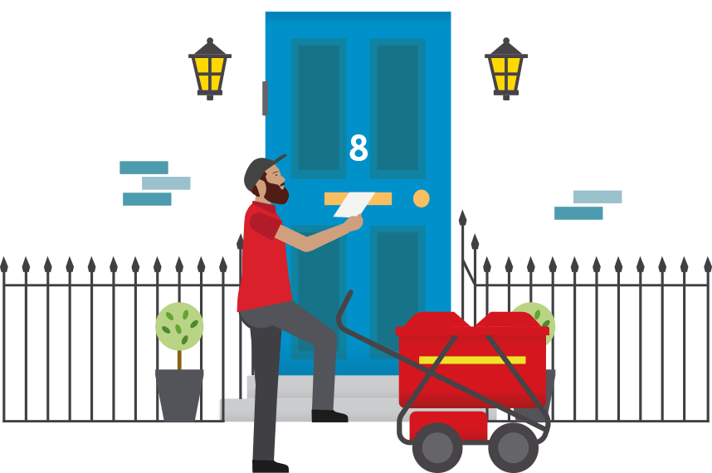

Scenario 4
Paul completes his standard shift & completes an overtime duty. He drives for 5 hours.
His net duty time is 14 hours
Paul is in breach of the legislation
Why?
He is driving more than 4 hours & he is working more than 11 hours net duty time

Slide 10
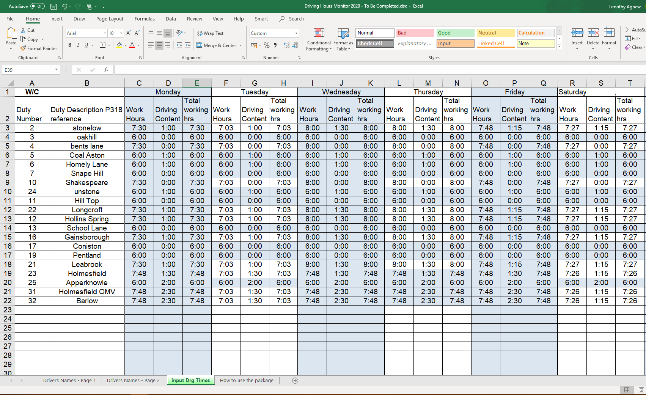
What do I need to do to get started?
Ensure you have completed the ‘Input DRG Times’ Tab of the Driving Hours Monitor file
Enter all of your duties, their drive time & working hours into the file
  This data can be sourced from Shrewsbury, Trimble, Local Spreadsheets (e.g. previous delivery revision)
  If you do not have this data, follow the instructions on the next slide

Slide 11
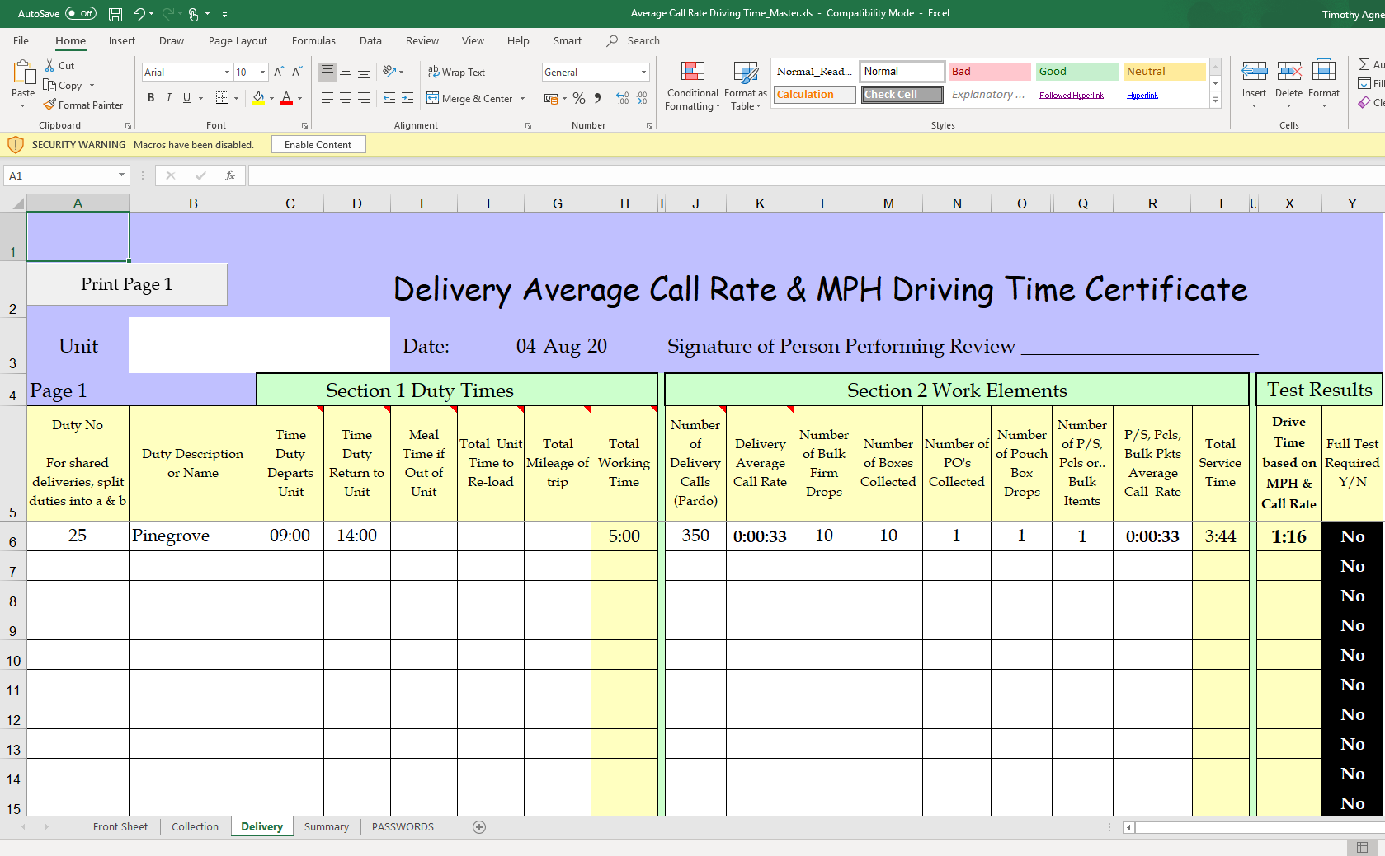
What if I don’t know my baseline driving times?
You can use the ‘Av Call Rate Driving Time Master’ file to calculate your drive times
Enter your duty details into each Column & you will see the total drive time output

Slide 12
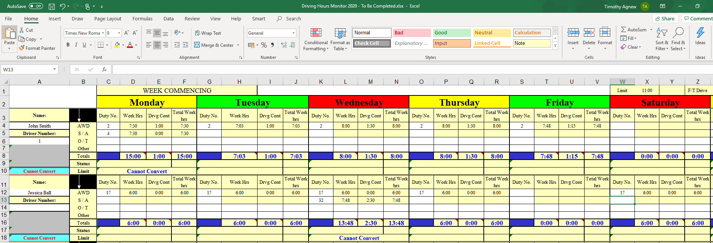
What do I need to do each week?
Plan your duties to ensure that you will not breach the legislation.
Monitor drivers who are completing duties with 4+ hours driving in the ‘Drivers Hours Monitor’ Spreadsheet
Check 552 forms throughout the week to identify if anyone driving has completed overtime/SA resulting in more than 11 hours net duty time – If so, record them in the ‘Drivers Hours Monitor’ Spreadsheet
You do not need to monitor every driver, only those that (a) drive more than 4 hours or (b) work more than 11 hours net duty time

Slide 13
Timeline
Operating Rhythm
The plan is shown below:
Week 1
Onboarding
Week 2
DOM onboarding & baseline activity
Week 3
Issue final communications
Week 4
Go Live
Week 7
Transition to BAU
Week 8
Confirm embedded
Onboarding session with SDL, OMs, Performance Coach, and Fleet Operations Manager
All DOMs to have initial communications from OMs
Baseline activity to be completed by DOMs (Supported by Fleet Ops Manager)
Go Live
Performance Coaches to drive adoption and hold calls to assist DOMs
Completed files to be shared by DOMs on Monday – Performance Coach to review the completion of process

