Slide 2

IDS Investor Webinar, 23rd January
Agenda and Speakers
1. Tom Powdrill, PIRC – Welcome and opening remarks
2. Bill Taylor, Head of Research CWU – The current situation facing investors
3. Dave Ward, Andy Furey CWU – An overview of the challenges facing Royal Mail
4. Questions and Answers
Notes:
CWU represents over 115,000 CWU members working for Royal Mail in frontline non managerial roles, including in delivery, processing, customer service, engineering and administration.

Slide 3

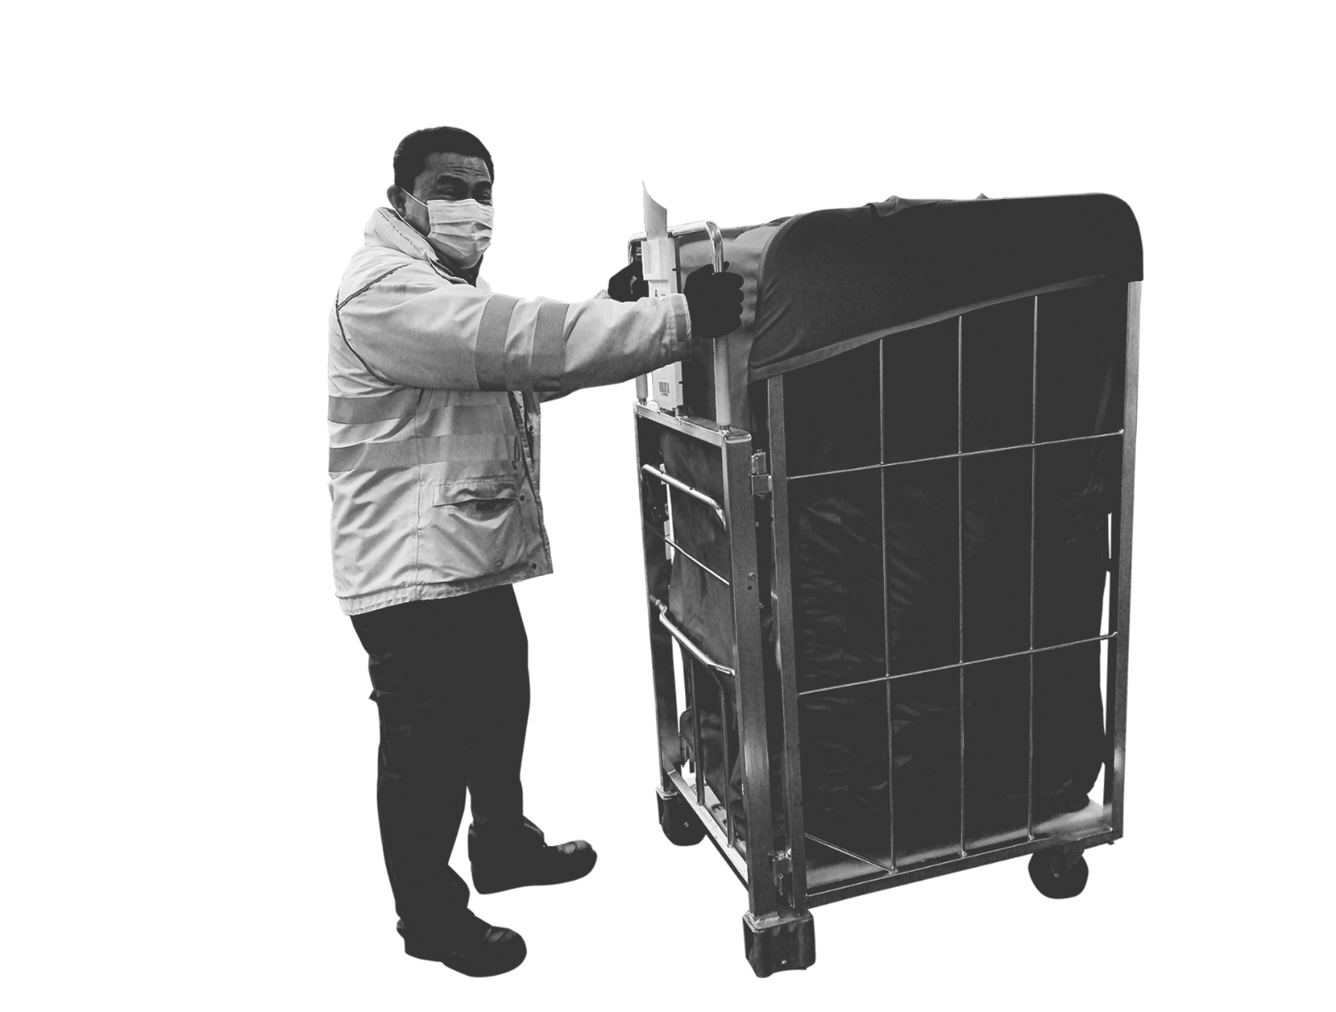
Who CWU represents
Over 115,000 members in Royal Mail including in:
Delivery
Processing
Customer service
Engineering
Administration
Parcelforce
Distribution/Network
Notes:
CWU represents over 115,000 CWU members working for Royal Mail in frontline non managerial roles, including in delivery, processing, customer service, engineering, administration, Parcelforce and distribution and network.

Slide 4
IDS plc Finances - The True Picture
For the latest financial year, IDS plc reported record profits of £758m
Royal Mail UK reported near record profits of £416m
In May RM UK profits for FYE March 2023 were forecast at £303m but in October
this fell to a predicted loss of £350-£450m
The IDS Board has led Royal Mail from massive profits to record losses in just 6 months
Notes:
Up until very recently, IDS Group has been a highly profitable business.
Only in May, IDS Group reported a record operating profit of £758m for the year to March 2022.
And Royal Mail UK reported near record profits of £416m in 2022 (they made £417m in 2016) – GLS the international parcel business made the remaining £342m.
In May Royal Mail was forecasting profits of £303m for year end 2023 for the UK business, but in October these year end forecasts plunged to a predicted loss of £350 - £450m. Some analysts are now reportedly forecasting losses of nearly £750m for Royal Mail UK for the year to March 2023.
It is astonishing to the CWU that the IDS Board has led the company from massive profits to record losses in the space of just 6 months.
(They also have a large asset base worth over £10bn, including property plan and equipment, and they have fixed pension costs after the CWU negotiated an agreement with them on a new Collective Defined Contribution pension scheme).

Slide 5
IDS Shareholder Returns 2022
75% of operating profits returned to shareholders in 2022 (£567m in dividends
and a buyback)
IDS must balance the needs of all stakeholders to secure long term business success
Notes:
We recognise the importance of IDS plc rewarding its shareholders, but 75% of operating profits were returned to shareholders in 2022. That’s a total of £567m in dividends and a share buyback.
If some of that money had been channelled into pay and responding to the challenges of lower parcels volumes, that could have helped to resolve the dispute.
We think IDS needs to better balance the needs of all stakeholders to ensure the long term success of the business

Slide 6
IDS Executive Pay 2022
CEO pay ratio has increased from 20:1 in 2021 to 23:1 in 2022
CEO total remuneration £753,000 including £142,000 bonus
CFO total remuneration £1,339,000 including £847,000 bonus
The CEO and CFO have been awarded large packages despite missing quality of service targets.
Notes:
IDS Executives were generously rewarded in 2022 when CWU members had a 2% award imposed on them.
The CEO Simon Thompson’s pay increased to 23 times the average Royal Mail employee, up from 20 times in 2021.
And he was awarded a £142,000 bonus
The Chief Financial Officer Mick Jeavons earned total pay of £1.34 million, including a bonus of £847,000.
This is despite Royal Mail missing a number of important quality of service targets including for the delivery of 1st and 2nd class mail.
And it’s at a time when the Investment Association – the trade body for asset managers – has called for companies to show restraint on executive pay and bonuses, ensuring that executive pay packets are balanced against the experiences of their wider workforce, customers, and other stakeholders.
(And they’re coming at this from a business rather than a moral perspective, saying that the retention and motivation of employees below the executive level will be key for many companies and Board decisions could impact on the productivity of the whole workforce.
Statement available at: https://www.theia.org/media/press-releases/investors-call-companies-consider-cost-living-crisis-when-setting-executive)

Slide 7
The Dispute- Why Royal Mail workers are on strike
Pay: Unagreed 2% pay award imposed = a real terms pay cut of 9.1% against RPI/7.0% against CPI
Changes to terms, conditions and the wider service, including:
  The company walking away from the Pathway to Change Agreement 2021
  Cutting 10,000 jobs while introducing a new resourcing model which brings in agency workers and owner-drivers on contracts worth 20% less and with longer hours
  Starting delivery up to three hours later in the day, therefore abandoning the morning delivery period and deliberately undermining the universal postal service
Notes:
Royal Mail has imposed a 2% pay award without our agreement which amounts to a real terms pay cut this year with RPI inflation running at 11.1% and CPI at 9.0% at the time the award was imposed. Inflation has increased since then with RPI currently at 13.4% and CPI at 10.5%.
The real terms reduction in pay means many of our members cannot afford to get by and are having to cut back on food and energy or choose between heating and eating.
CWU members are also taking strike action in defence of their terms and conditions of employment and the postal service in general.
This follows the business walking away from major collective bargaining agreements including the Pathway to Change Agreement of 2021.
Cutting 10,000 jobs and introducing a new resourcing model based on agency workers and self-employed drivers on contracts worth 20% less doing longer hours.
And starting delivery up to 3 hours later in the day, which means abandoning the morning delivery period and deliberately undermining the universal postal service.

Slide 8
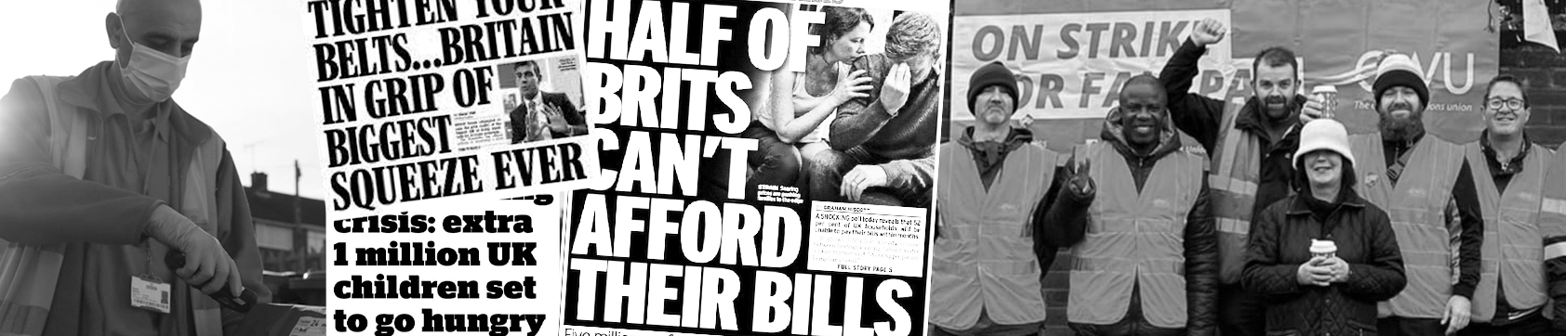
Industrial Action so far
18 days strike action since August, with a re-ballot underway
Members are angry at aggressive, unjustified attacks on jobs, pay and conditions
With the threat of job losses hanging over them, members are being made to pay for IDS leadership’s mistakes
The dispute remains strong – we want a fair deal that aligns the interests of CWU members, customers and all stakeholders
Notes:
CWU members in Royal Mail have so far taken 18 days of strike action since August, with an industrial action re-ballot now underway.
They’re angry at what they and the union see as aggressive, unjustified attacks on their jobs, pay and conditions.
Faced with the threat of losing their jobs, they’re being made to pay for the IDS leadership’s mistakes.
And our members’ support for the dispute remains strong – we’re looking for a fair deal that aligns the interests of CWU members, customers and all stakeholders.

Slide 9


    Why IDS should improve its offer
    Decent jobs and fair pay means:
    A motivated, committed workforce
    Investment in long term sustainability
    Higher retention and productivity
    Better quality, reliable services
Notes:
Apart from the moral argument that IDS should look after its workers during a cost of living crisis, it’s also the right thing for the business.
That’s because paying workers fairly will ensure a motivated, committed workforce.
And investing in staff is an investment in the long term sustainability of the business. (IDS are undermining that goal by attacking the pay and conditions of its workforce and seriously damaging industrial relations).
If workers are treated fairly this will create huge business benefits, including
Higher staff retention and productivity
And better quality, reliable services helping IDS to capture growth and compete effectively for new business.

Slide 10
    Dispute is damaging IDS’s share price
19th May = 2021-22 results
14th October = Profit warning
26th August = First strike date
18th November = Half year results
28th April = CWU Conference votes to ballot for industrial action based on imposed pay offer and detrimental changes proposed by Royal Mail
30th October = CWU cancels strike action to allow for meaningful talks
17th January = BEIS Select Committee
Notes:
The dispute is damaging IDS’s share price
As the chart shows, since May last year when Royal Mail reported its annual results 2022, the share price has fallen by 30% from 325p to 229p earlier today.
There was a 15 pence fall in the share price after the BEIS Committee hearing on 17th January.
(

Slide 11
    IDS share price has performed worse than FTSE 100 and 250
Notes:
The IDS share price has performed significantly worse than the FTSE 100 and FTSE 250 over the last year, falling by 56% compared with a fall of 12.2% for the FTSE 250 and growth of 3% for the FTSE 100.

Slide 12
Questions of Trust and Integrity in IDS Leadership
IDS plc CEO Simon Thompson told the BEIS Select Committee 17th Jan:
  Royal Mail does not prioritise parcels over letters despite evidence to the contrary
  Royal Mail does not track workers despite evidence to the contrary
  Royal Mail is not engaged in ‘fire and replace’ despite making 10,000 redundancies and bringing in thousands of agency and self-employed workers to cover the same work.
CEO was critizised by Committee over clarity and honesty of evidence
Employees have lost trust in leadership
Puts business success and shareholder value at risk
Notes:
We are also now seeing serious questions being raised around trust and integrity in the IDS leadership team.
The lack of honesty and integrity that the CWU has experienced throughout the last nine months of negotiations was very publicly exposed in Parliament last week when the IDS CEO Simon Thompson gave evidence before the BEIS Select Committee.
He told the Committee that it’s not Royal Mail’s policy to prioritise parcels over letters despite the Committee Chair showing evidence to the contrary and quoting from instructions in a Royal Mail workplace telling staff to prioritise parcels. Our members know Thompson’s statement on this isn’t true because they are being told to prioritise parcels on a daily basis.
He said Royal Mail does not use tracking data to monitor the performance of employees or to penalise them, but there is evidence to the contrary on this. Mr Thompson himself posted a large-scale analysis of the data taken from these devices to the employee online communication platform and highlighted the relationship between employee speed and parcel volume.
And Thompson said that Royal Mail is not engaged in a strategy of fire and replace, despite plans to make 10,000 permanent employees redundant and to retain and bring in thousands of agency workers and self-employed drivers.
Members of the Committee were critical of the CEO’s evidence in terms of clarity and honesty saying his performance gave them grave concern about his narrative when there was clear evidence to the contrary.
It’s this lack of honesty that means Royal Mail’s employees have now lost trust in their leadership. Obviously that’s a barrier to introducing change, making a success of the business and delivering shareholder value.

Slide 13
    We are asking IDS shareholders to:
    Write to IDS to raise your concerns about the leadership of Royal Mail and the direction the company are going in and call for an alternative approach to the business.
    Ask questions of the Board on how they intend to resolve the dispute.
    Notify IDS that you will vote against executive pay if they don’t negotiate to settle the dispute.
    Express concern to IDS ESG ratings agencies about the ongoing issues at Royal Mail.
    Urge the IDS Board to reach a fair resolution in the dispute that aligns the interests of CWU members, customers and stakeholders
Notes:
We want shareholders to take action to help us resolve this dispute, and for the reasons we’ve set out we think that is in the long term interests of the business and the IDS share price.
Firstly we’d like you to urge the IDS Board – either in an engagement meeting or in writing - to improve their offer to the CWU and reach a fairer resolution on pay that reflects the cost of living crisis.
We’d like you ask questions of the Board on how the intend to resolve the dispute.
We’d like you to express concerns to IDS’s Environmental, Social and Governance ratings agencies about the dispute. IDS has a strong brand image and a reputation as a responsible business delivering an essential public service as one of the UK’s largest employers. As such, Royal Mail should value the importance of workforce engagement and working with trade unions, but the opposite is happening. We would like shareholders to contact the ESG raters and recommend they downgrade IDS’s ESG ratings if they don’t work with us to resolve the dispute.
And finally, we’d like you to tell IDS that you will vote against executive pay proposals if they don’t negotiate to settle the dispute and protect their workers from the cost of living crisis.

