Slide 1
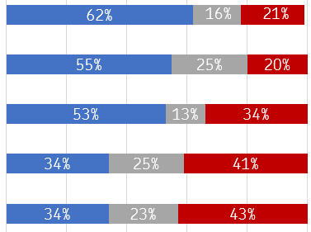
OM Area specific questions: check-in on the Pathway to Change Agreement
Trust
January Trust Check-in
In my workplace, I feel that overtime is allocated fairly
In my workplace, the revision has allowed part-time employees to progress to full-time
In my workplace, I find it easy to book odd days annual leave
I have felt involved in the revision in my workplace
In my workplace, the revision has resulted in workload that is fair and achievable
Favourable Neutral Unfavorable

Slide 2
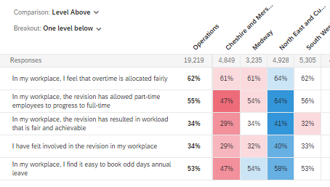
OM Area specific questions: check-in on the Pathway to Change Agreement
Trust
January Trust Check-in
Heatmap to show differences across SDL areas
NB: The blue represents a positive difference of 5 or more compared to SDLs overall. The red represents a negative difference of 5 or more compared to SDLs overall.

Slide 3
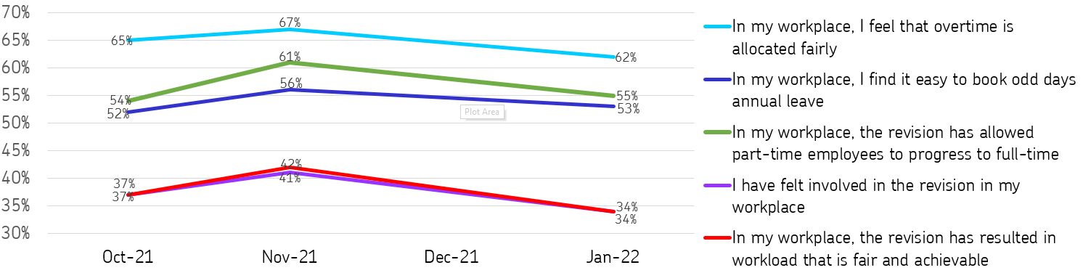
OM Area specific questions: check-in on the Pathway to Change Agreement
Trust
Trends

