Slide 1
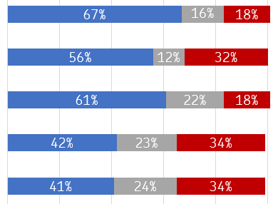
OM Area specific questions: check-in on the Pathway to Change Agreement
Trust
November Trust Check-in
Comparison with October Trust Check-in
N/A I am not aware of a revision in my unit
In my workplace, I feel that overtime is allocated fairly
+2
In my workplace, I find it easy to book odd days annual leave
+4
In my workplace, the revision has allowed part-time employees to progress to full-time
1,295
+7
In my workplace, the revision has resulted in workload that is fair and achievable
1,323
+5
I have felt involved in the revision in my workplace
1,278
+4
Favourable Neutral Unfavorable

Slide 2
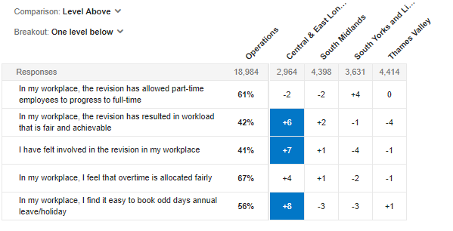
OM Area specific questions: check-in on the Pathway to Change Agreement
Trust
November Trust Check-in
Heatmap to show differences across SDL areas
NB: The blue represents a positive difference of 5 or more compared to SDLs overall. The red represents a negative difference of 5 or more compared to SDLs overall.

