Slide 1
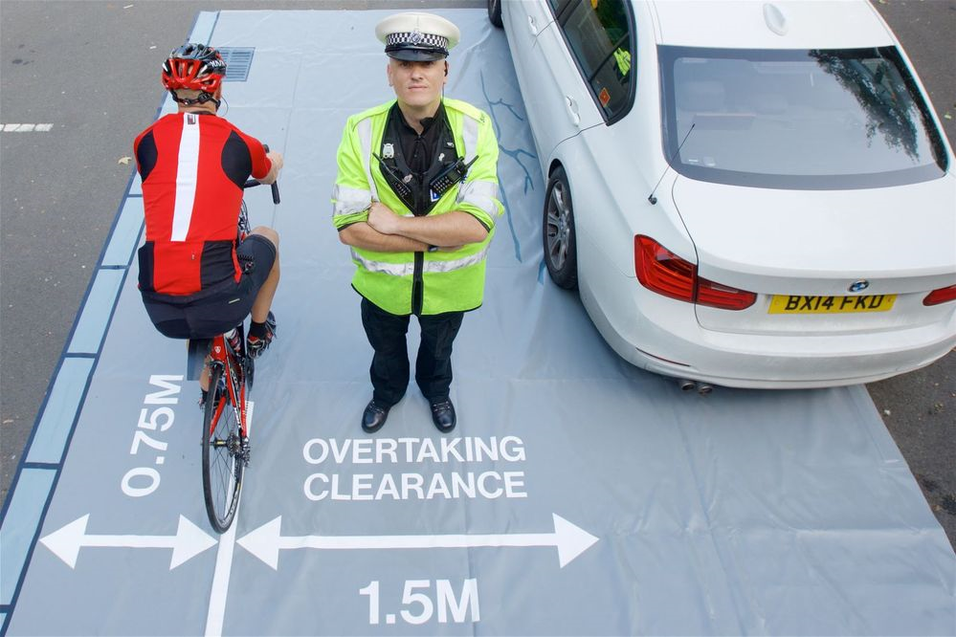

When passing cyclists:
Be Patient – wait until it is safe to pass
Pass Wide – a minimum of 1.5m
Pass Slow – remember cyclists have no protection
Overtaking Cyclists

