Slide 1
COVID 19 Social Distancing in the Workplace 1m distance
Temp amended Visual Standards by product / process

Slide 2







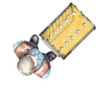


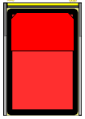
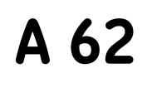
Tactical Conveyor system for parcel processing
Safety and Maximum Weights
Adhere to SSOW and SOP’s.
York = 250kg.
Parcel = 20kg (with assisted lift).
Set-up
Ensure the work area is as per the 5s standard and adhering to safe distances.
Quality
Mis-streaming = 0%
Missorts = Less than 0.2%
York cards match content = 100%
Visual aids used (1 per selection)
Tracked not to be mixed T24/T48 or with non-tracked parcels.
Max dimensions = 640x460x460mm
Minimum 1 metre distance (social distance guidelines) must be followed at all times.
Gloves to be worn where practicable and cleaning/sanitising stations made available.
Version Control
Approval Date = 25.06.2020
Issued by: Matt Kelly
Temporary due to Coronavirus.
Minimum Standards
2.0m gap
B
B
2.0m gap
B
A
C
A
D
C
C
D
C
Handover selection
C
C
C
Observe social distancing guidelines allowing minimum 1 metre distance between operators.
Visual Aids
(1 per selection)
Minimum 1.5 metre gap surrounding area
People (incl. efficiency calc)
A = Induct (number to allow minimum social distancing guidance)
B = Primary sorters (x3)
C = Secondary sorters (to observe 1m distance)
D = Porters (maintaining 1m gap)
Equipment
Powered Conveyor (x1)
Gravity conveyors (x4)
York selections (as per PSSA)
York cards and visual aids
Hand scanners (1 per induct operator)
100 nested York’s
Waste bin
Multiple Area
TM covers up to 2 machines
WAM covers multiple areas
Porters cover multiple areas and operate continuously to maintain flow to and from area. 1 metre social distancing must be adhered to.

Slide 3
Volumetric conveyor system for parcel processing
Safety and Maximum Weights
Adhere to SSOW and SOP’s.
York = 250kg.
Parcel = 20kg (with assisted lift).
Set-up
Ensure the work area is as per the 5s standard and adhering to safe distances.
Quality
Mis-streaming = 0%
Missorts = Less than 0.2%
York cards match content = 100%
Visual aids used (1 per selection)
Tracked not to be mixed T24/T48 or with non-tracked parcels.
Max dimensions = 640x460x460mm
Minimum 1 metre distance (social distance guidelines) must be followed at all times.
Gloves to be worn where practicable and cleaning/sanitising stations made available.
Version Control
Approval Date = 25.06.2020
Issued by: Matt Kelly
Temporary due to Coronavirus.
Minimum Standards
A
B
B
B
VMS
C
A
C
C
C
D
D
C
C
C
Visual Aids
(1 per selection)
Observe social distancing guidelines allowing minimum 1 metre distance between operators.
Minimum 1.5 metre gap surrounding area
People (incl. efficiency calc)
A = Induct (number to allow minimum social distancing guidance)
B = Primary sorters (x3)
C = Secondary sorters (to observe 1m distance)
D = Porters (maintaining 1m gap)
Equipment
Powered Conveyor (x1)
Gravity conveyors (x4)
York selections (as per PSSA)
York cards and visual aids
100 nested York’s
Waste bin
Multiple Area
TM covers up to 2 machines
WAM covers multiple areas
Porters cover multiple areas and operate continuously to maintain flow to and from area. 1 metre social distancing must be adhered to.

Slide 4
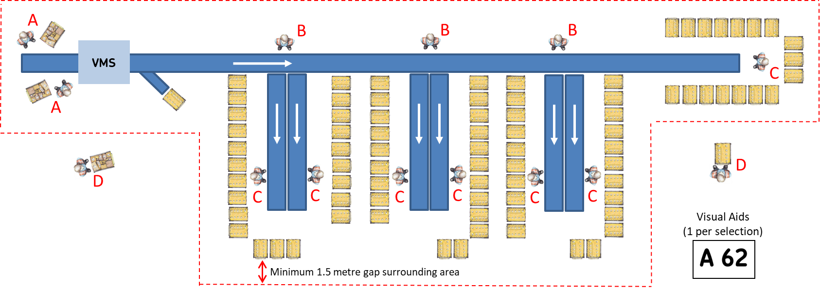
Volumetric conveyor system for parcel processing – utilising additional gravity chutes
Safety and Maximum Weights
Adhere to SSOW and SOP’s.
York = 250kg.
Parcel = 20kg (with assisted lift).
Set-up
Ensure the work area is as per the 5s standard and adhering to safe distances.
Quality
Mis-streaming = 0%
Missorts = Less than 0.2%
York cards match content = 100%
Visual aids used (1 per selection)
Tracked not to be mixed T24/T48 or with non-tracked parcels.
Max dimensions = 640x460x460mm
Minimum 2 meter distance (social distance guidelines) must be followed at all times.
Gloves to be worn where practicable and cleaning/sanitising stations made available.
Version Control
Approval Date = 24.03.2020
Issued by: Matt Kelly
Temporary due to Coronavirus.
Minimum Standards
2.0m gap
2.0m gap
2.0m gap
Observe social distancing guidelines allowing minimum 2 metre distance between operators.
People (incl. efficiency calc)
A = Induct (number to allow minimum social distancing guidance)
B = Primary sorters (x3)
C = Secondary sorters (x2 per bullring max)
D = Porters (maintaining 2m gap)
Equipment
Powered Conveyor (x1)
Gravity conveyors (x4)
York selections (as per PSSA)
York cards and visual aids
100 nested York’s
Waste bin
Multiple Area
TM covers up to 2 machines
WAM covers multiple areas
Porters cover multiple areas and operate continuously to maintain flow to and from area. 2 metre social distancing must be adhered to.

Slide 5

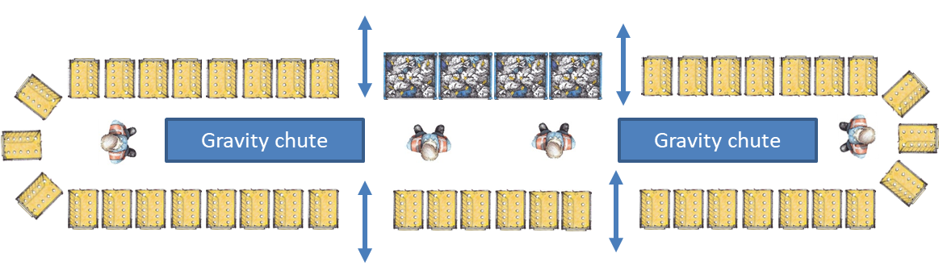
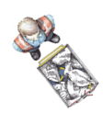
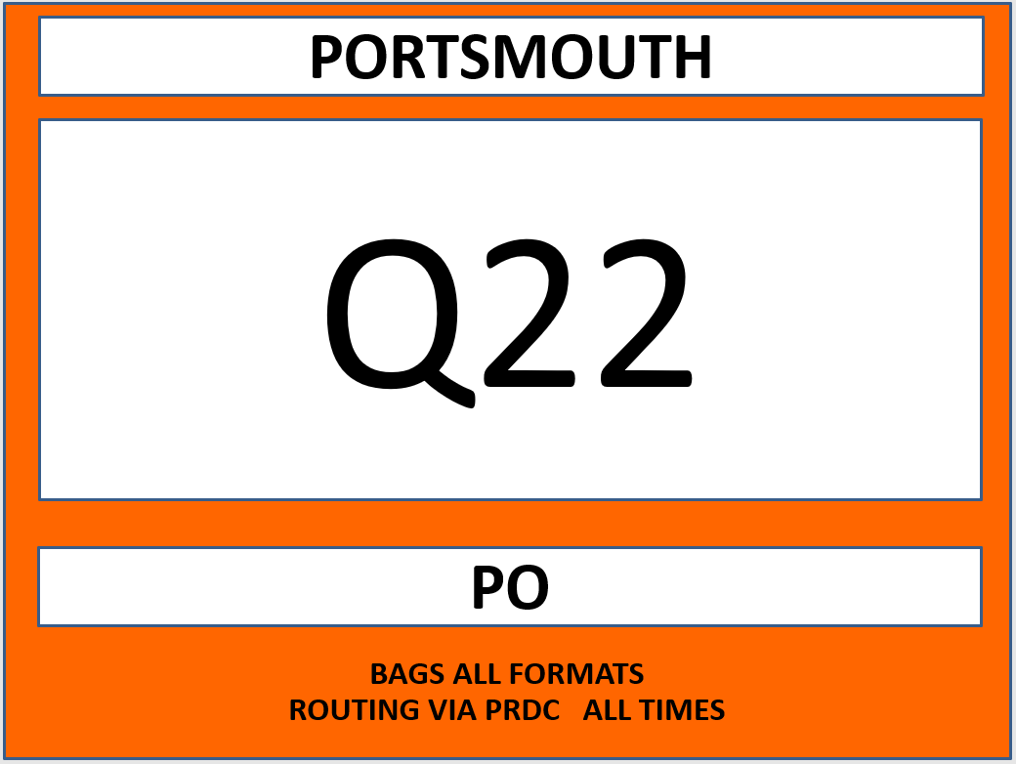
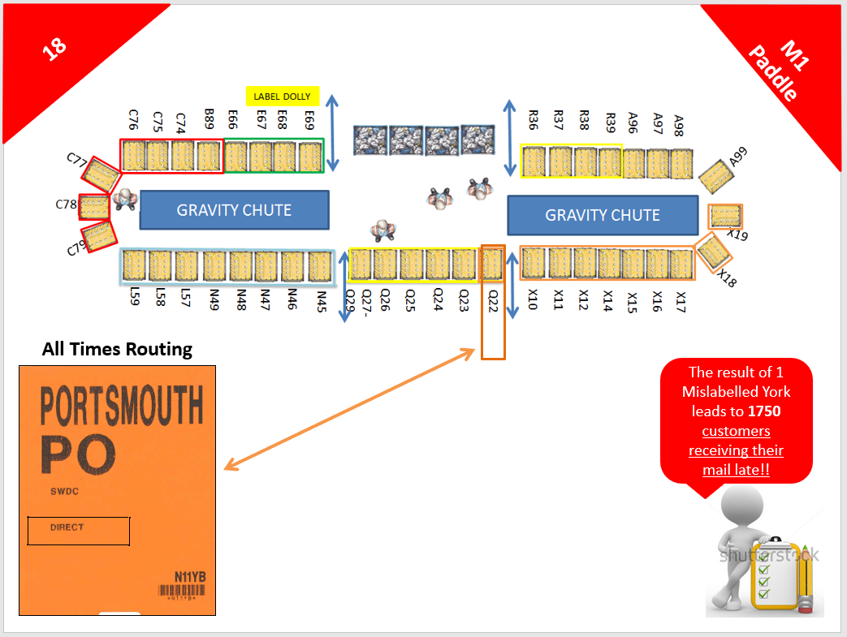
Mailsort: Sortation Area
Safety
Adhere to SSOW and SOP’s.
Do not throw bags.
Maximum weights
RSC = 750kg
York/APL = 250kg
Bag = 11kg
Tray = 10kg
Bundle = 10kg
Set-up – Ensure the work area is set as per the 5s standard and adhering to safe distances.
5s Checks completed each shift.
Quality
Mis-streaming = 0%
Missorts = Less than 0.2%
York cards match content = 100%
Visual aids (1 per selection)
M1 all formats in one bullring
M2/Econ processed together with separate bullrings for bags/bundles, trays.
Version Control
Approval Date = 25.06.2020
Issued by: Matt Kelly
Temporary due to Coronavirus.
C
Minimum Standards
D
D
A
B
B
1.5 metre gap surrounding area
Access/Egress
Observe social distancing guidelines allowing minimum 1 metre distance between operators.
Visual Aids (1 per selection)
People (incl. efficiency calc)
Total = 7 to 10 + 2 porters
A = Primary sortation (x2)
B = Secondary sortation (x2)
C = Hand pallet/PPT (x1)
D = Porters (maintaining 1 metre gap).
Equipment
42 York selections (Agreed direct MC sortation)
Gravity conveyors (x2)
Hand pallet or PPT x1
York cards and visual aids
50 nested York’s
Waste bin
Gloves provided where applicable.
Multiple Area
WAM covers multiple processing areas
Porters cover multiple areas and operate continuously to maintain flow to and from area. 1 metre social distancing must be adhered to.

Slide 6
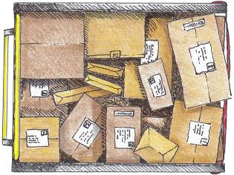
Tracked Returns: Sortation Area – not utilising conveyor system
Safety
Adhere to SSOW and SOP’s.
Do not throw items.
Maximum weights
York/APL = 250kg.
Parcel 20kg (assisted lift).
Set-up – Ensure the work area is set as per the 5s standard and adhering to safe distances.
5s Checks completed each shift.
Quality
Mis-streaming = 0%
Missorts = Less than 0.2%
York cards match content = 100%
Visual aids (1 per selection).
Version Control
Approval Date = 25.06.2020
Issued by: Matt Kelly
Temporary due to Coronavirus.
Minimum Standards
Unprocessed items
Unprocessed items
Customer selections
Customer selections
Customer selections
Customer selections
1 metre distance
A
A
B
Single operator per area
Single operator per area
Customer selections
Observe social distancing guidelines allowing minimum 1 metre distance between operators.
Area is set up according to number of selections, which vary between plants.
People (incl. efficiency calc)
A = Sortation (x1 per area
B = Porters (maintaining 1 metre gap).
Equipment
Relevant number of customer selections
PDA Scanner (1 per operator)
York cards and visual aids
Minimum 50 nested York’s shared across areas
Waste bin.
Gloves provided where applicable.
Multiple Area
WAM covers multiple processing areas
Porters cover multiple areas and operate continuously to maintain flow to and from area. 1 metre social distancing must be adhered to.

Slide 7
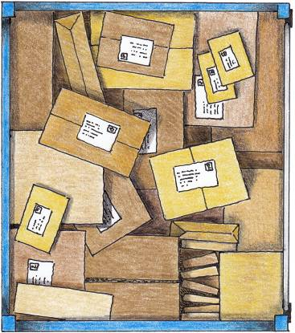
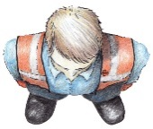

Unloading Vehicles onto Boom Conveyor
Minimum standards
Rear of trailer
Safety
Adhere to SSOW and SOP’s.
York = 250kg.
Parcel = 20kg (with assisted lift).
Set-up
Ensure the work area is as per the 5s standard and adhering to safe distances.
Extend Boom in to trailer, press belt start button to activate, and place items from the rear of the trailer on to the conveyer. Move boom further in to vehicle as required. When trailer is empty, press stop button and return to parked position.
Check dimensions of parcel and ensure that parcels are placed on to conveyer belt Tracked label side up.
Version Control
Approval Date = 25.06.2020
Issued by: Matt Kelly
Temporary due to Coronavirus.
A
1 metre distance
A
Key
Boom
Induct
People (incl. efficiency calc)
A = Induct (number to allow minimum social distancing guidance)
Equipment
Boom Conveyor (x1)
Hand scanners (1 per induct operator)
Multiple Area
TM covers up to 2 machines
WAM covers multiple areas
Porters cover multiple areas and operate continuously to maintain flow to and from area. 1 metre social distancing must be adhered to.

