Slide 1
Fire Safety Focus

Slide 2
Fire Safety Focus
The purpose of Fire Safety Week is to help raise awareness of the Person In Controls roles and responsibilities and the important part they play in the management of fire safety on their sites, This is to ensure our legal requirements are met and to ensure our employees and visitors to the property are kept safe at all times.
Fire Safety Week highlights the requirement for an annual review of the Operational Fire Risk Assessment and ensures that all actions highlighted within this are undertaken and recorded as required.
The following slides will give some context around the types of issues PiCs can expect to deal with. These are a selection of issues highlighted in the Technical Fire Risk Assessors.

Slide 3
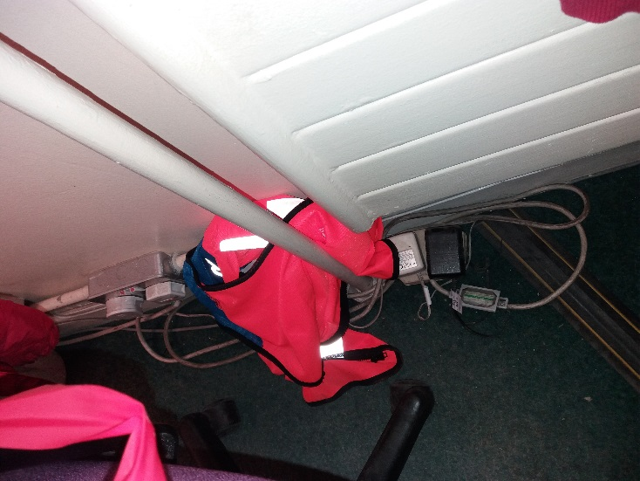
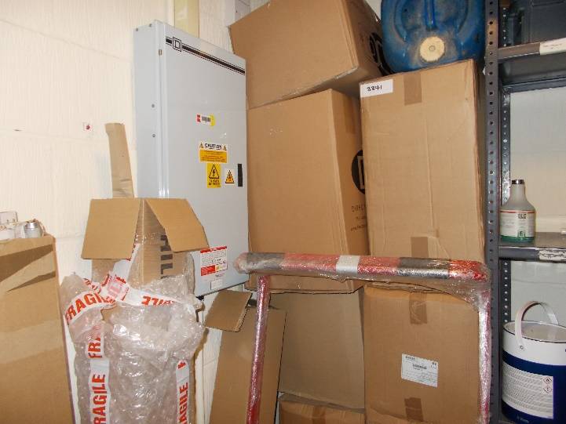
Electrical Sources of Ignition
Learning Points
Do not daisy chain extension leads
Reduce Combustibles and store away from heat sources

Slide 4
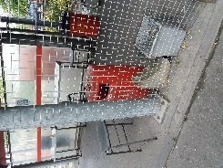
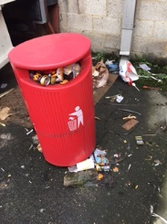
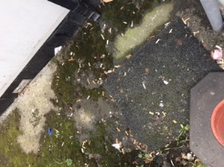
Smoking
Learning Points
Observe behaviours near smoking shelters. Is good housekeeping being observed

Slide 5
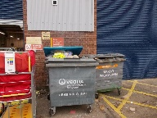
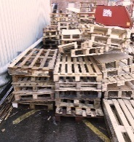
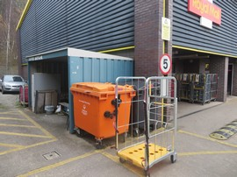
Arson / Wilful Fire Raising
Learning Points
Do not allow a build up of waste around your site.

Slide 6
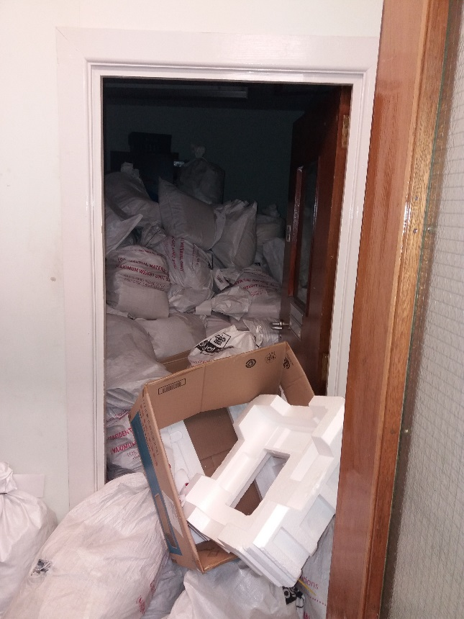
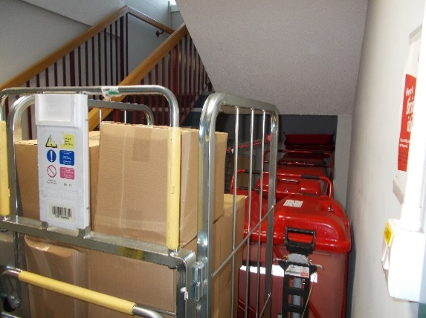
Housekeeping
Learning Points
Ensure all stairwells are clear of obstructions
Plant and Electrical rooms must be free of all storage.

Slide 7
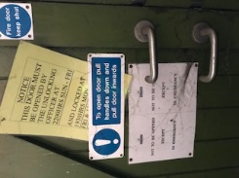
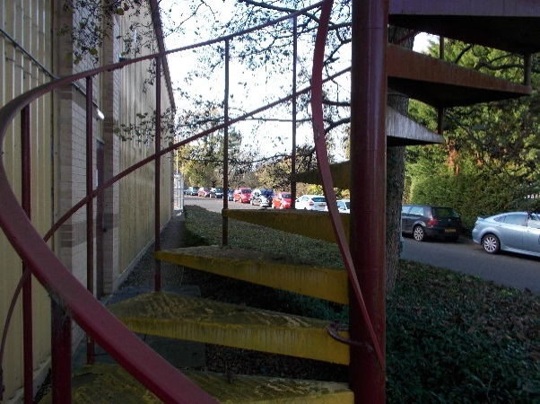
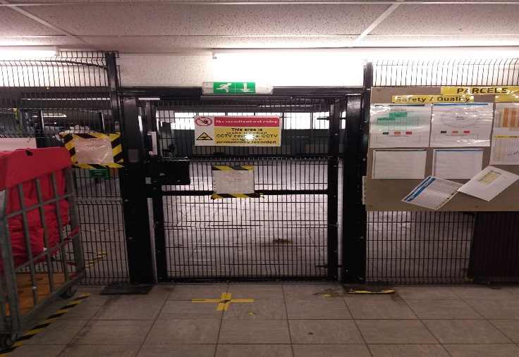
Means of Escape From Fire
Learning Points
Too many signs can be confusing
All escape routes must be maintained and emergency access doors and exits available for use and checked for access.

Slide 8
Management of Fire Safety General management requirements
Fire Safety Evacuation Plans – Must be uploaded to the CRD
Ensure sufficient number of fire wardens, Fire Warden Training is available through PSP.
Operational Fire Risk assessments to be uploaded to the CRD
Cooperation and coordination must take place between unit managers and shared sites
Record keeping of fire alarm weekly tests and emergency lighting monthly tests must be kept in the Site Log Book (forms available on CRD)
Notes:
P&FS Employees can access Fire Warden Training through Citric access

Slide 9
PiC Tasks
PiCs must complete the Operational Fire Risk Assessment as highlighted in the SHE calendar for July
Each Operational Fire Risk Assessment has an action plan attached and these actions must be closed or managed.
Once complete PiCs should upload this to the CRD property.records@royalmail.com

Slide 10
PiC Tasks:-
Check the Fire Evacuation Plan and any Personal Evacuation Plans to ensure that they in date and have been revised in the last 12 months. Discuss these with site Fire Wardens as they will use these plans in an emergency. Ensure these are then uploaded to the Compliance Records Database (CRD) property.records@royalmail.com
Make sure all staff have read and understood the plans and what is required of them in the event of an evacuation. Point out emergency evacuation routes and ensure staff are aware of routes required to use in an emergency. Use the “Staff Update Training Operations” slides and record fire safety training in the Site Log Book.
With the Coronavirus restrictions full evacuation exercises are postponed until there is a lifting of requirements. PiCs should ask individuals or small groups what they would do in the event of a fire, how they would leave the building safely and where they would assemble and record this in the site log book to satisfy this requirement.

