Slide 1
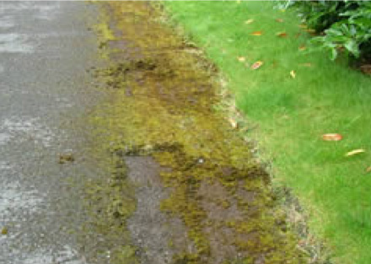
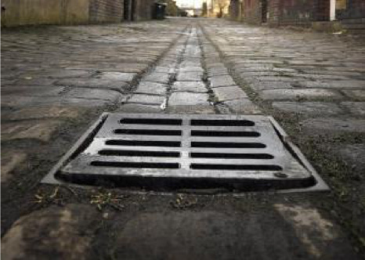
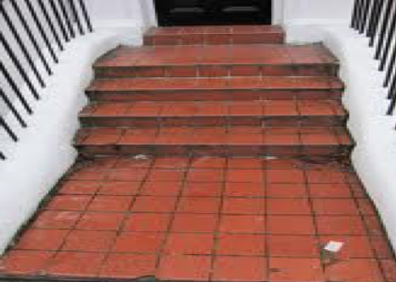
Slips, Trips & Falls Outdoors –
Be Hazard Aware

Slide 2
Slips, Trips & Falls Indoors
Be hazard aware
Keep work areas clear and tidy
Return equipment to designated place
Don’t leave containers/tools/belongings on the floor
If you see a hazard sort it if its safe to do so or report it to a manager

Slide 3
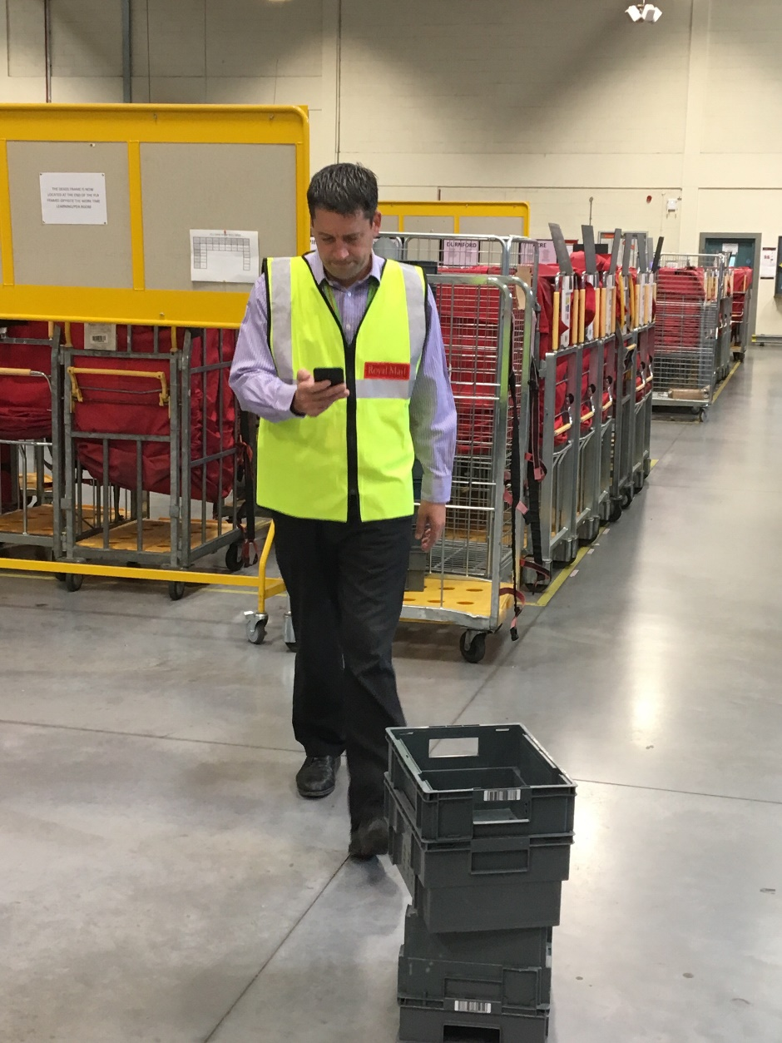
Slips, Trips & Falls
Don’t read and walk!
Look where you are going
Look ahead for hazards so you can avoid slips and trips
If you see a hazard sort it if its safe to do so or report it to a manager

Slide 4
Slips, Trips & Falls
Dynamic Risk Assessment – Look, Consider, Decide
Look for Hazards
Consider the Risk
Decide what to do Safely

