Slide 1




Because Healthy Minds Matter
Stress Risk Assessment Survey
Trial Launch
Dan Clarke – Group Health and Wellbeing Development and Systems Manager

Slide 2
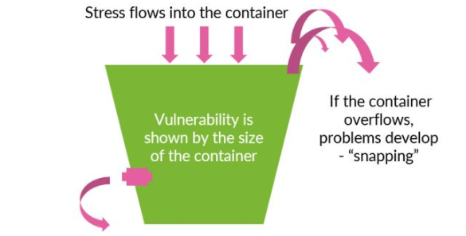
What is Stress?
Our body’s response to pressure.
Everyone’s response is different.
Stress can be positive.
Distress can negatively impact our physical and mental health.
Home life, as well as work life can both be contributing factors.
Notes:
What contributes to stress can vary hugely from person to person and differ according each persons circumstances.
Sometimes, stress can be an appropriate, or even a positive reaction. The feeling of ‘pressure’ can help us achieve in certain nerve-wracking or intense situations, like public speaking, moving house, or completing a difficult piece of work.
Usually we can quickly return to a resting state without any negative effects on our health if the stress we feel is short-lived - and many people are able to deal with a certain level of stress without any lasting effects.
There can be times when stress becomes excessive and too much to deal with. If we are repeatedly in a state of stress, often over a period of time, the effects can result in wear and tear on the body. Rather than helping us achieve things, this pressure can make us feel in a permanent state of distress and unable to cope and it can impact on both physical and mental health.
What is going on in peoples personal lives, as well at work can both effect stress levels – not always in the same way. What causes stress to someone at home, might not impact them in the same way at work – e.g. time pressure to hit a deadline.

Slide 3
The data is compelling
Stress in society
According to a Mental Health Foundation study in 2018:
3 out of 4 people were 'overwhelmed or unable to cope’ during the last year.
46% reported stress caused them to eat unhealthily and 29% turned to alcohol.
51% of adults who felt stressed reported feeling depressed.
1 in 3 adults said they had experienced suicidal feelings as a result of stress.
Mental Health at RMG
Mental health continues to be our largest absence category of all long-term sickness absence.
Mental health absence is more likely to be long term in nature.
Stress accounts for more than half of all mental health related absences.
Calls to First Class Support Helpline increased 20% in 2018/19.
Sources of problems reported: 47% Home, 25% Work and 28% Home and Work.
Relationships, money worries, physical health and caring responsibilities main contributing factors to home related issues.
Work related stress and bullying and harassment both areas of concern in work.

Slide 4
Activity to date…
Signing of the Time to Change Pledge between RMG and CWU;
Developed 5 mental health support videos with Mental Health Foundation;
Introduced the Mental Health First Aid Awareness one day course;
Launch of the Stress Toolkit;
Launched the five-year strategy and underpinning plan ‘Because Healthy Minds Matter;
Created the ‘Because Healthy Minds Matter’ mental health e-learning;
Mental health support z-cards sent into all units;
Launched a Mental Health Ambassador Pilot of 160 ambassadors;
Agreed an approach to upskilling 5,500 physical first aiders to include mental health first aid;
Increased promotion of our “Feeling First Class” and “Employee Assistance” programmes;
Continued activity through our mental health charity partnerships including the ‘Everyday People’ video;
Notes:
Time to Change Pledge – 2014
MH Foundation Videos – 2016
MHFA Awareness Course – 2016
Stress Toolkit – 2016
MH Strategy – October 2017
MH Elearning – 2017
MH Z-Cards – 2017
Everyday People MH Video – 2017
MH Ambassador Pilot – 2018
Upskilling Physical First Aiders – From 2019

Slide 5
Preventing and Managing Workplace Stress
October 2016
Launch of the Stress Toolkit:
Individual Stress Risk Assessment Process and guidance; and
The Online Stress Tool
Aim:
Minimise the risk of individual stress-related illness or injury through:
Signs of individual stress identified or an employee is absent with Stress/Stress related condition.
Individual and line manager complete a Guided Conversation for Stress.
Cause/s of stress identified and supporting action plan in place where required.
Follow up schedule agreed and actions reviewed against plan.
Re-assessment activity where mutually agreed.
Support available:
HRSC Advice and Support.
First Class Support helpline.
SHE Team.
H&W Intranet pages and on PSP.

Slide 6
Preventing and Managing Workplace Stress
Health and Safety Executive (HSE) Workplace Stressors
To help workplaces work together to address stress the HSE has identified six key areas (or ‘risk factors’) that can be causes of work related stress.
Change
Demands
Stress
Role
Control
Relationships
Support

Slide 7
Preventing and Managing Workplace Stress
Health and Safety Executive (HSE) Workplace Stressors
To help workplaces work together to address stress the HSE has identified six key areas (or ‘risk factors’) that can be causes of work related stress.
Workplace Stressor | HSE Definition Includes
The demands of your job | Workload; work patterns; and the working environment.
Your control over your work | How much say the person has in the way they work.
The support you receive from managers and colleagues | The encouragement and resources provided by the organisation, line management and colleagues.
Your relationships at work | Promoting positive working practices to avoid conflict and dealing with unacceptable behavior.
Your role in the organisation | Whether people understand their role within the organisation and do not have conflicting roles.
Change and how its managed | How organisational change is managed and communicated

Slide 8
Individual Stress Risk Assessment
The Stress Toolkit (available via H&W Intranet Pages):
Preventing and Managing Stress Guide.
Stress Flow Chart.
Guided Conversation for Stress (Individual Stress Risk Assessment).
Online Stress Tool (35 questions relating to six workplace stressors)
(Using the HSE Management Standards for stress through the Feeling First Class website ).

Slide 9
Introducing: Stress Risk Assessment Survey
What is it?
An addition to the existing Stress Toolkit.
Use to identify, assess and introduce controls to prevent and/or manage workplace stress.
Works by using the same 35 questions of the individual stress risk assessment survey
Allows multiple people to complete the survey
Combines all responses to give a better view of the level of workplace stress that exists.
When should it be used?
To be used when a need is identified:
Evidenced through people metrics (absence, engagement, grievances, employee retention);
Through receipt of feedback;
Part of workplace best practice; or
Any other reason!
Who can use it?
To be agreed locally – suggest all roles responsible for the health and wellbeing of employees – E.g. Line/Office Manager, Workplace Coach, Health and Safety Lead, Union Representative, HR Business Partner.

Slide 10
Process - Stress Risk Assessment Survey
1
A need is identified (e.g. H&S Audit; relevant HR data; or verbatim feedback).
Ensure all relevant stakeholders (e.g. Management team, Union Representatives, Field HR) are informed who agree and plan activity including agreeing a survey coordinator.
Coordinator could be DOM, WAM, MCM, H&S Lead, ASR Rep, IR Rep, HRBP.
(Health and safety escalation process to be followed if required.)
Engage with employees:
Introduce activity, the process and timescales (may include managing expectations).
Questionnaires supplied and completed (during WTLL / returned to agreed person).
Responses submitted into collation tool – all completions anonymous.
Use tool to analyse results. Share and discuss survey results with employees.
Agree an action plan and timelines with employees and local stakeholders.
Regularly review the plan and progress against agreed actions.
Repeat survey process as appropriate and agreed.
2
3
4
5
6
7
8
Sharing survey outcomes and identifying improvements with employees is vital.
Data can give a broad indication of underlying issues but if you want to know what is affecting employees, you have to ask them.

Slide 11
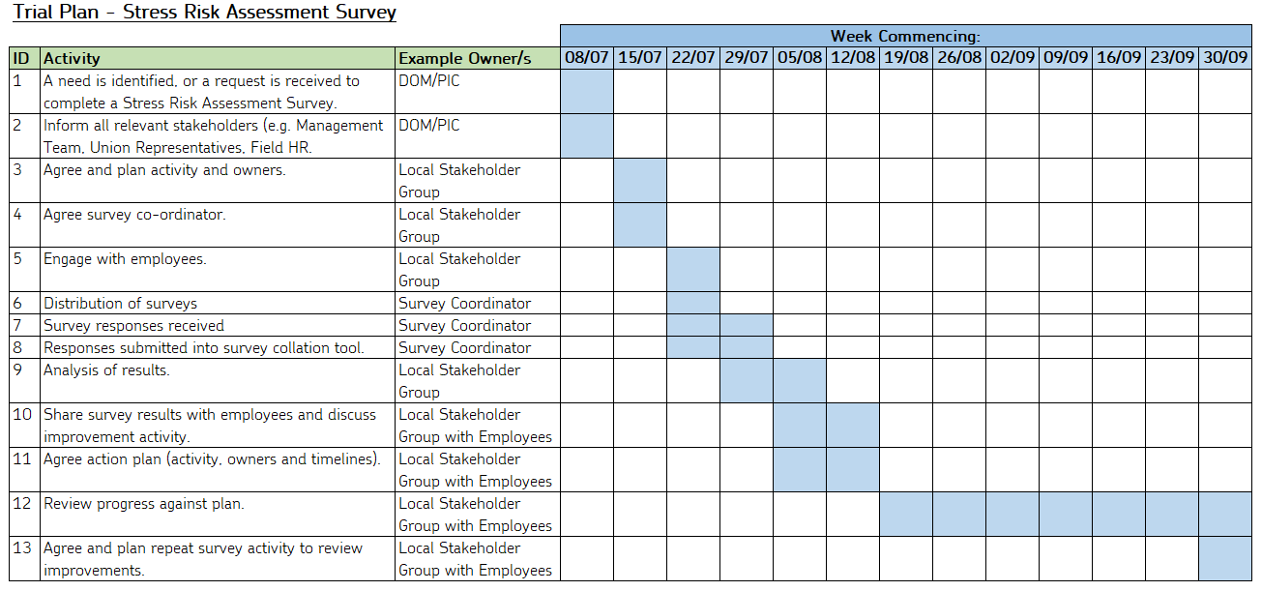
Trial Plan Example

Slide 12
Stress Risk Assessment Survey: Materials
Example Trial Plan:
Instruction Manual:
Stress Risk Assessment Survey:
Survey collation tool (template and completed example):
Survey action plan template:

Slide 13
Trial units and timeline
In the following workplaces - CWU Grades will participate in the Trial:
Taunton MPU (TA)
Crewe DO (CW)
Newcastle Under Lyme DO (ST)
Cheadle DO (ST)
Lincoln DO (LN)
Blair Gowrie DO (PH)
Cardiff Mail Centre (CF)
Northern Ireland Mail Centre (BT)
Exeter Mail Centre (EX)
Exeter LD (Parcelforce Worldwide) (EX)
Medway LD (Parcelforce Worldwide) (ME)
Additionally, Unite/CMA have nominated three Offices/Sectors where Managers will participate
in the Trial:
Swindon Mail Centre Nights (Management team)
Manchester Delivery Sector (Management team)
ML/KA Glasgow Delivery Sector (Management team)
Trial launch date – w/c 8th July 2019.
Planned trial end date – w/c 30th September 2019 (dependant on trial progress).
Trial Post Implementation Review (PIR) – October 2019 (dependant on trial end date).

Slide 14
Next steps
Familiarise yourself with trial requirements, process and materials.
Working group to discuss and agree plan activity and timelines.
Decide, engage and brief any additional stakeholders (e.g. HR Business Partners / Attendance Coaches / Union colleagues).
Inform your operational leadership team of the trial activity.
Utilise each other.
Further ‘catch up’ conference calls will be scheduled.
Ongoing support is available – please do ask any questions you may have.
Email: dan.clarke@royalmail.com
Mobile: 07718098179

Slide 15
Questions?

Slide 16
Appendices:
Existing Health and Wellbeing support available in RMG

Slide 17
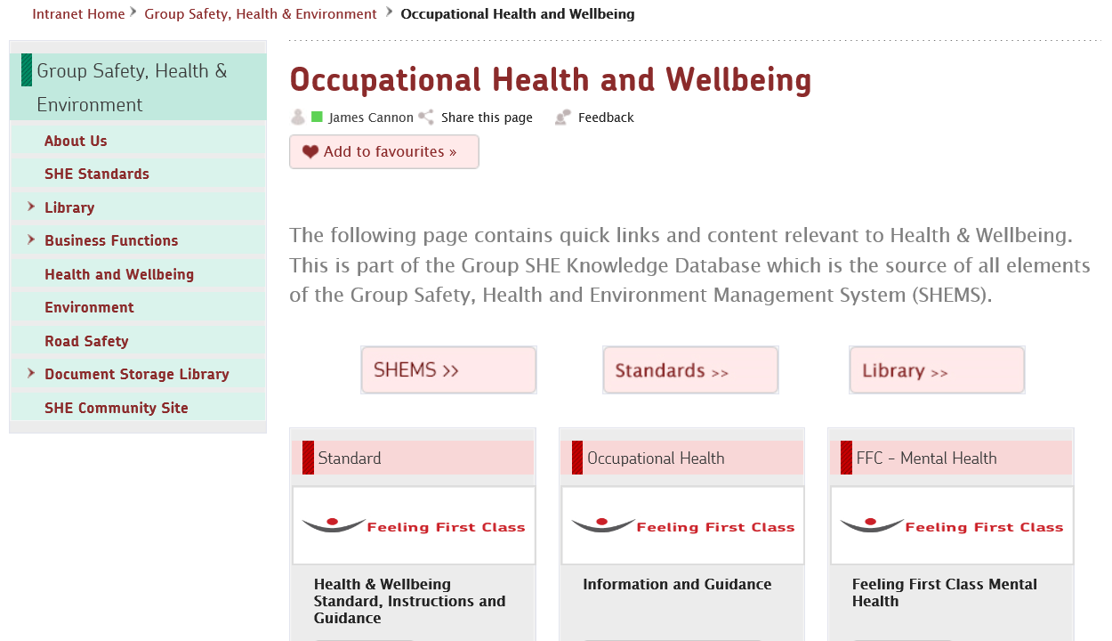
What existing support is available at RMG?
Health and Wellbeing Intranet Pages
https://intranet.royalmailgroup.com/HealthSafety/Pages/Health-and-Wellbeing.aspx
Intranet Home > Group Safety, Health and Environment > Health and Wellbeing

Slide 18
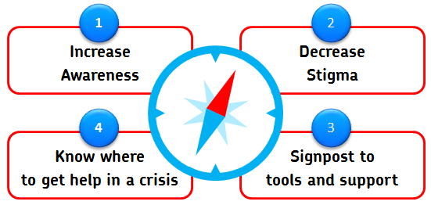
Mental Health ‘Because Healthy Minds Matter’
Within RMG the top three mental health conditions are Stress, Depression and Anxiety.
Our mental health strategy launched in October 2017 ‘Because Healthy Minds Matter’ is supported by a comprehensive plan and focuses on four key elements:
Remember to ACT
Acknowledge
If you or someone close to you isn’t their “usual” self.
Communicate
If you are not feeling okay speak to someone about it. If you are worried about someone else, ask them if they are okay and encourage them to talk and take time to listen.
Take Action
Find out what support is available and encourage others to do the same.

Slide 19
Mental Health ‘Because Healthy Minds Matter’
Signposting to support
First Class Support: www.rmgfirstclasssupport.co.uk (0800 6888777) offering 24/7 free and confidential employee assistance, manager coaching and direct self-serve access to mental health support for all employees.
Manager referred mental health support: can also be accessed for team members via an occupational health referral.
Training: Mental Health Awareness training (1 day classroom based via SucessFactors); and ‘Because Healthy Minds Matter’ mental health awareness eLearning (via SuccessFactors, Feeling First Class or Health and Wellbeing Intranet Pages.
Health & Wellbeing Intranet Pages: Feeling First Class - Mental Health for access to Internal and external mental health support services and guides; Mental Health Awareness course (information and link to SuccessFactors); Toolkit for managers (booklets, posters, advice and promotional material); details of the Online Stress Tool and workplace stress guidance.
Feeling First Class wellbeing website: www.feelingfirstclass.co.uk (use code FFC1 to register) for proactive physical and mental health advice and content as well as the Lifestyle Assessment, Online Stress Tool and access to the ‘Because Healthy Minds Matter’ mental health awareness e-learning. You can also download the Feeling First Class app from both iTunes and the Google Play store.
Rowland Hill Fund: 0345 6004586 www.rowlandhillfund.org offering financial aid to colleagues, pensioners and their families in times of need.
Neyber: Through My Bundle’s Financial Wellbeing option you can access debt consolidation loans and financial education. Log into My Bundle through PSP or visit mybundle.myroyalmail.com.
Stepchange:: Offering expert, tailored advice and practical solutions to problem debt, contact the UK’s leading debt charity on 0800 138 1111 or visit www.stepchange.org.
For urgent support in a crisis: Call the Samaritans on 116 123 (open 24/7) or in a suicide or other emergency situation ring 999 (9999 from a Royal Mail Landline).
If you are worried that someone is at immediate risk of taking their own life you should stay with that person and take one of the following steps:
Encourage them to call the 24/7 phone line Feeling First Class Support or the Samaritans on 116 123 (open 24/7).
Contact their GP for an emergency appointment or the out of hours support service.
Call their Community Mental Health Team (CMHT) if they have one.
Ring 999 (9999 from a Royal Mail Landline), NHS direct (111) or go to the nearest Accident and Emergency (A&E) department.

Slide 20
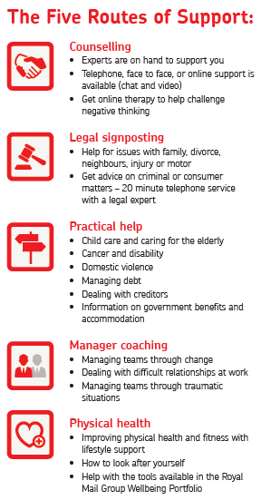


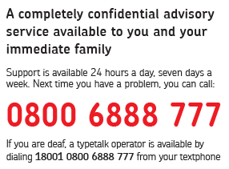

Slide 21
Mental Health ‘Because Healthy Minds Matter’
Services available via the First Class Support Helpline.
Mental Health Support
Direct access to support, including counselling to help with any work-related or personal issues in a non-judgemental and confidential environment. Counselling can be provided by telephone, face to face and on-line (chat or video).
Manager Coaching
Coaching (including role play scenarios) is available for you to support others with their mental health, or when you may need some guidance in approaching a difficult conversation with someone.
Legal signposting
Legal information is available via telephone with an expert (for up to 20 minutes) on a wide range of issues such as family/divorce, personal injury claims, neighbour disputes, criminal, consumer and motor.
Debt Advice and Practical Help
Advice on how to control or clear debts (regardless of size) is available, in addition to helping you to understand government benefits and resolve any accommodation issues. You can also receive guidance on accessing support relating to elder and child care, domestic violence, cancer and disability.
Lifestyle Advice / Physical Health
Receive support to help you make healthier choices, increase physical health and fitness as well as improving work life balance and resilience.
Available for every employee, fully confidential and free to call 24/7.

Slide 22
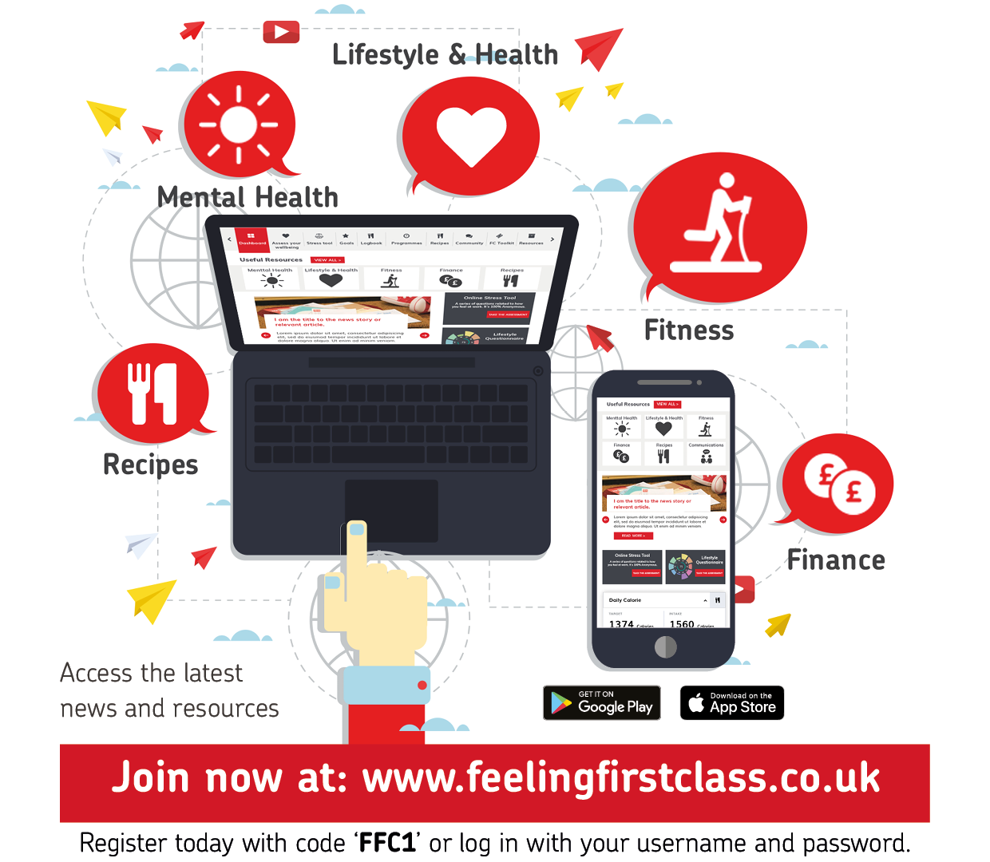
Proactive Health Ownership: Feeling First Class portal
Access proactive physical and mental health advice and content.
Complete a lifestyle assessment questionnaire.
Access and complete the online stress tool.
View recipes and fitness programmes.
Create a personal profile and set and track personal goals.
Download the manager toolkit to help promote health and wellbeing.
You can also download the app onto your phone via the Google Play or iTunes store.

Slide 23
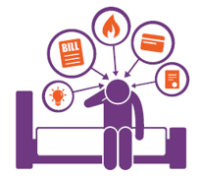
Employee Benefits - Financial Wellbeing
As a responsible employer, the emotional, physical and financial wellbeing of our employees is very important to us.
We want all employees to feel financially confident, healthy and secure, both today and for the future, with the financial freedom to make choices to enjoy life and stay on track to meet their future financial goals.
Why is financial wellbeing important?
The financial pressures of modern life and the increasing cost of living mean many people are worrying about their finances.
Many people don’t have any rainy day savings to help when the unexpected happens such as a washing machine breakdown or car repairs, so a small financial hiccup can result in a downward spiral of debt. Worrying about finances can impact negatively on someone’s everyday life including:
Problems concentrating at work
Stress or other mental health issues
A negative impact on their physical health
Arguments with their partner
Relationship problems with family and friends
How can Royal Mail help?
As well as the financial benefits such as competitive pay and pension, Royal Mail has teamed up with Neyber and StepChange debt charity.
More information about financial wellbeing is available on My Bundle: mybundle.myroyalmail.com.
All of which can lead to absence from work.

Slide 24
Employee Benefits - Financial Wellbeing
Neyber
If you want to build your financial knowledge, or consolidate existing debt Neyber is our partner for financial wellbeing hints, tips and information that can improve your financial knowledge and build a path to a greater stability.
Neyber also provides loans that can help you consolidate your existing debts, focused on helping you feel happier with your finances and could be saving you money on your monthly debt repayments.
The Neyber Financial Wellbeing Hub is a site packed with expert content, tools, and calculators to help you be better with your finances. The Hub covers subjects from improving your credit score to pensions and saving for life’s bigger expenses. Neyber members can also attend monthly webinars to improve their knowledge of key financial topics.
Access is via the employee benefits platform - My Bundle at mybundle.myroyalmail.com.
Worried about debt? – contact StepChange
StepChange Debt Charity is the UK’s largest provider of free independent debt advice and managed solutions. They help thousands of people every week and their service is available to everyone, however big or small their debt problem.
For over 25 years, StepChange Debt Charity has been helping people resolve problems, repay debts and rebuild lives. They understand the causes and see the consequences of debt, but most importantly they know the way out.
They are the UK’s largest provider of genuinely free independent debt advice and managed solutions, helping thousands of people every week deal with problem debt.
Contact via a freephone helpline 0800 138 1111 (Monday to Friday 8am-8pm or Saturday 8am-4pm).
Use their anonymous online advice tool www.stepchange.org/debtremedy.

