Slide 1
Dog Awareness Week 2019

Slide 2
Internal Communications - AVOID
A is for AVOID
Do not take and use dog biscuits, these attract dogs to you. If there is a dog at large and you have to return mail back to the delivery office, you can endorse the mail using a P6705 Sticker.
V is for- Value Yourself
It really could happen to you. In the last financial year there were 2660 dog bites reported. That is over 8 each day. Most people are bitten by a dog they already know. Do not think to yourself “Dogs like me” or “I will be OK”. Do not become a statistic; your health is more important than any need to come into contact with a dog. Value yourself. Follow these key messages.
O is for OBSERVE
Walk Logs are a guide for the post person to know what his/her duty consists of and some key features to help them to do that walk safely, securely and effectively. A hard copy Walk Log must be kept on every Delivery Preparation Frame and updated frequently.
A key point is that Walk Logs must not be overloaded. If there is too much in them, they won’t be used.
I is for INFORM
Mark your frames with a yellow sticker where there is a dog hazard - this will protect your colleagues
D is for DEFEND
If required, defend against a dog bite by using your delivery equipment, such as your pouch or trolley, to create a barrier between you and the dog. Most bites occur on the limbs, so wearing long trousers and sleeves can help protect from serious injury.
Notes:
Internal communication channels will focus on the AVOID message. The WTLL will feature AVOID with daily huddles each day to cover specific topics.

Slide 3
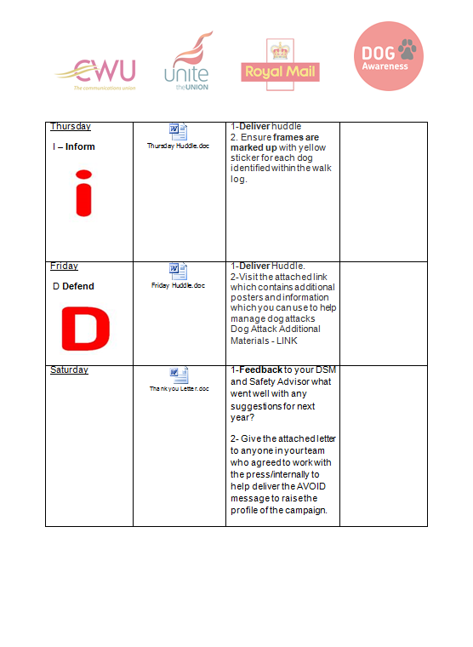
Managers Daily Task List
Notes:
This is the managers

Slide 4
Campaign Board in units
Notes:
This is what we would like to see units put in place. One Allocated Notice Board for the week.

Slide 5
What else can be done
Dog Warden involvement & partnership
Letters to Schools available on the Share point for managers to use
Copies of posters sent to units to be put on the share point so that extra copies can be printed and shared with local businesses, doctors surgeries, vets etc
An ASR checklist has been produced for CWU and CMA and will be sent out by Dave Joyce and Stephen Jones respectively to request their involvement with the week.
Notes:
These are some other activities that units could consider to increase activity across the week.

Slide 6
What else are we doing
There will be an indica on all mail during the week to raise the profile of the week with members of the public
Social Media channels will be used encourage responsible dog ownership
External Comms are working with press agencies to raise the profile of the week and we will be using employee cases studies to get that press coverage
Press Briefing Pack will be available for anyone asked to take part in any interviews of behalf of the SHE team. Permission to talk to media must be sought through - natasha.ayivor@royalmail.com
Notes:
External Comms will be leading on the following topics.

