Slide 1

Property & Facilities Solutions
Risk, Compliance & Assurance
Site Log Book Replacement Programme – Update Jan 19
Gurkan Hasan/Katharine Bate

Slide 2


Introduction
    The Site Log Book & PiC have been
    reviewed in conjunction with each other.
    The aim was to modernise our approach – bringing them into line with Group SHE expectations, Delivery Simplification programme, make it easier to understand & with clear instructions of responsibility.
    Condensing the site log book to contain site specific documents only.
    Remove duplicated information held in the SLB & in the PiC Handbook –
    PiC Roles & Responsibility instructions will be held in the new PiC Handbook.
Property & Facilities Solutions
Property Risk, Compliance & Assurance
Notes:
Deployed as part of the API programme 2018. The SHEM SLB is currently being reviewed to take account of the changes. Why are we changing the SLB?

Slide 3
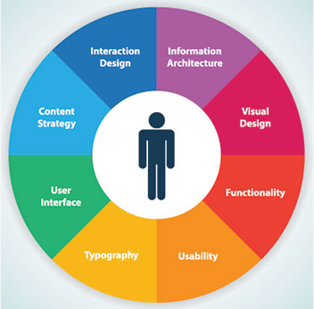
New Site Log Book
We have streamlined the new SLB to improve user accessibility
We have reduce volumes from 6 to 1
Reduced pages from 187 to 48.
Avoided replication of data held on the Compliance Records Database (CRD)
Incorporate the PFS Ltd SLB templates
SLB now contains site specific documents only, with links to CRD/the intranet for generic information/forms
Property & Facilities Solutions
Property Risk, Compliance & Assurance
Notes:
Deployed as part of the API programme 2018. The SHEM SLB is currently being reviewed to take account of the changes.

Slide 4

Additional Benefits
Reduced Printing costs
Reduced environmental impact
(printing and circulating across the estate)
Longer term objective to go paperless (CRD)
    The new version will allow for greater control, rapid updates of content (generic material will be online) and in line with any regulatory changes (Inc CDM Regs)
Property & Facilities Solutions
Property Risk, Compliance & Assurance
Notes:
Cost savings – significant reduction in material required for the SLB

Slide 5

New Site Log Book (SLB) Update
We shared final version of SLB with stakeholders feedback –Jan/Feb 18
    Produced & Deployed the communications (Inc Unions) – Feb to Mar 18
    A programme for SLB deployment has been incorporated as part of the Annual Inspection Programme (API) Oct 18/19 & Sept 19/20.
    To date over 300 sites out of 1600 sites have had the New SLB deployed
    All PiC’s get briefed by NDC on the date of the inspection regarding the new SLB changes and deployment.
    All old SLB information gets archived for upto 3 years then destroyed.
    Access to the New Site Log Book, various templates & briefings are held on the Compliance Records Database (CRD) : https://royalmail.info-exchange.com/Secure/Default.aspx
    If you don’t have access to the CRD, then contact: rmwebsites@ndc-uk.co.uk
Property & Facilities Solutions
Property Risk, Compliance & Assurance
Notes:
Guidance on document retention will be produced and also a database of all the SLB contents, templates, form name, description and details of the forms that have been removed, the reason why and also relevant links to legislation/ standards - Feb 18.

