Slide 1
Slips, Trips and Falls
Dynamic Risk Assessment – Look, Consider, Decide
Look for Hazards | Consider the Risk | Decide what to do Safely
Report all hazards to your Manager
Health & Safety

Slide 2
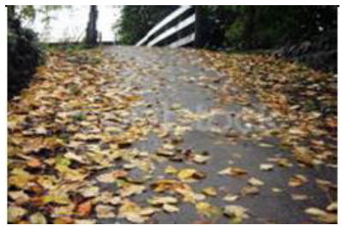
Make the right choices – Slips, Trips and Falls
Look for Hazards | Consider the Risk | Decide what to do Safely
Slips, trips and falls resulting in injuries such as broken bones, bruising and musculoskeletal conditions.
If possible find an alternative route.
Do not read and walk
Do not take shortcuts
Do not rush
Report all hazards to your Manager
Health & Safety

Slide 3
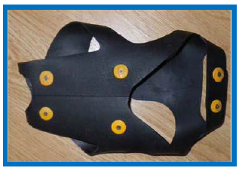
Make the right choices – Slips, Trips and Falls
Look for Hazards | Consider the Risk | Decide what to do Safely
Slips, trips and falls resulting in injuries such as broken bones, bruising and musculoskeletal conditions.
Wear Spikeys in snow and ice
Take shorter steps
If the risk is too great, do not proceed.
Report all hazards to your Manager
Health & Safety

Slide 4
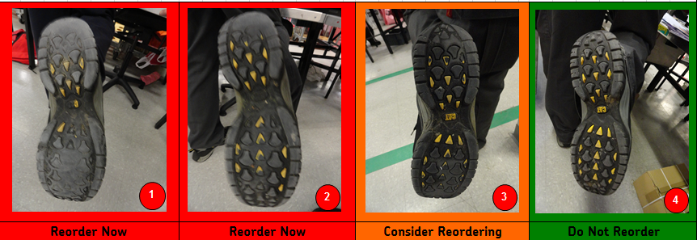
Slips, Trips & Falls – Be Prepared
Footwear must have good tread and be suitable for the role.
Use the RM issue footwear
Use Spikeys when required,
Report all hazards to your Manager
Health & Safety

Slide 5
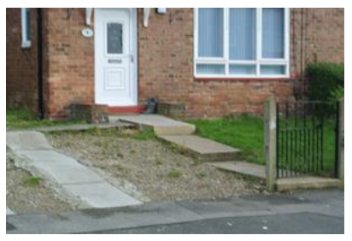
Make the right choices – Slips, Trips and Falls
Look for Hazards | Consider the Risk | Decide what to do Safely
Slips, trips and falls resulting in injuries such as broken bones, bruising and musculoskeletal conditions.
Follow the SSOW at all times
Identify safe routes or suspend delivery if this is not possible.
Report hazards to your Manager
Report all hazards to your Manager
Health & Safety

Slide 6
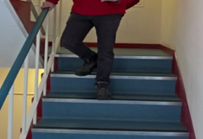
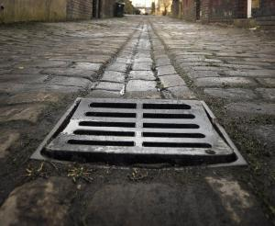
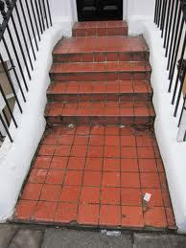
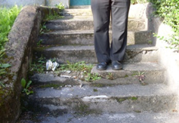
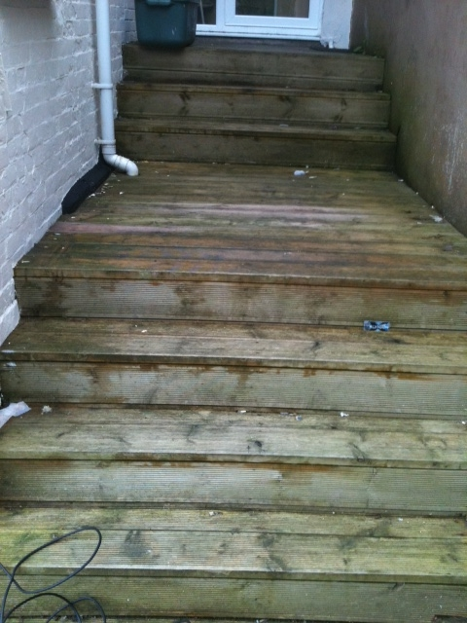
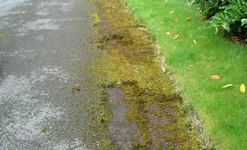
Slips, Trips and Falls – Identify Hazards
Report all hazards to your Manager
Health & Safety

Slide 7
Slips, Trips and Falls – Follow the SSOW
The SSOW (Safe System of Work) shows:
The risks of completing the activity
What to do and what not to do
How to do it
Report all hazards to your Manager
Health & Safety

