Slide 1
Instructions for HIU STF Initiative
ASR/SHE Team HIU Engagement

Slide 2
Did you know we are high impacting for Slips, Trips and Falls?
Our Unit has been selected to support the deployment of an initiative to raise awareness of injuries sustained from Slips, Trips and Falls
Our ASR and SHE Advisor will visit the unit:
w/c_________________________

Slide 3
Script for CWU ASRs
Pre – Attendance at unit
Create the display materials (notice board, mobile boards or minimum standard a flip chart) to be used for presenting (follow the example provided)
CWU ASR to make contact with the Ops manager, DOM inform Workplace Safety Rep to agree the dates to attend the unit for HIU awareness engagement sessions with employees.
Send the Unit Manager the completed information sheet (slide 2) displaying the agreed dates giving min 1 week notice.
Manager or unit Safety Rep to display the information and agreed dates in the unit in advance of attendance.

Slide 4
Script for CWU ASRs
Attending the unit
ASRs work with the Workplace Safety Rep to find an agreed appropriate location in the unit to display flip chart or display materials (the busier the location the better).
Start engaging with employees on 1-2-1 basis or small groups to talk about STF accidents.
Coach employees how to minimize injuries.
Complete the ASR Checklist by speaking with staff and Managers.
Remain in the unit for 3 or 4 days or until all employees have been spoken to.
Leave the materials on display and go to the next planned high impacting unit
ASR to gain commitment from Workplace Safety Rep and manager to maintain the awareness of STF
ASR to complete the STF ASR Activity Feedback Survey Link

Slide 5
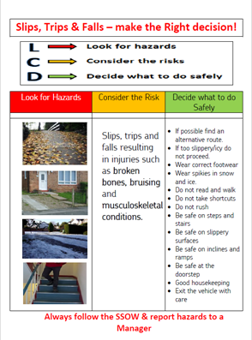
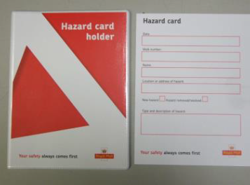
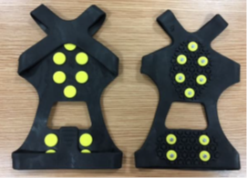
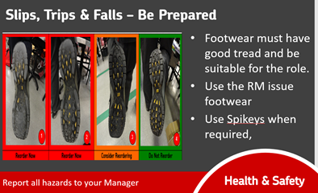
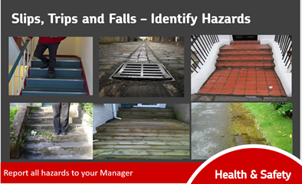
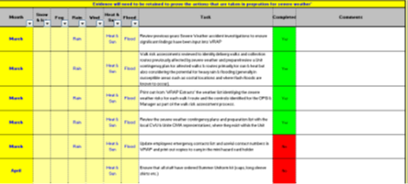
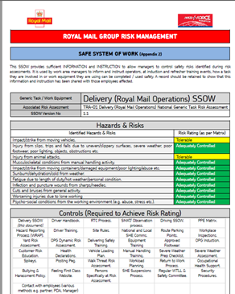
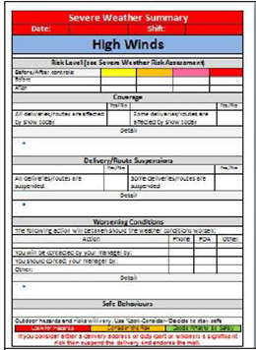
Flip Chart/Board Display:
Display 1 | Display 2 | Display 3
STF Poster: | Hazard card and P6705 stickers | Spikey SSOW & Pair
STF Page(s) – 7 available | STF Page(s) – 7 available | Site SW Prep List
Delivery SSOW | WPQ (example) | SW Notification Brief (example)
Local materials to be included as required.

Slide 6
Script for CMA Unite ASRs and SHE Team
Attending the unit
Agree date with the CWU ASR and Manager
Ensure the STF Manager Checklist has been completed.
Review the Workplace Offsite (WRAP) Standard with the Manager and discuss any gaps
Confirm that the Delivery SSOW has been completed and discuss key elements.
Discuss the process for authorizing and ordering shoes.
Ensure the Severe Weather Preparation List is completed effectively.
Demonstrate the effective use of the Severe Weather tool
Discuss and complete and effective SMAT
Discuss what post-accident countermeasures are implemented e.g. Delivering Safely
Complete the STF ASR Activity Feedback Survey Link

Slide 7
HIU per Delivery Director & Delivery Leader

Slide 8
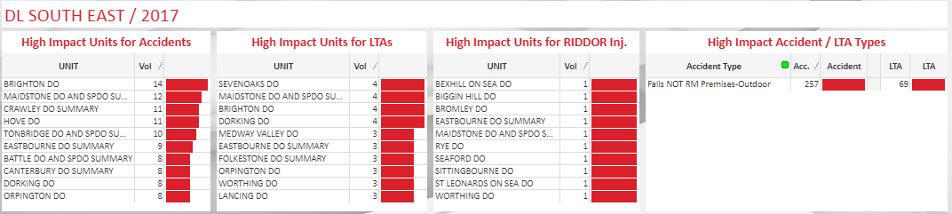
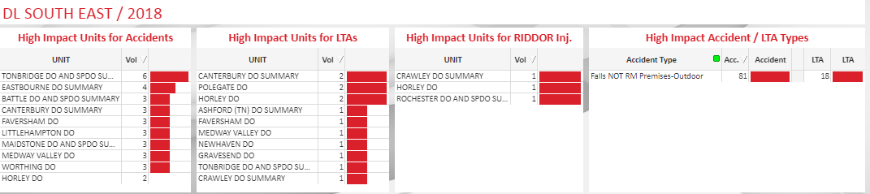

Slide 9
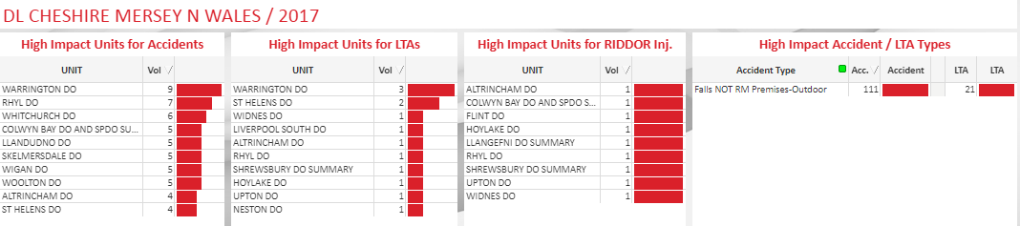
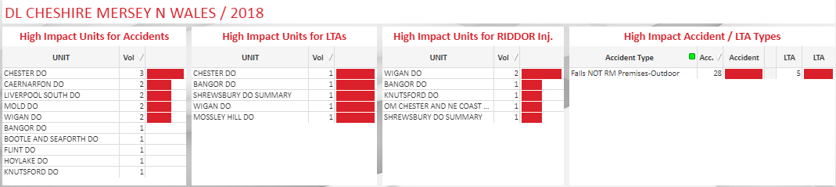

Slide 10
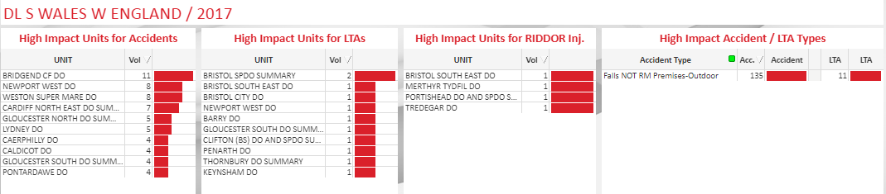
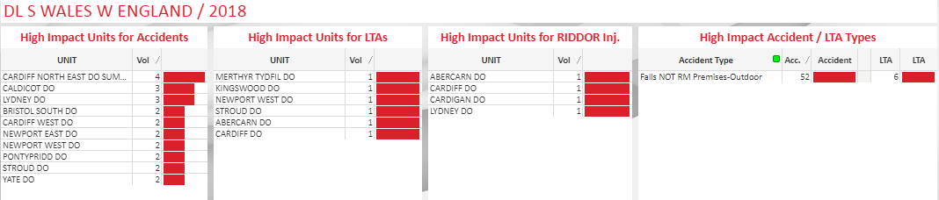

Slide 11
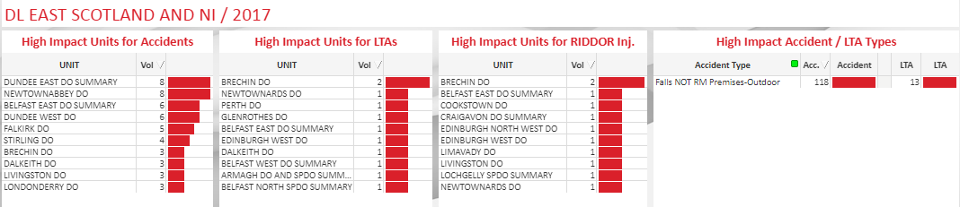
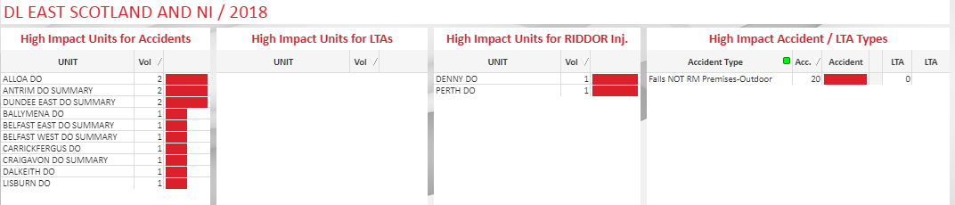

Slide 12
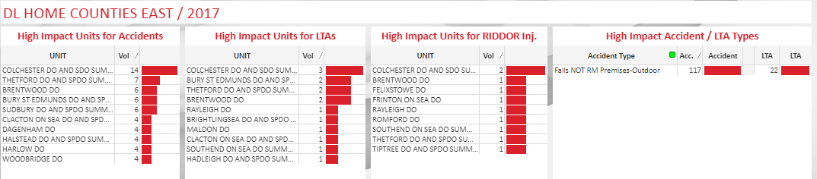
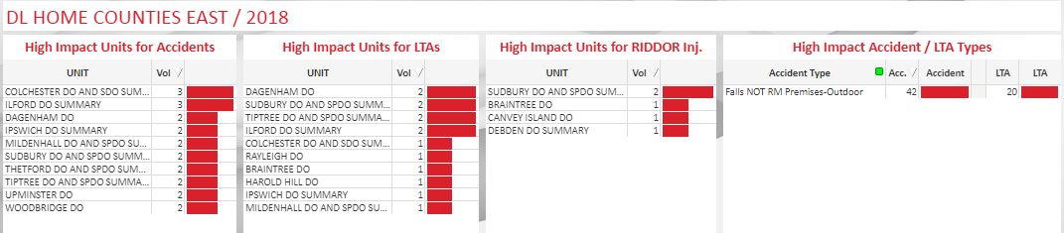

Slide 13
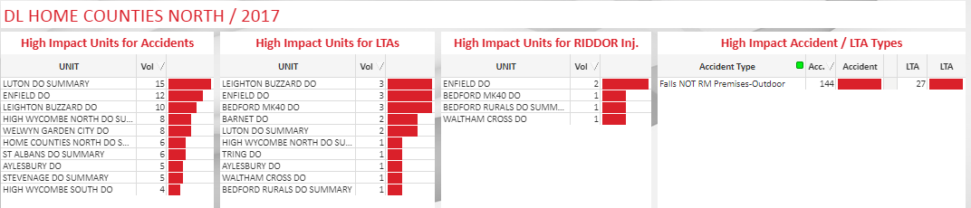
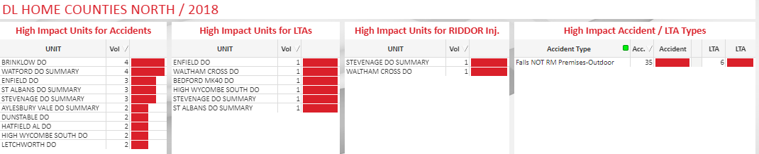

Slide 14
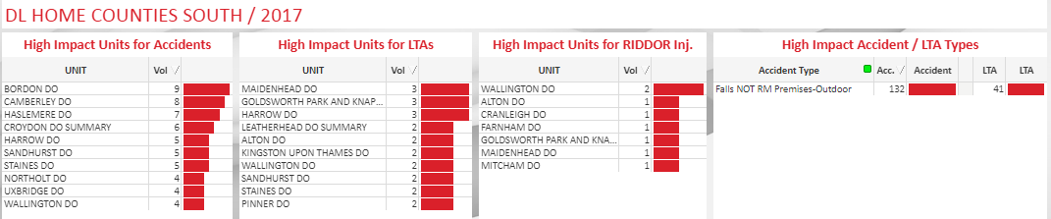
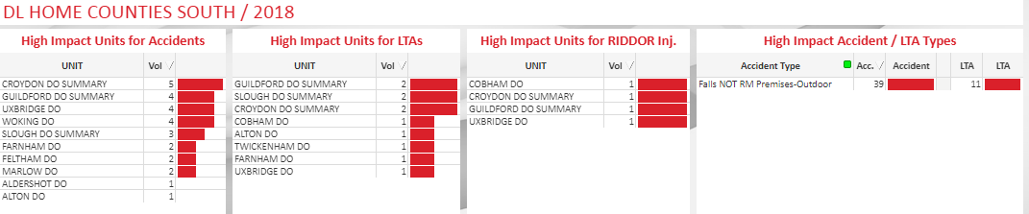

Slide 15
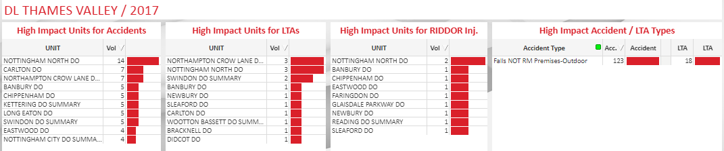
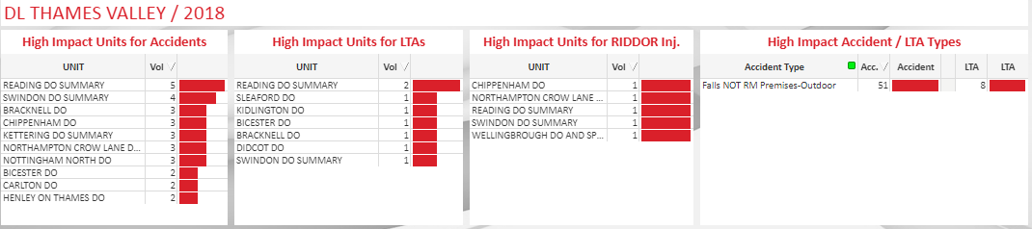

Slide 16
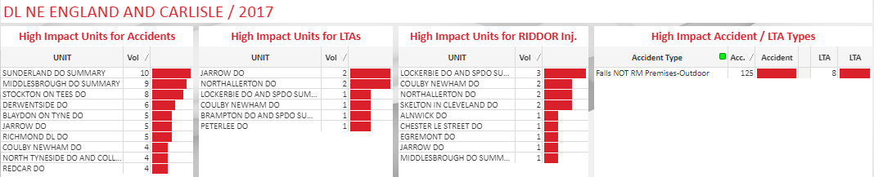
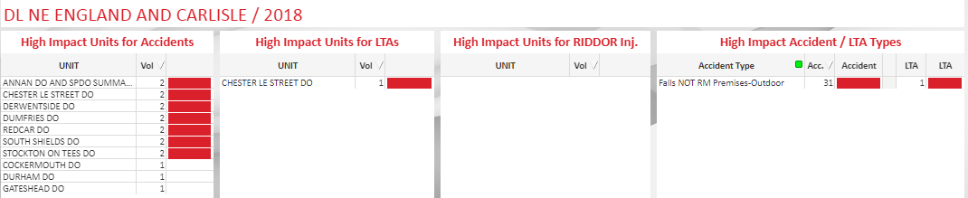

Slide 17
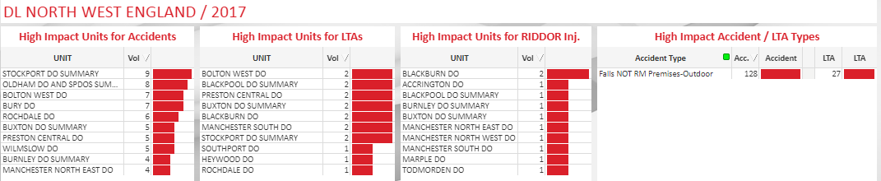
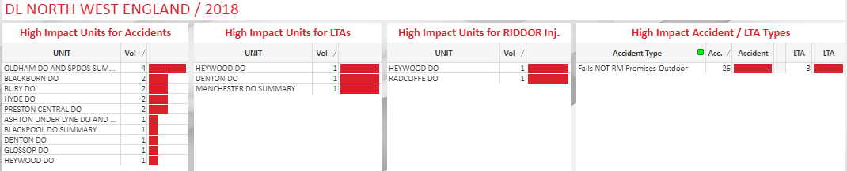

Slide 18
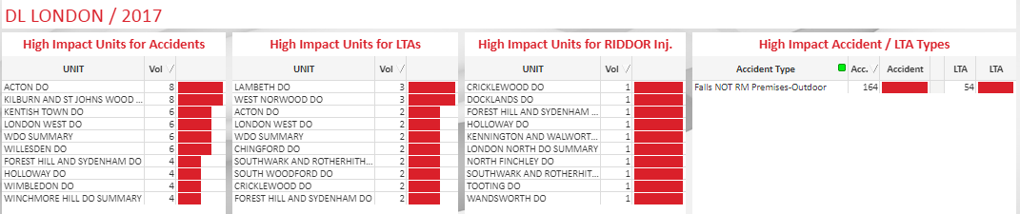
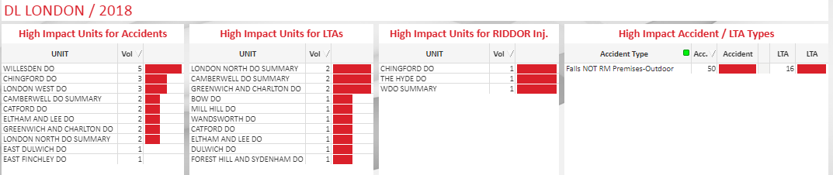

Slide 19
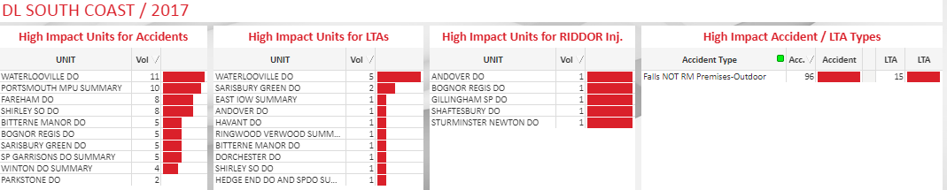
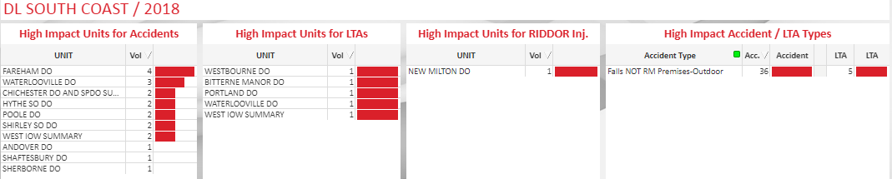

Slide 20
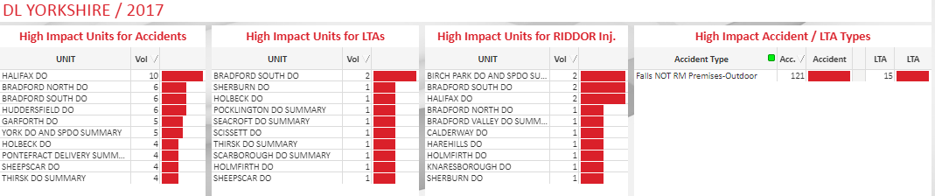
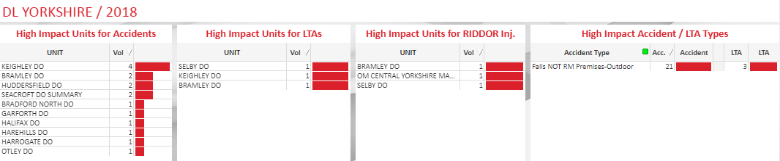

Slide 21
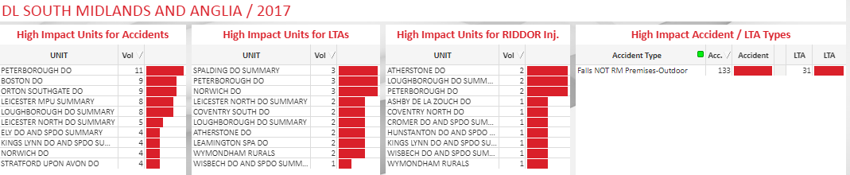
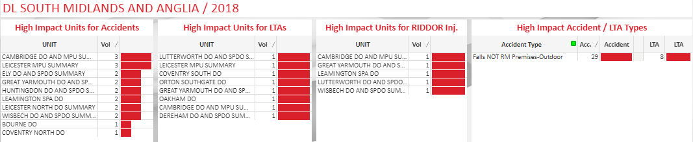

Slide 22
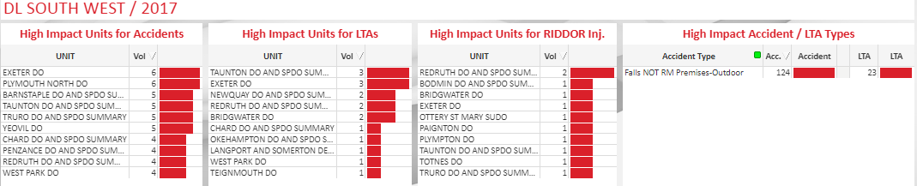
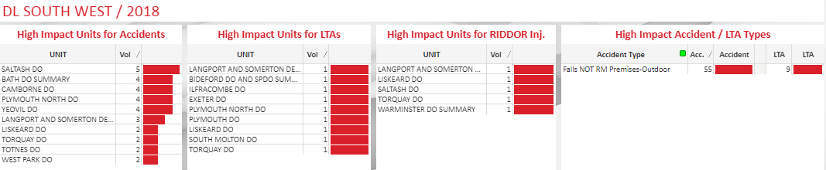

Slide 23
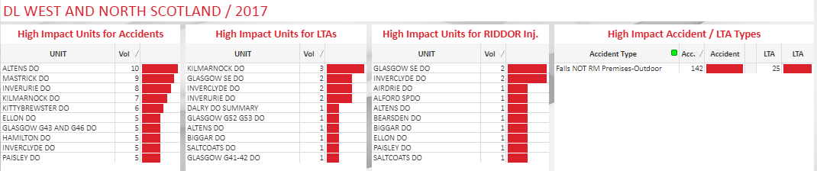
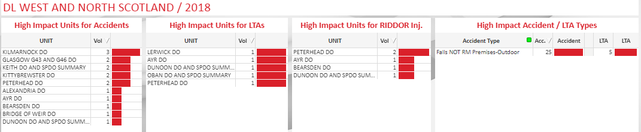

Slide 24
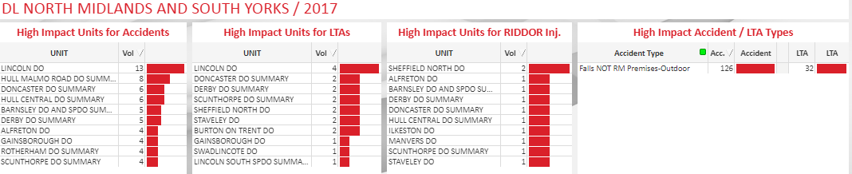
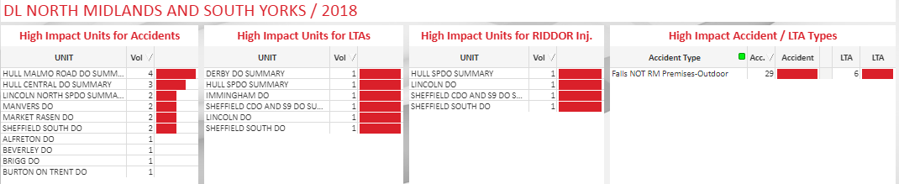

Slide 25
