Slide 1
Transport -
Strategy and Sector Plan
Andrew Kingscott
PAEV Sector
Transport and Public Services Unit
CWU – H&S Fringe Meeting – 23/04/18

Slide 2

Overview
Strategy HGBWW
Tackling ill health
  Utilities Sector Plan
  Transport Sector Plan incl. Load Security, MSD and WRRR

Slide 3



Helping Britain Work Well

Slide 4
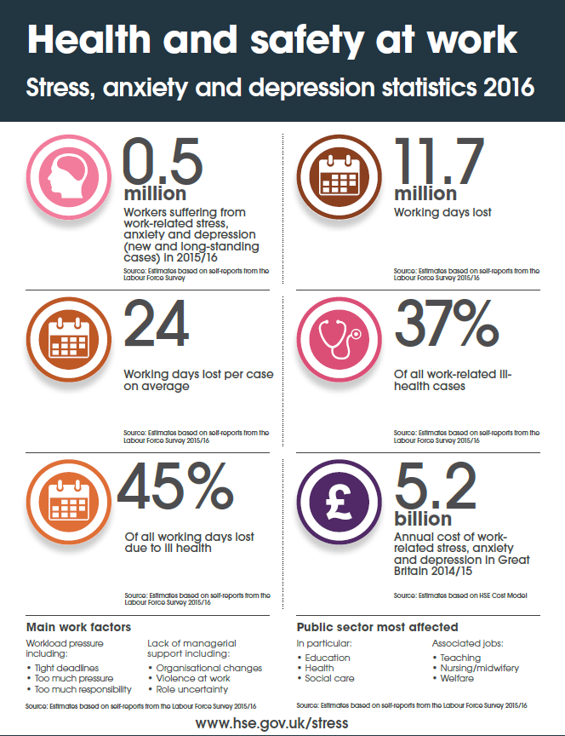
Tackling ill health
Health Priority Plan
3 priorities
  Occupational Lung Disease
  Musculoskeletal Disorders (MSD)
  Work-related Stress

Slide 5

HSE contribution
Continue as the prime mover in the health and safety system
  Develop & maintain regulatory framework
  Encourage & support action
  Enforce law & provide justice

Slide 6
Utilities Sector Plan

Slide 7
Utilities Sector Plan
Ensure new large infrastructure projects,
and ageing plant and assets, do not lead
to an increase in injuries or ill health
Acknowledge there is no acceptable
level for harm to consumers by unsafe
gas work
Ensure that worker competence is
maintained and managed for the future

Slide 8
Utilities Sector Plan
We will lead and engage with others to improve workplace health and safety by:
Supporting and promoting strategic industry initiatives that show leadership in tackling key problems
Working with key stakeholders, such as:
  BT & Openreach (helping to improve the health, and ensure the safety, of tens of thousands of telecommunications workers)
  Mast and Tower Safety Group (improving the safety of workers employed by the key mobile telecoms infrastructure companies)

Slide 9
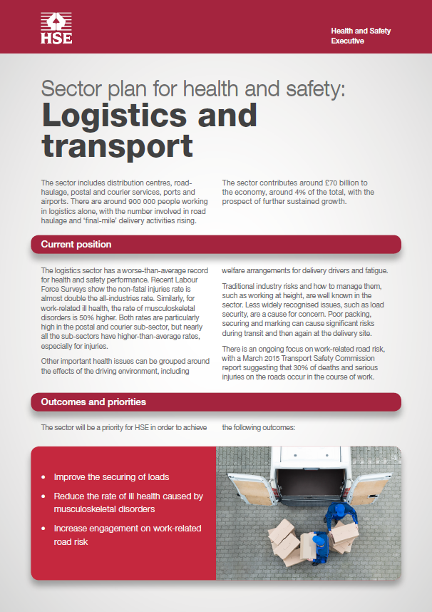
Transport Sector Plan
Improving poorly secured loads
Reducing the rate of ill health caused by MSDs
Increasing engagement with work-related road risk

Slide 10
Transport Sector Plan:
Load security
22000 road impact incidents caused by falling objects from vehicles in England (HE, 2013)
Significant risk to driver, road users and those loading and unloading
Significant cost to UK plc in damaged goods, wasted time and damage to infrastructure
Not just the Driver’s responsibility – also those who “cause or permit”

Slide 11
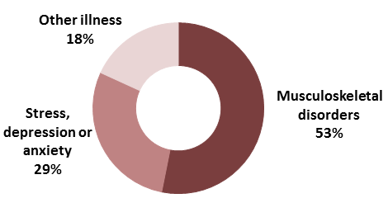
Transport Sector – ill health
52000 workers suffering a work-related illness each year (LFS)
MSD and Stress, depression, anxiety account for 82% of self-reported illness
Work-related ill health by illness type

Slide 12
Transport Sector Plan:
Ill health - MSD
Transport Sector has higher than all industry average rate of MSD
All industry - 8.9 million days lost, £9.7bn cost, £18500 per case in 2016/17
Results of qualitative insight work due soon.
Results will form the basis of future work in this industry.

Slide 13
Transport Sector Plan:
Work-related road risk (WRRR)
HSE has commissioned research
See what other guidance is available
How do companies use the information
What good looks like
Possible review of INDG382 – Driving at Work

Slide 14
Transport Sector Plan:
Work-related road risk (WRRR)
INDG382 –
  Safe driver: competent and capable, trained, instructions to keep safe and fit and healthy,
  Safe Vehicle: fit for purpose, maintained,
  Safe Journey: routes planned, realistic work schedules, allowing time, poor weather

Slide 15

Many thanks

